Slide 1

SUPPORTED SCAFFOLD
USER HAZARD AWARENESS TRAINING
Notes:
Leave this slide on the screen until all trainees arrive or until the official start time.

Slide 2


Welcome to the SAIA Supported Scaffold
User Hazard Awareness Training
This training is for anyone who uses a scaffold. This class teaches you to recognize scaffold hazards and who to tell when you see hazards. It is assumed that the student has some familiarity with scaffolds.
Scaffold Hazard Awareness training is required for anyone who performs work while on a scaffold.
Notes:
Explain that this course is not Competent Person training, but this training is required for all persons that perform work while on a scaffold.

Slide 3


ACKNOWLEDGEMENTS
This User Hazard Awareness Training update was made possible thanks to the generous support of the Scaffold & Access Industry Association Education Foundation (SAIAEF) and the many SAIA members who volunteered their time and expertise. SAIA is the governing body for these trainings.
COPYRIGHT NOTICE
© Copyright 2022 by the Scaffold & Access Industry Association
All rights reserved. This work may not be reproduced or transmitted in any form or by any means, electronically or mechanically, including photocopying, recording, or by an information storage and retrieval system without the prior written permission from the Scaffold & Access Industry Association
Notes:
Explain who SAIA is - To ensure those who make, install, depend on, or govern the use of scaffold and access equipment pursue the highest standards of safety, craftsmanship, and ethics. To lead the advancement and promotion of safety in the scaffold and access industry utilizing resources, education, and communication.

Slide 4




Listen
Questions
Practice active listening.
Avoid distractions
Emergency
Exits
It is ok to ask if you don’t understand.
Emergency
exit
Respect
Time
Safety
Give everyone
your respect.
Keep comments brief. Return from breaks on time.
Work safely and
wear PPE.
Phones
Share
Feedback
Phones on silent.
Focus on the training.
Your knowledge & experiences add
to our training.
Please give honest feedback in your
course evaluation.
Notes:
Explain that there are a few ground rules and expectations you want to agree on so everyone benefits from this training. Review each of these ground rules – clarify your expectations around each of these rules FEEDBACK – explain that at the end there will be a course evaluation and you welcome honest feedback
HOUSEKEEPING – go over any housekeeping details (location of bathrooms, emergency exits etc.)

Slide 5


OUR MISSION:
To ensure those who manufacture, install, depend on or govern the use of scaffold and access equipment pursue the highest standards of safety, craftsmanship and ethics.
SAIA provides safety education to thousands of contractors through its training program, SAIA University.
The Scaffold & Access Industry Association (SAIA) is the global leader in advocacy and support on the safe use of scaffold and access equipment.
SAIA has provided safety education to many thousands of contractors through its renowned seminars and training courses.
Notes:
Explain briefly about the SAIA and the training provided through SAIA University.
The vision of the SAIA is to lead the advancement and promotion of safety in the scaffold and access industry utilizing resources, education, and communication. We are committed to excellence in developing and promoting best practices in the scaffold and access industry.

Slide 6
LEARNING OBJECTIVES
Upon completing this program, the participant will be able to:
Recognize common types of supported scaffolds
Identify the hazards associated with supported scaffolds
Report hazards
Notes:
Review these bullet points with the class so that they know what the expected take away is.

Slide 7
INTRODUCTION
OSHA REQUIREMENTS, training Requirements and Definitions
1
Notes:
Tell the trainees you will begin with a brief introduction of some background OSHA requirements.

Slide 8
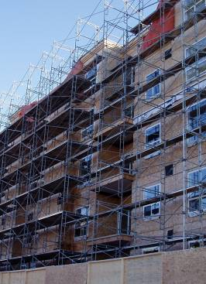
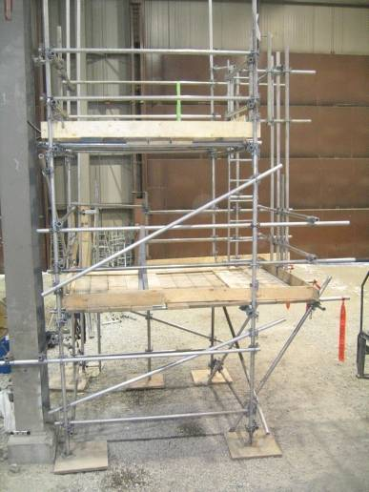
A SCAFFOLD IS:
Any temporary elevated
work platform and its
supporting structure
used to support
workers, materials or both
Notes:
Explain the definition of a scaffold by using the illustrations. Talk about the temporary elevated platform(s) and the supporting structure.

Slide 9
OSHA Requires THAT…
  Scaffolds and scaffold components shall be inspected for visible defects by a Competent Person before each work shift, and after any occurrence which could affect a scaffold’s structural integrity.

Slide 10
oSHA requires that…
Scaffolds shall be erected, moved, dismantled or altered only under the supervision and direction of a Competent Person qualified in scaffold erection, moving, dismantling or alteration. Such activities shall be performed only by experienced and trained employees selected for such work by the Competent Person.
Notes:
Users are NOT allowed to alter scaffolds in any manner without the supervision and direction of the Competent Person. An example would be removing guardrails without permission.

Slide 11
Competent Person
A Competent Person is defined as "one who is capable of identifying existing and predictable hazards in the surroundings or working conditions which are unsanitary, hazardous, or dangerous to employees, and who has authorization to take prompt corrective measures to eliminate them.”
Notes:
Explain that the employer is responsible for designating the Competent Person and that the Competent Person must be able to recognize scaffold hazards.

Slide 12
qualified Person
A Qualified Person is defined as a person who, “by possession of a recognized degree, certificate, or professional standing, or who by extensive knowledge, training and experience, has successfully demonstrated his/her ability to solve or resolve problems relating to the subject matter, the work, or the project.”
Notes:
Explain that the Qualified Person is the one that is responsible for designing scaffolds. Scaffold erection etc. is under the direction of the Competent Person qualified in scaffold erection, NOT the Qualified Person.

Slide 13

COMPETENT PERSON
✔
Directs workers who build, dismantle, move, or alter scaffolds.
✔
Inspects scaffolds and jobsites for potential hazards and takes prompt corrective action to solve them.
Determines if it is safe to work on or from a scaffold during storms or high winds and ensures workers are properly protected from falls.
✔
✔
Determines the feasibility/safety of providing fall protection and access.
Determines if a scaffold will be structurally sound if components from different manufacturers are intermixed.
✔
Notes:
Review this list of responsibilities of the Competent Person and discuss the importance of continuously training and staying up-to date on local regulations, codes & standards to be able to carry out these responsibilities effectively.
Users must verify that the scaffold has been inspected by the Competent Person prior to accessing the scaffold. Users are NOT authorized to inspect scaffolds. If you see a hazard, report to your supervisor/Competent Person.

Slide 14
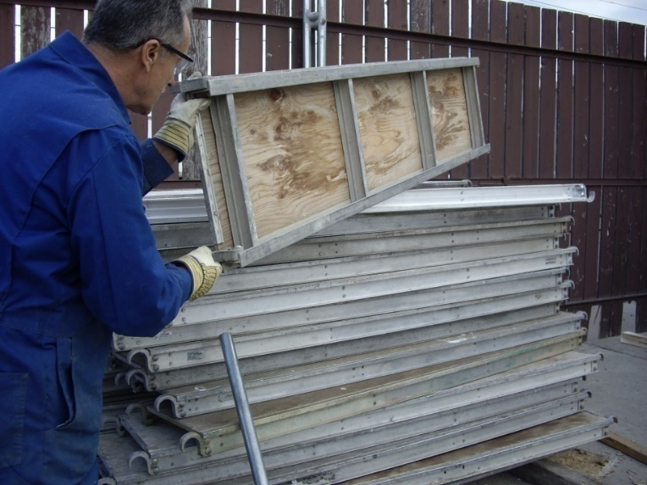
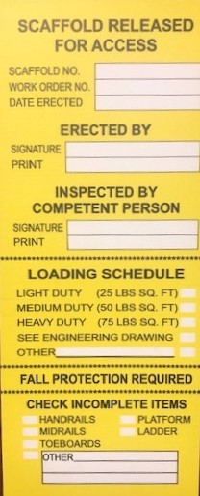
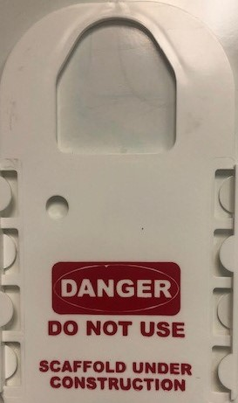

SCAFFOLD INSPECTION
Scaffolds must be inspected by the
Competent Person prior to each work
shift and after any event that could
affect the scaffold stability
Take note of any hazards or conditions
that may be listed on the Scaffold
Inspection Tag
Notes:
The users must verify that the scaffold has been inspected by a Competent Person. It is important that the user pay special attention to anything that has been noted by the Competent Person regarding the scaffold, such as fall hazards and capacity ratings.

Slide 15
OSHA Training Requirements
The employer shall have each employee who performs work while on a
scaffold trained by a person qualified in the subject matter.
The scaffold training shall teach users to recognize the hazards associated
with the type of scaffold being used and understand the procedures to
control or minimize those hazards.
Notes:
This slide explains who is required to provide Hazard Awareness training and outlines the content of that training

Slide 16
OSHA Training Requirements
  The training shall Include:
  The nature of any electrical hazards, fall hazards and falling object hazards in the work area
  The correct procedures for dealing with electrical hazards and for erecting, maintaining, and disassembling the fall protection systems and falling object protection systems being used
  The proper use of the scaffold, and the proper handling of materials on the scaffold
  The maximum intended load and the load-carrying capacities of the scaffolds used
  Any other pertinent requirements
Notes:
OSHA outlines the most common hazards associated with scaffolds that workers must be aware of, and the control measures used to minimize or eliminate those hazards.

Slide 17

This person is recognized by a degree, certificate, or extensive knowledge, training and experience can successfully demonstrate an ability to solve scaffold related problems.
Qualified Person
Competent Person
Superintendent
Notes:
Instructor: the answer choices will come in automatically.

Slide 18
This person has a recognized degree, certificate or professional standing, or who by extensive knowledge, training and experience, has successfully demonstrated his/her ability to solve or resolve problems related to the subject matter, the work, or the project.
Qualified Person
Competent Person
Superintendent
Notes:
Answer: Qualified Person

Slide 19
Types of Scaffolds
Different types of scaffolds and their uses
2
Notes:
Tell the trainees you will begin with a brief introduction to the different types of scaffolds.

Slide 20

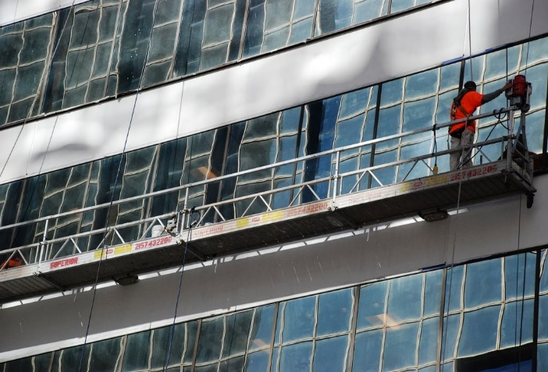
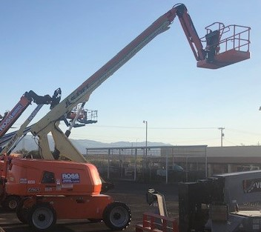
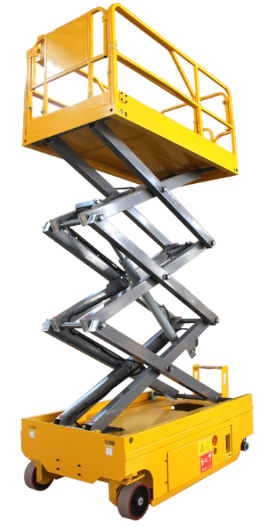
Types of Scaffolds
Mobile Elevated
Work Platform (MEWP)
Supported Scaffold
Suspended Scaffold
This class focuses on the 3 most commonly used supported scaffolds
Notes:
There are 26 different types of scaffolds – The three most common are pictured in the slide. Supported Scaffolds (rigid support), Suspended Scaffolds (non-rigid support hanging from overhead structure), and Mobile Elevated Work Platforms (MEWP, formally known as Aerial Work Platforms AWP) (mechanical devices used to provide temporary access or work platforms for personnel). This course covers only the most commonly used Supported Scaffolds.

Slide 21
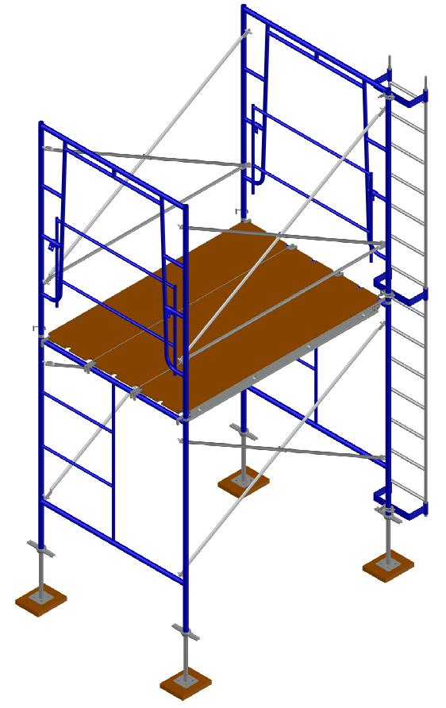
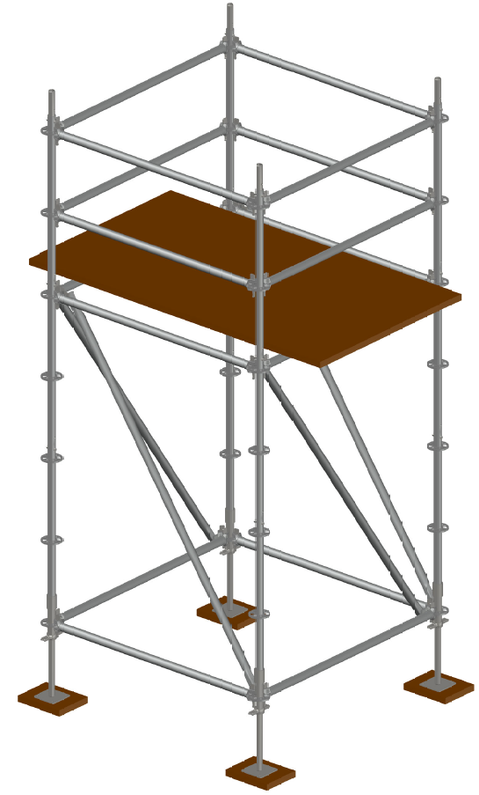
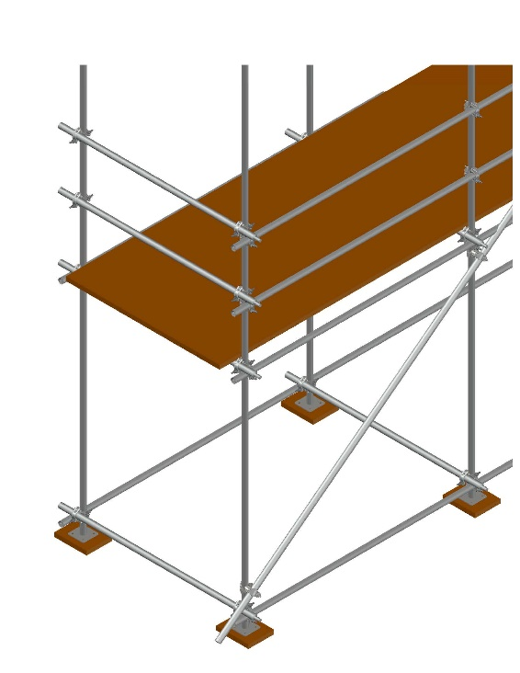
Supported Scaffolds
Platforms supported by legs, posts, frames, or similar rigid support.
Tube & Clamp Scaffolds
Frame Scaffolds
system Scaffolds
Notes:
Provide the definition of Supported Scaffolds and briefly introduce the three most commonly used types of supported scaffolds. Tube and clamp scaffolds are also called tube and coupler scaffolds. There are also other types of supported scaffolds such as pump jack, ladder jack, etc. , but these are the most common types.

Slide 22
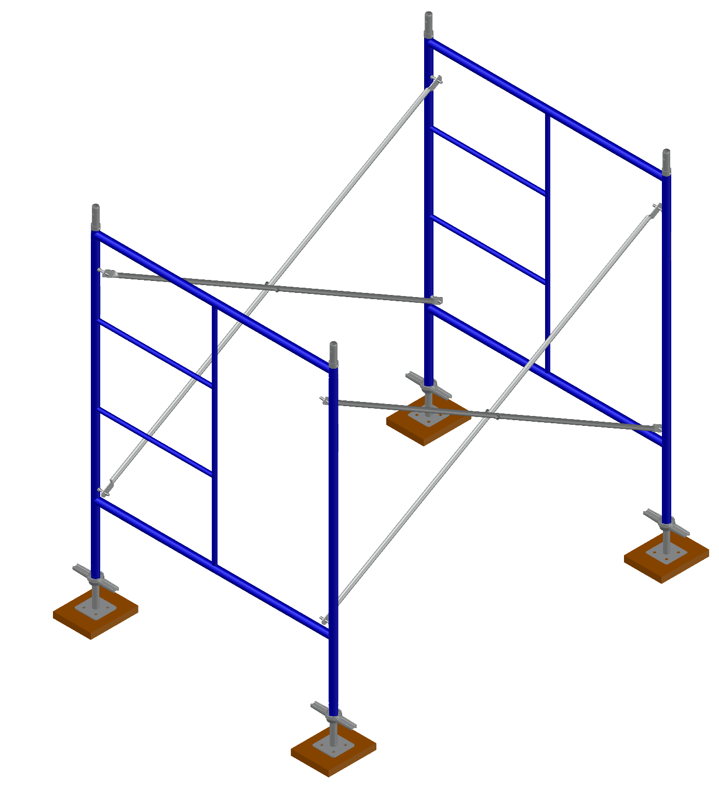
FRAME
CROSSBRACE
COUPLING PIN
Frame Scaffolds
Frame scaffolds are one of the most common types of scaffold used in commercial and residential construction
SCREWJACK
SILL
SCREW JACK
BASEPLATE
BASE PLATE
Notes:
Instructor: The items will automatically appear. Point out the different components of the frame scaffold. Explain the purpose of each component as the label appears. Note that there are other types of frames and frame configurations.

Slide 23
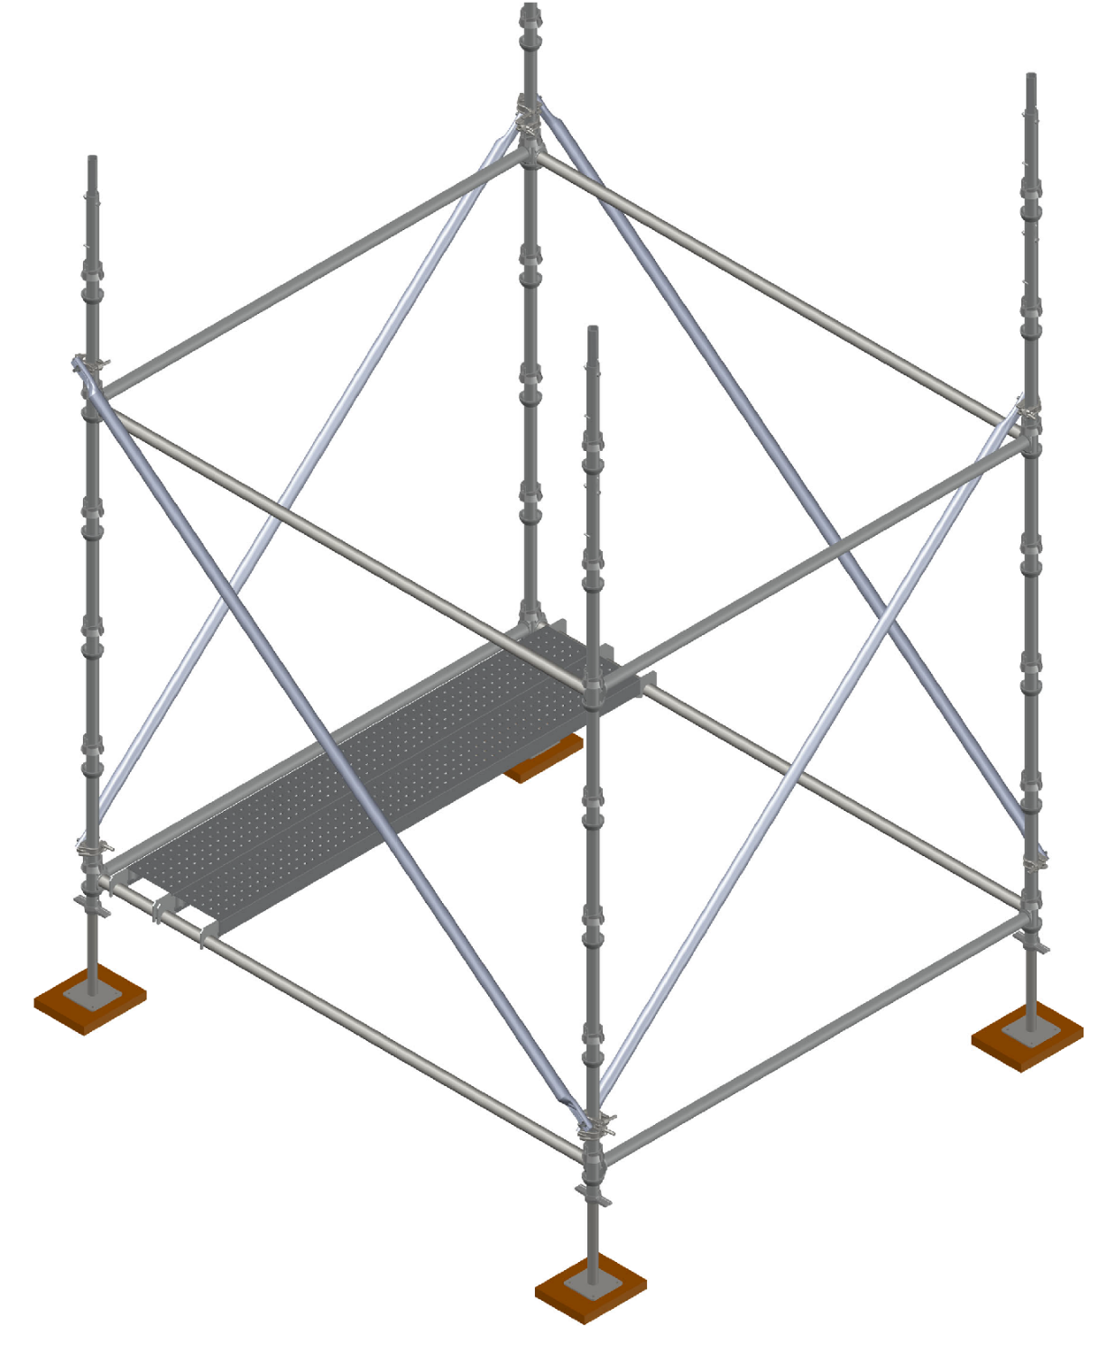
POST
BRACE
CONNECTION POINT
System Scaffolds
System Scaffolds have fixed connection points at equal
intervals along the posts
BASEPLATE
SILL
BEARER/TRANSOM
LEDGER/RUNNER
SCREWJACK
Notes:
Instructor: The items will automatically appear. Describe the different components of Systems Scaffolds as the labels appear. Connection configurations vary as can be seen on the next slide.

Slide 24
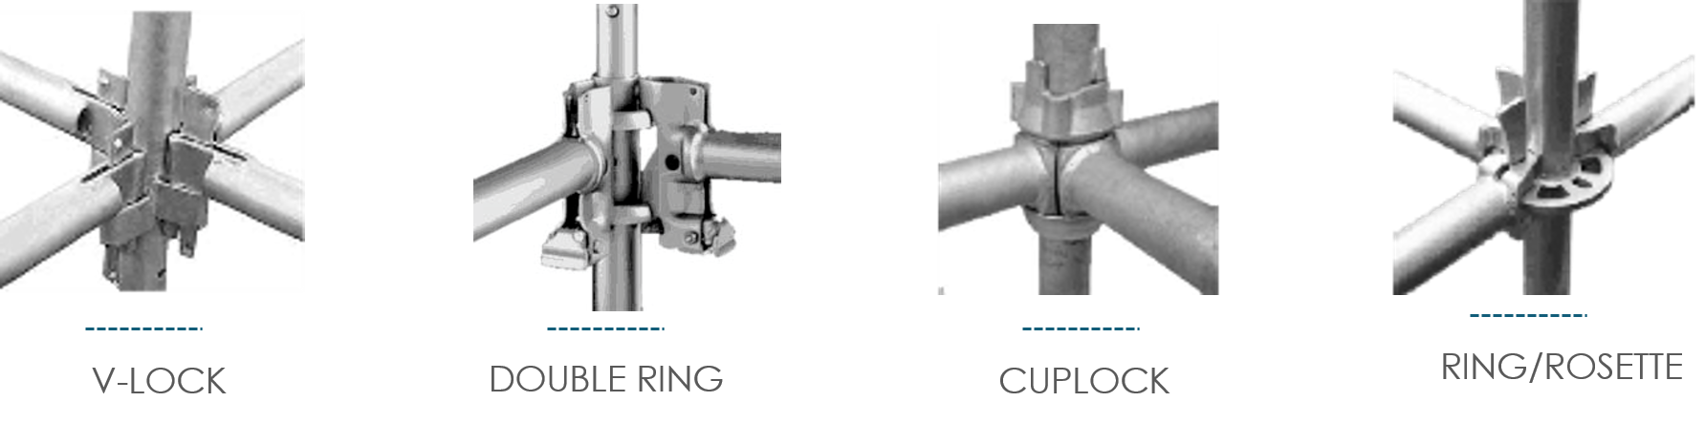
Common System Scaffold connections
Notes:
System Scaffolds are unique due to the type of connection the manufacturer may use to attach horizontal and diagonal members to the post, upright, leg, standard, etc. These are but a few of the connection types.

Slide 25
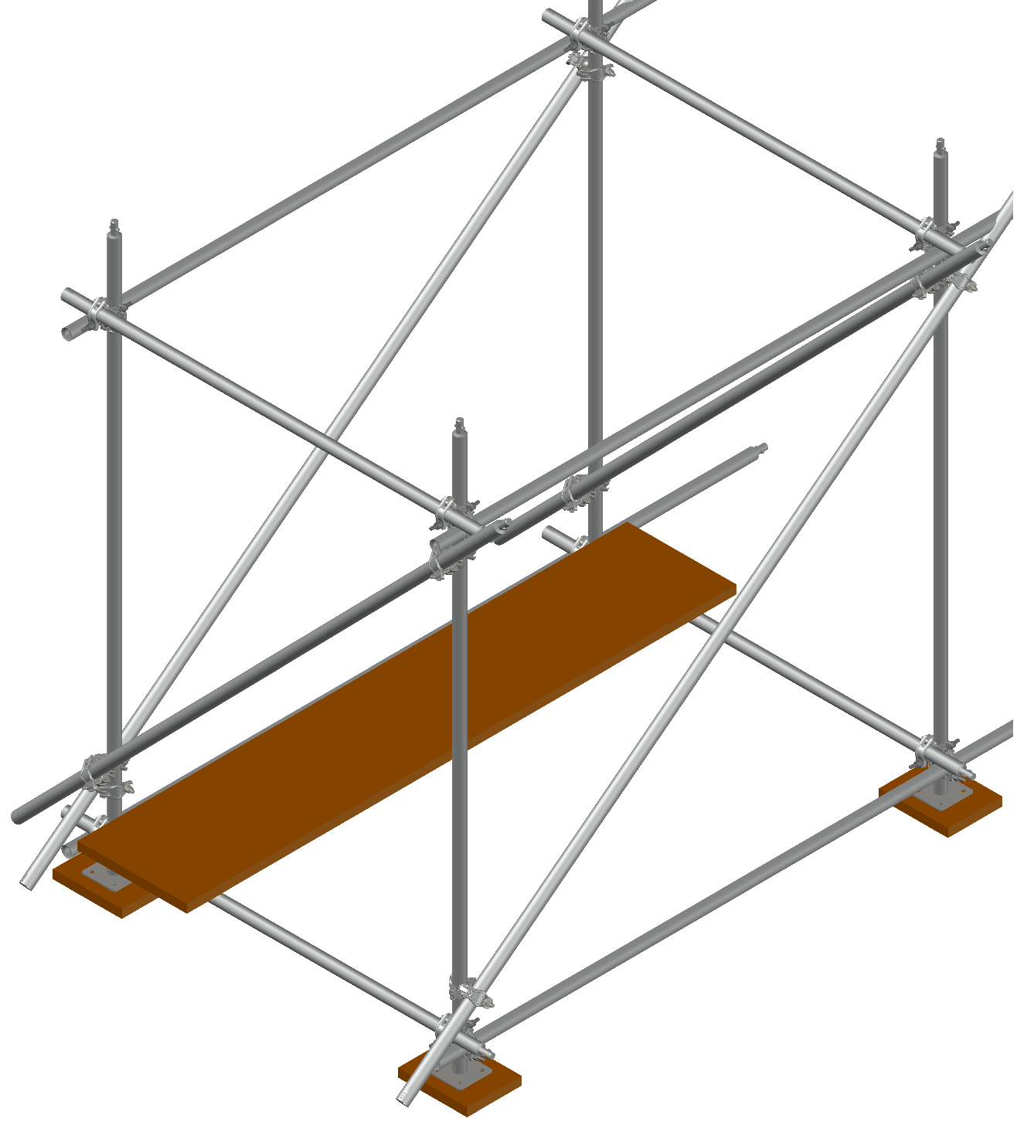
POST
SWIVEL COUPLER
RIGHT ANGLE COUPLER
BRACE
Tube & Clamp Scaffolds
Tube & Clamp Scaffolds are flexible and suited for access to irregular work areas
SILL
BEARER
RUNNER
BASEPLATE
Notes:
Instructor: The items will automatically appear. Identify the different components of Tube & Clamp (Tube & Coupler) Scaffolds as the labels appear and explain their function. The terms Clamp and Coupler are interchangeable. In the United States, Tube & Clamp is usually used to complement frame and system scaffold and is not normally used as a stand-alone configuration.

Slide 26
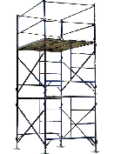
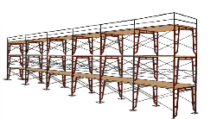
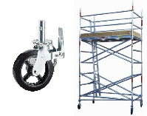
SUPPORTED Scaffold Configurations
Scaffold Run
Rolling tower
Scaffold Tower
Scaffold Run
Single bay Scaffold Tower
Notes:
Describe Scaffold Towers and explain their typical uses.
Describe Scaffold Runs and explain their typical uses.
Describe Rolling Towers and explain their typical uses.

Slide 27
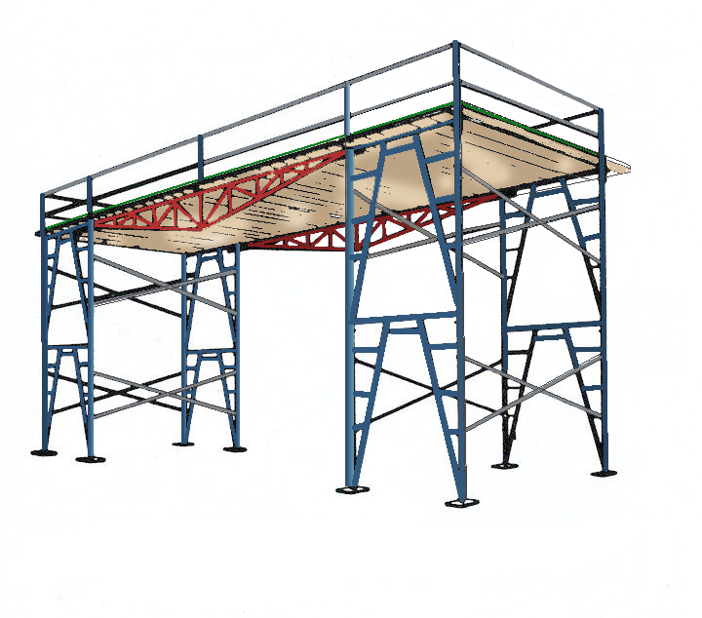
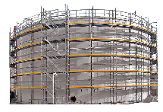
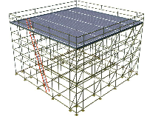
SUPPORTED Scaffold Configurations
Area scaffold
Bridging Scaffold
Circular Scaffold
Notes:
Describe Area Scaffolds and explain their typical uses. Explain that we will look at these in more detail later in the course.
Describe Bridging Scaffolds and explain their typical uses.
Describe Circular Scaffolds and explain their typical uses.

Slide 28
Key Points
Three types of scaffolds: supported, suspended, AND MOBILE ELEVATED Work Platforms
Frame, System, and Tube & Clamp are the most common supported scaffolds
Frame Scaffolds are easy to build and require fewer components to complete than
other types of scaffolds
System Scaffolds have fixed connection points along the posts. They are versatile,
quick and easy to use
Tube & Clamp Scaffolds can be adapted to suit many sizes and shapes
Supported scaffolds can be configured in many ways
Notes:
Review the Key Points from this session

Slide 29
Which Scaffold has fixed connection points at equal intervals along the posts?
Frame
System
Tube and Clamp
Notes:
Instructor: the answer choices will come in automatically. The next slide has the answer.

Slide 30
Which Scaffold has fixed connection points at equal intervals along the posts?
Frame
System
Tube and Clamp
pop quiz
Notes:
Answer: B. System

Slide 31
Scaffold Hazards
The 5 most common scaffold hazards
3
Notes:
Introduce the section of identifying the five most common hazards associated with supported scaffold use.

Slide 32
Notes:
OSHA statistics identify fatalities in different categories: Shown in this slide are the percentages of fatalities for Falls, Scaffold Collapses and Contact with Overhead Wires.
90% of Fatalities result from Falls
6% of Fatalities result from Scaffold Collapse
4% of Fatalities result from Contact with Overhead Wires
These issues will be looked at in more depth later in this presentation.
Fatalities from falls for 2019 were at a 28 year high with 17% of construction fatalities being falls from scaffold.

Slide 33
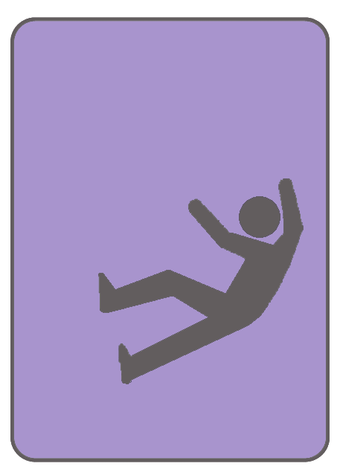
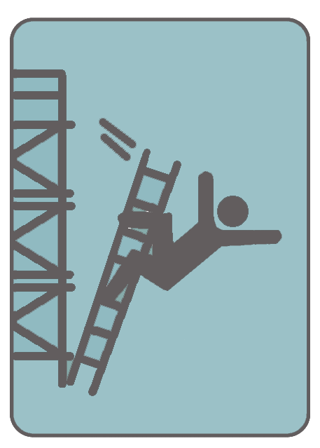
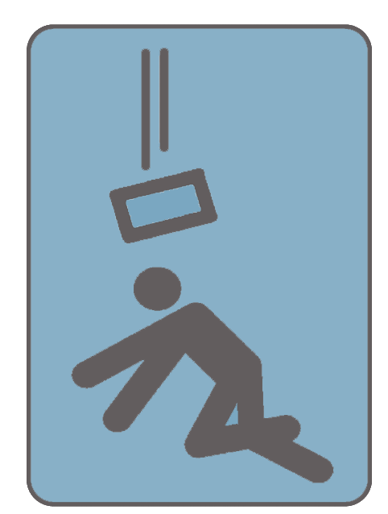
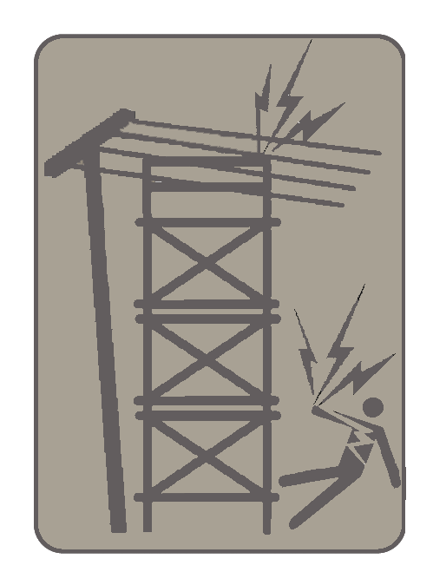
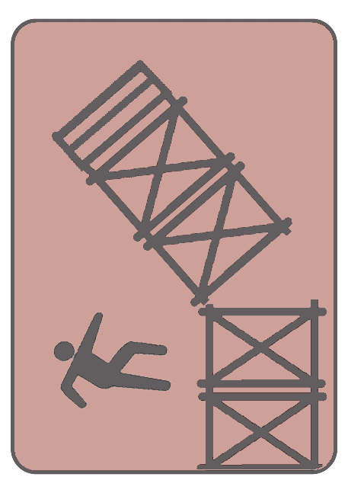
Five Most Common Scaffold Hazards
F
U
S
E
S
Notes:
Tell trainees you are going to list the 5 Most Common Scaffold Hazards based on accident statistics.
CLICK – Describe FALLS and how common these are in scaffold/construction industry
CLICK – Describe UNSAFE ACCESS and provide examples
CLICK – Describe how scaffold builders can be STRUCK BY FALLING OBJECTS
CLICK – Describe ELECTROCUTION hazards
CLICK – Describe SCAFFOLD COLLAPSE and give an indication of how common this is

Slide 34
Notes:
Scaffold Fall Fatalities By Contractor Type
Here we see the main trades (jobs) that experience these fall fatalities.
Masons 15%
Painters 15%
Laborers 20%
Scaffold Erectors 10%
Others 40%

Slide 35
Notes:
Here you see the OSHA Fatalities by Scaffold Type:
25% Two-Point Suspended
25% Frame
19% Mobile
31% Other

Slide 36
falls
F
U
S
E
S
Notes:
F = Falls

Slide 37
Falls
The most common scaffold hazard
Falls from heights are the leading
cause of death in construction
Falls on the same level (slips and
trips) are the leading cause of
injuries
Notes:
Discuss Falls in more detail and share a personal story or ask trainees to share a fall-related story.

Slide 38
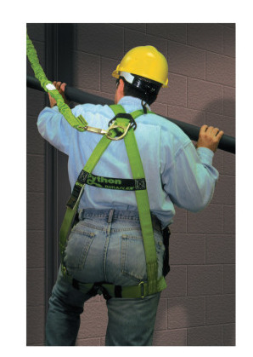
PERSONAL FALL PROTECTION
In most cases, the fall protection system will be the guardrails for users. In the event an alternate form of protection is utilized, such as a personal fall arrest system, the users must be trained on the use of the system in place.
Notes:
Discuss Personal Fall Protection and the Competent Person’s responsibilities in relation to fall protection on scaffolds. Point out the different components of the personal fall protection system and briefly explain how they work.

Slide 39

FALL HAZARDS
Not fully planked between scaffold uprights
Inadequate or missing guardrails
Notes:
This picture illustrates two major fall hazards; Lack of proper fall protection on platforms and poorly constructed platforms (the lack of guardrails around the work platform and the work deck not being fully planked. )

Slide 40
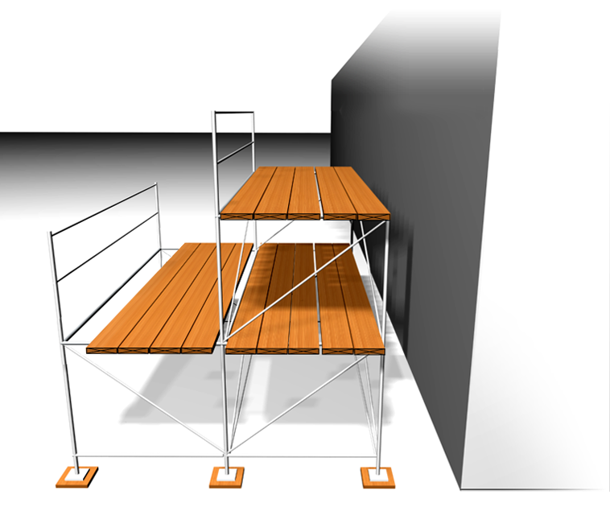
Scaffold Platform Construction
Distance from front edge of platform and the face of work:
Outrigger Scaffold = 3”
Plastering & Lathing = 18”
All others = 14”
Platform shall be fully planked or decked between the front uprights and the guardrail supports
Guardrail Supports
Fully Planked Platform
Front Uprights
1”
Maximum Space between Platform units = 1”
Exception:
Space can be greater to fit around uprights.
1”
Maximum space between back edge of Platform and Guardrail system is 9 ½”
Notes:
40
Explain that OSHA requires platforms to be fully planked. Review the slide contents to further explain when openings in platforms are allowed.
Based on the type of scaffold or certain trades, the platforms must be within 14” inches from the face of the work, unless guardrails or PFAS systems are in place.

Slide 41
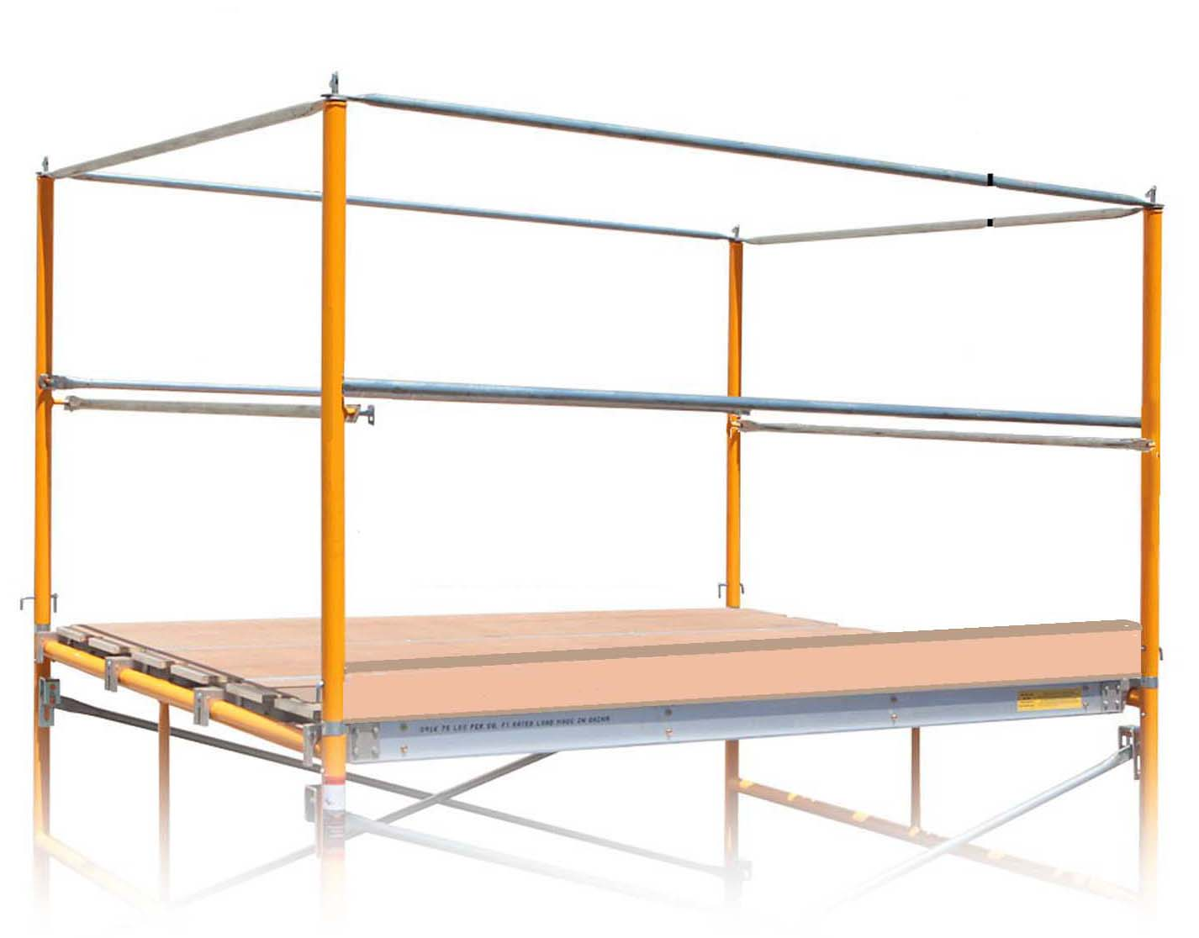
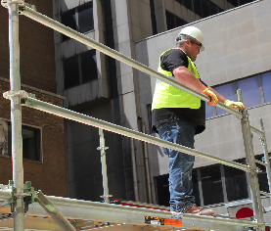
FALL HAZARD PREVENTION
GUARDRAILS AND TOEBOARDS
Guardrails are required on all open sides and ends of the scaffold platform.
GUARDRAIL & MIDRAIL
Notes:
Guardrails must have a midrail halfway between the toprail and the scaffold platform.
If scaffold guardrails are removed for any reason, personal fall arrest systems must be utilized. The height at which fall protection is required varies depending on the jurisdiction, but it is never more than 10 feet above a lower level. Be certain to use the correct height for your physical location.
The front edge of all platforms shall not be more than 14 inches from the face of the work, or 18 inches for stucco and EFIS (exterior insulation finishing system) work, unless guardrail systems are erected along the front edge and/or personal fall arrest systems are utilized.

Slide 42
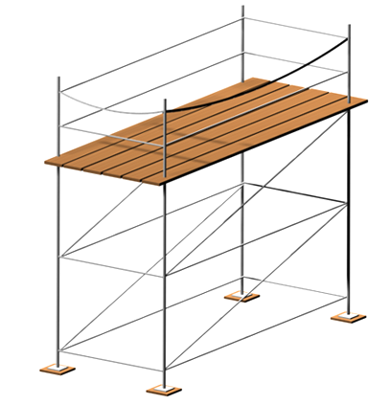
Scaffold Guardrail Installation
Required Rail Strength
Toprail = 200 pounds
Toprail = 200#
Midrail = 150 pounds
Midrail = 150#
Toprail:
Federal OSHA:
Construction: 38”- 45”
Midrail Height
General Industry: 38” - 45”
Toprail Height
California: 42”- 45”
Midrail:
Corp of Engineers: 42”+/- 3”
Federal OSHA:
Approx. ½ way
Maritime: 42”- 45”
*
California:
Approx. ½ way
Height when a Guardrail is required:
Deflection Limits
Federal OSHA:
Federal OSHA:
Corps of Engineers:
Halfway
Construction and General Industry: 10’-0”
Construction: 38”
General Industry: 38”
Maritime:
Halfway
California: 7’- 6”
Corp of Engineers: 6’- 0”
California:
Not Specified
Maritime 5’- 0”
Corp of Engineers: 39”
Maritime: Not Specified
*
or Personal Fall Protection
C
2009, DH Glabe & Associates, Inc.
Notes:
The instructor should explain that when scaffolds are used in different industries or jurisdictions, there may be different regulations in effect.
Review this slide complete

Slide 43
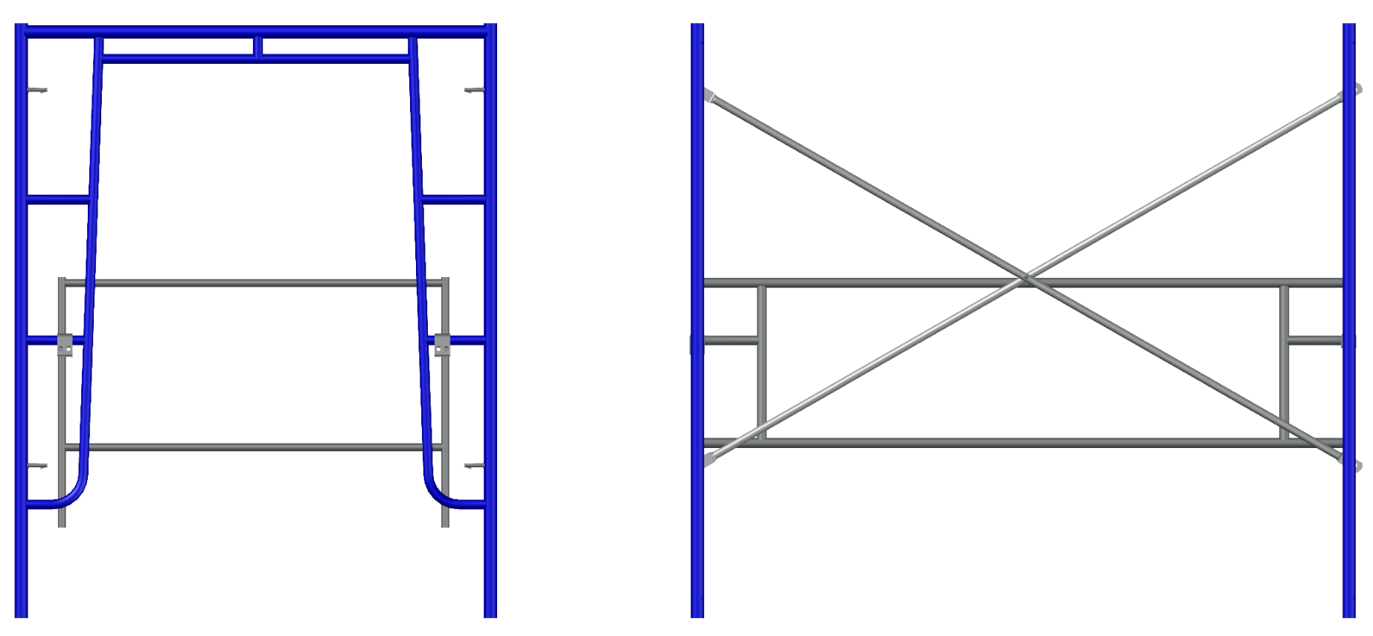
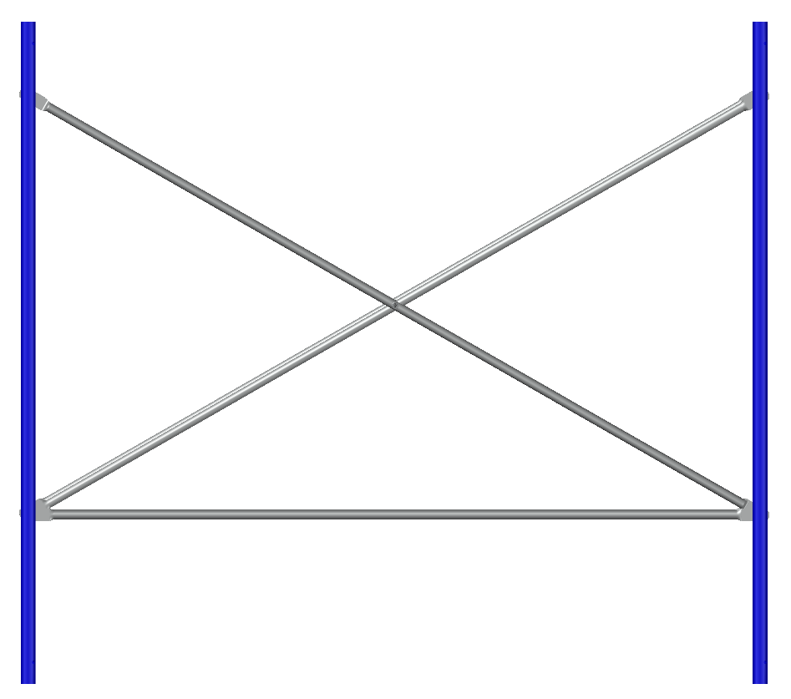
GUARDRAIL PANELS FOR FRAME SCAFFOLDS
*Crossbraces may be used as a midrail or a top rail, but not both
Panel attaches to frame directly behind crossbraces to guard scaffold run
Panel attaches to frame to guard platform end
Crossbrace with single straight rail as midrail
Notes:
Explain that there are also special guardrail panels available for Frame Scaffolds. Guardrail panels are made to fit common bay sizes and scaffold frames.
Crossbrace may be used as a mid rail or a top rail, but not both.

Slide 44
Crossbraces as Guardrails
38 in (0.96m)
to
48 in (1.22m)
20 in (0.51m)
to
30 in (0.76m)
48 in. (1.21m)
Max. Span
Crossbrace as top rail
Add the mid rail
Crossbrace as mid rail
Add the top rail
This is NOT acceptable in California
Notes:
Federal OSHA allows for the crossbrace to count as either a midrail or a toprail, but never both. This is determined by the location of cross section of the brace above the platform.

Slide 45
Crossbraces as Guardrails (CA Only)
42 in
to
48 in
20 in
to
36 in
48 in. (1.21m)
Max. Span
42 in
to
45 in
19 in
to
25 in
Crossbrace as top rail
Add the mid rail
Crossbrace as mid rail
Add the top rail
Notes:
In California, the crossbrace may be used as either a midrail or a toprail, but never both. This is determined by the location of cross section of the brace above the platform. In addition, California also specifies the range for the height of both rails, which is different than what Federal OSHA allows.

Slide 46
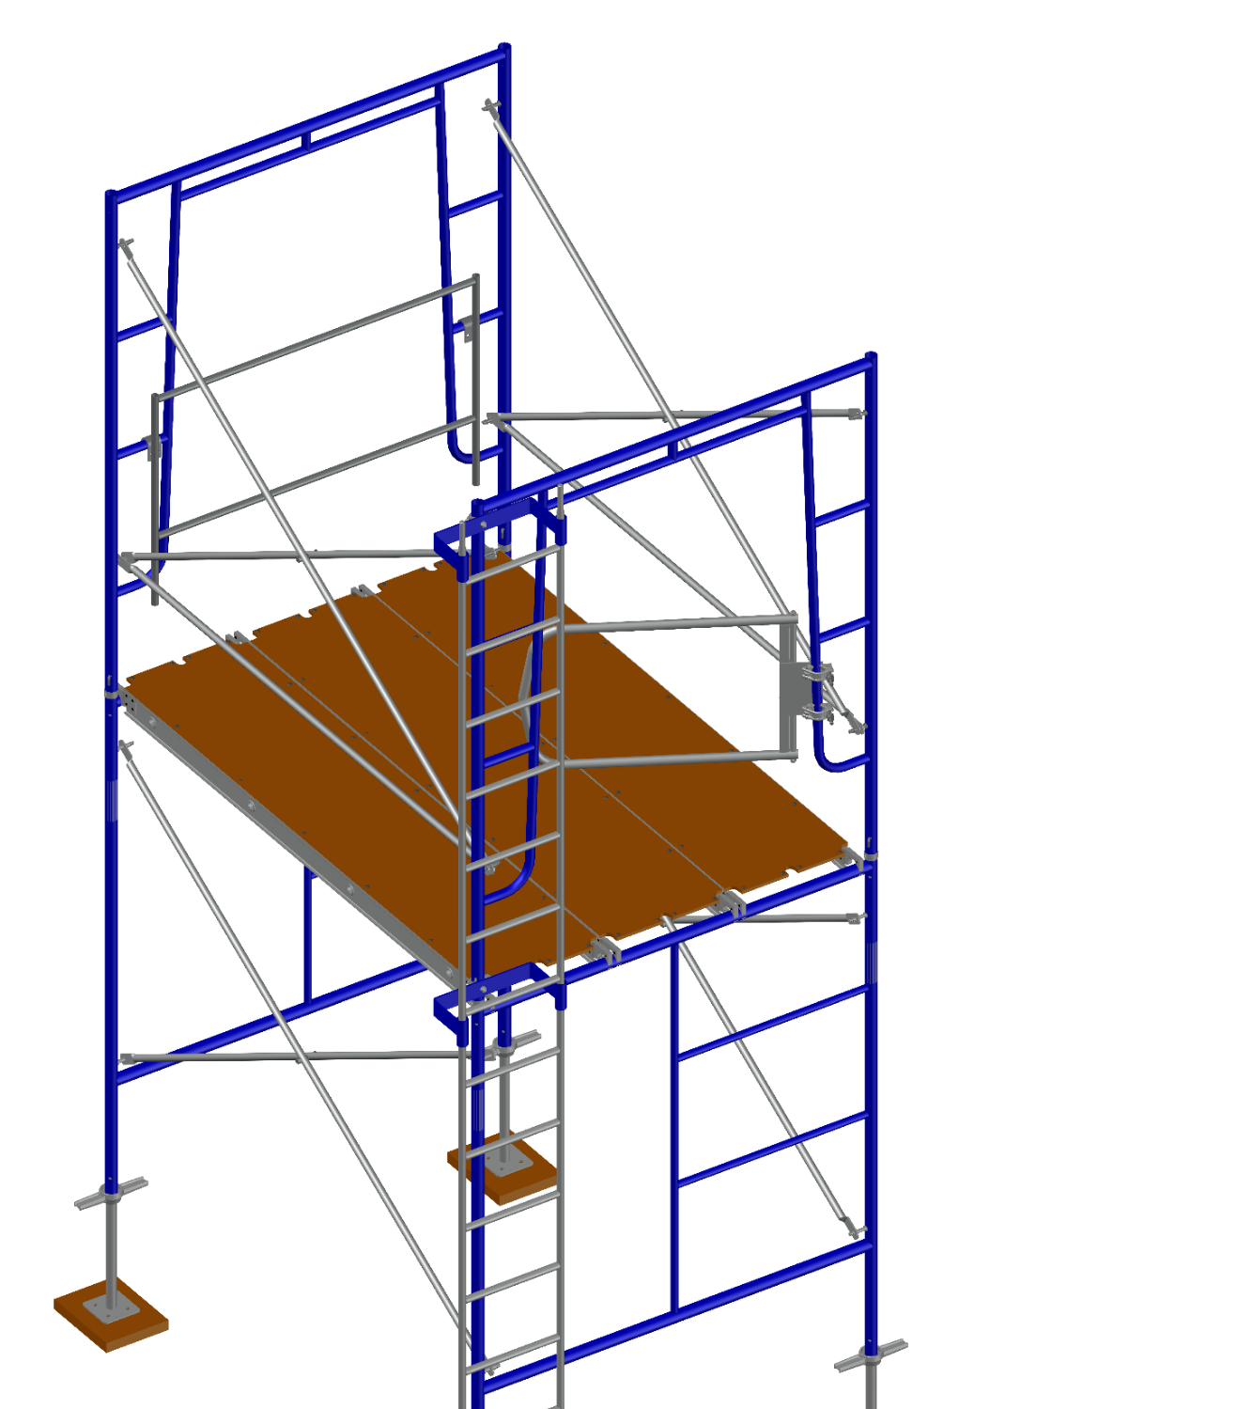
FALL HAZARD PREVENTION
Guardrail gates must swing INTO the platform.
Notes:
Fall hazard prevention is obtained by following OSHA Regulations, best practices and manufacturer’s guidelines

Slide 47
Key Points
Workers positioned above the ground are EXPOSED TO POSSIBLE FALLS
Check to be sure that the Guardrail System is on all open sides and
ends of planked levels unless an alternate fall prevention system is utilized
Verify that Platform is fully planked or decked between the front uprights
and the guardrail supports
Confirm that guardrails are installed at the proper height for your location
and jurisdiction
Notes:
Review the key points from this session.

Slide 48
What is the first thing you should do if your scaffold does not have guardrails?
Talk with your supervisor
Go find a guardrail to use
Stop Work
Continue working
Notes:
Instructor: the answer choices will come in automatically.

Slide 49
What is the first thing you should do if your scaffold does not have guardrails?
Talk with your supervisor
Go find a guardrail to use
Stop Work
Continue working
Notes:
Answer: Stop Work. If you see that the scaffold does not have a guard rail, do not get on it. If you discover that the scaffold does not have a guardrail while you are on it, get off. At any time if you see anything wrong with the scaffold, get off and find your supervisor or Competent Person.

Slide 50
According to OSHA’s 29CFR 1926 Subpart L, what is the height when fall protection is required on scaffolding?
6 feet
4 feet
10 feet
At all times
Notes:
Instructor: the answer choices will come in automatically.

Slide 51
According to OSHA’s 29CFR 1926 Subpart L, what is the height when fall protection is required on scaffolding?
6 feet
4 feet
10 feet
At all times
Notes:
Answer: 10 Feet.
Employers must provide fall protection for each employee on a scaffold more than 10 feet (3.1 meters) above a lower level. 1926.451(g)(1)

Slide 52
Unsafe access
F
U
S
E
S
Notes:
U = Unsafe Access

Slide 53
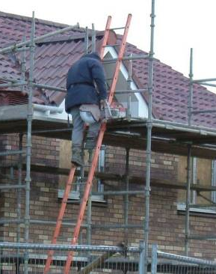
Unsafe Access
UNSAFE ACCESS is a major cause of accidents on the job
Proper access is required for all supported scaffolds
Workers can fall when climbing crossbraces or other parts of scaffold not meant to be climbed
Notes:
The worker shown here is carrying tools while climbing. Workers cannot maintain 3-points of contact when they are carrying tools or equipment while climbing up or down a ladder.

Slide 54
SCAFFOLD ACCESS OPTIONS
  Point of access must be no more than 24” above or below the scaffold platform
  Portable ladders
  Hook-on and Attachable Ladders
  Scaffold Stairtowers
  Stairway type ladders
  Ramps
  Walkways
  Integral prefabricated scaffold access
  Direct access from another scaffold, structure, personnel hoist or similar surface
Notes:
Access is required when scaffold platforms are more than two feet above or below a point of access. Explain the list of acceptable access methods.

Slide 55
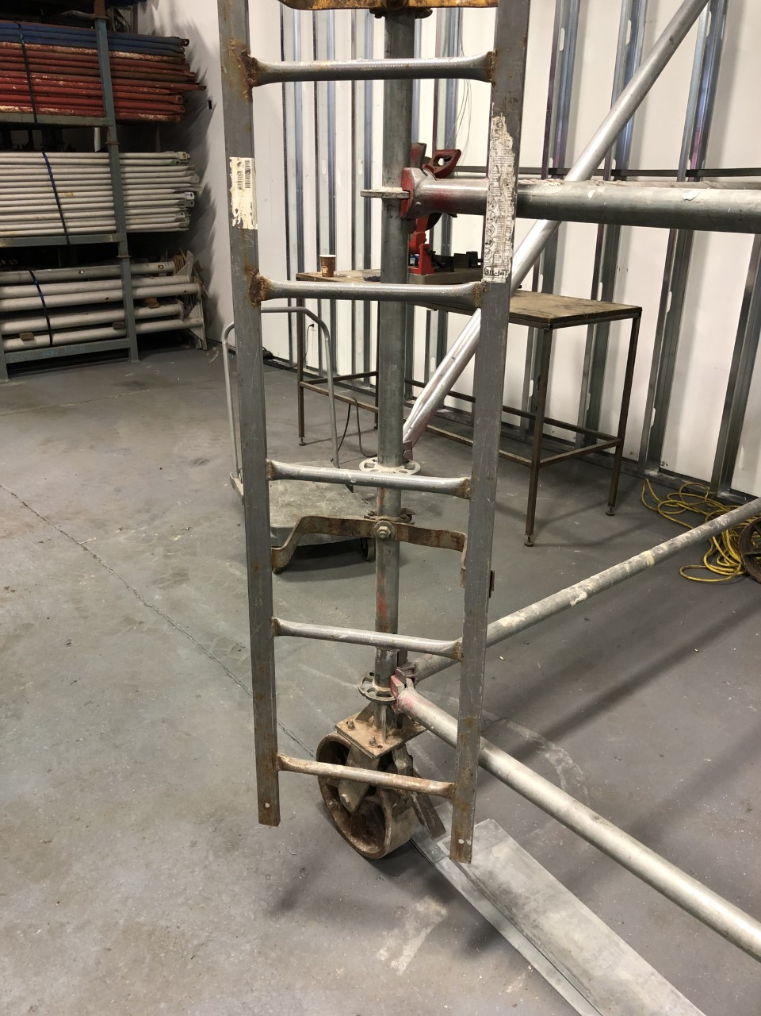
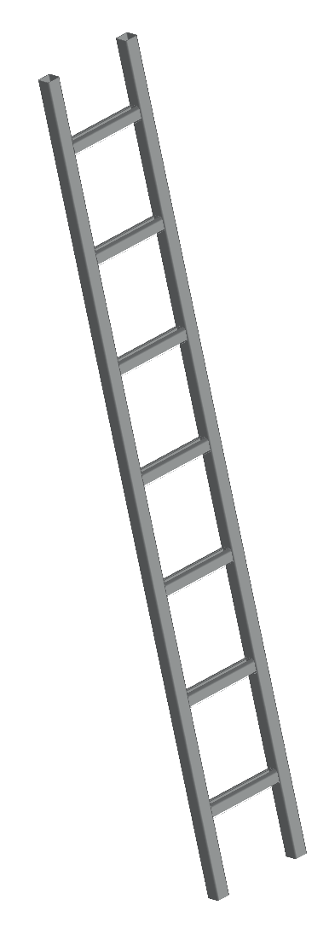
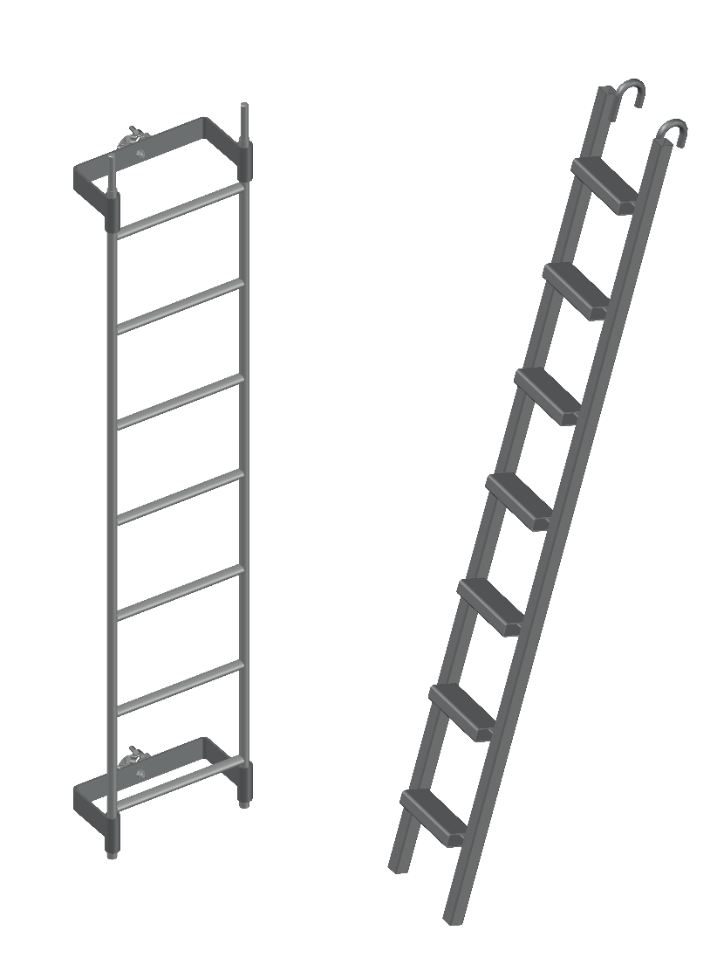
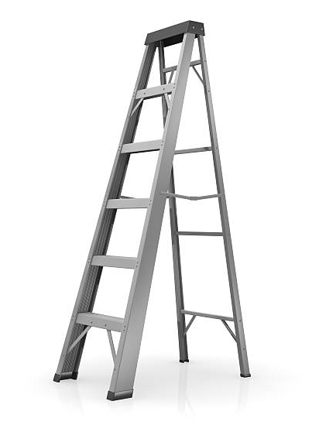
LADDERS
Portable, Hook-On and Attachable Ladders
Notes:
There is a variety of ladder types that may be used such as portable, hook-on, or attachable ladders. Portable ladders are Step Ladders and Extension-type Ladders. Hook-on and Attachable(or clamp-on) ladders are specifically designed for use with scaffolds. Hook-on ladders cannot extend above the platform because of how they are attached. Clamp-on ladders can extend above the platform.

Slide 56
LADDER REQUIREMENTS
Positioned so as not to tip the scaffold
The bottom rung must be no more than 24” above the scaffold supporting level
Rest platforms are required at 35-foot vertical intervals
Hook-on and attachable ladders must be specifically designed for use with the type of scaffold used
Minimum required rung length of 11-1/2”
Uniformly spaced rungs no farther than 16-3/4” apart

Slide 57
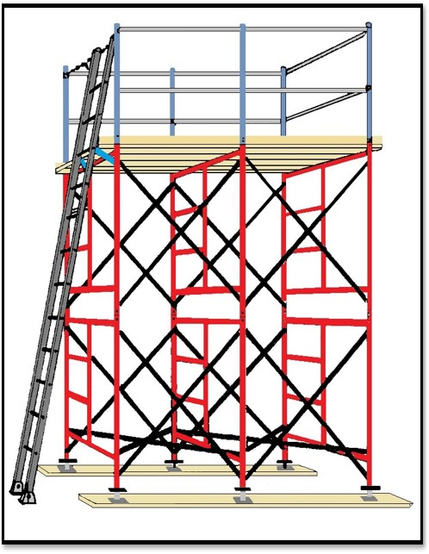
FALL HAZARD PREVENTION
Portable, Job built or Extension Ladders
Portable Ladders shall extend 3’ above the work deck unless properly secured at the top to a rigid support with a grasping device such as a grabrail

Slide 58
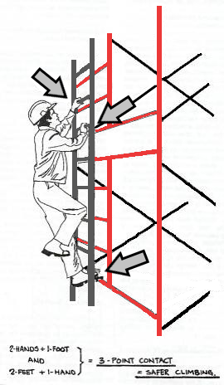
FALL HAZARD PREVENTION
Proper use of Ladders
Ladder shall have sufficient handholds
Three-Point contact climbing technique: 2 hands + 1 foot; 2 feet + 1 hand
Do not carry tools or anything else while climbing
Notes:
3-point contact is a must when climbing a ladder. It is critical that the worker firmly grasp the ladder with at least one hand when climbing up or down the ladder.

Slide 59
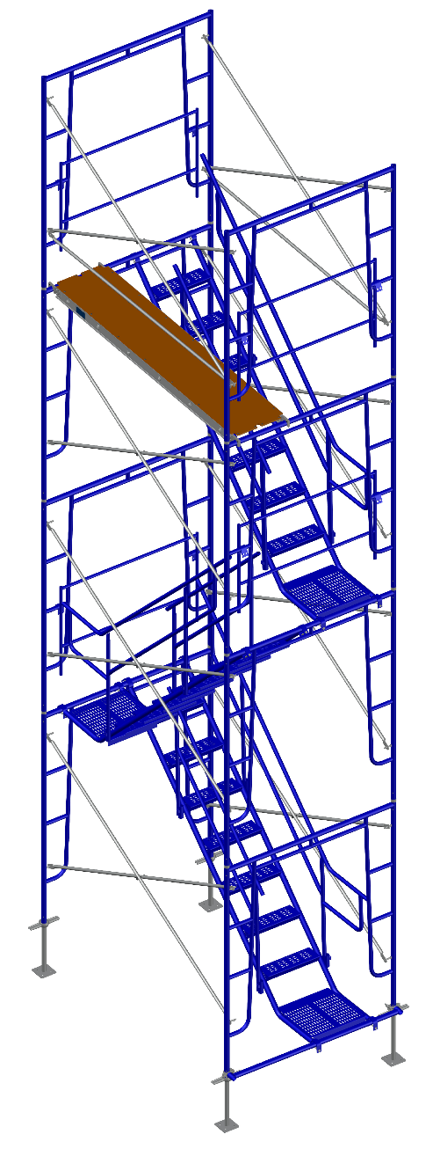
Stairtower REQUIREMENTS
  Positioned so that bottom step is not more than 24” above the scaffold supporting level
  Stairrail consisting of a toprail and midrail required on each side of stairway.
    Handrails, and toprails that are used as handrails, shall be at least 3 inches from other objects.
    Top of the stairrail must be between 28” and 37” from the surface of the tread at the forward edge of the tread
  A minimum 18”x18” landing platform required at each level
  Each Scaffold stairway shall be at least 18” wide
  Slip-resistant surfaces required on treads and landings

Slide 60
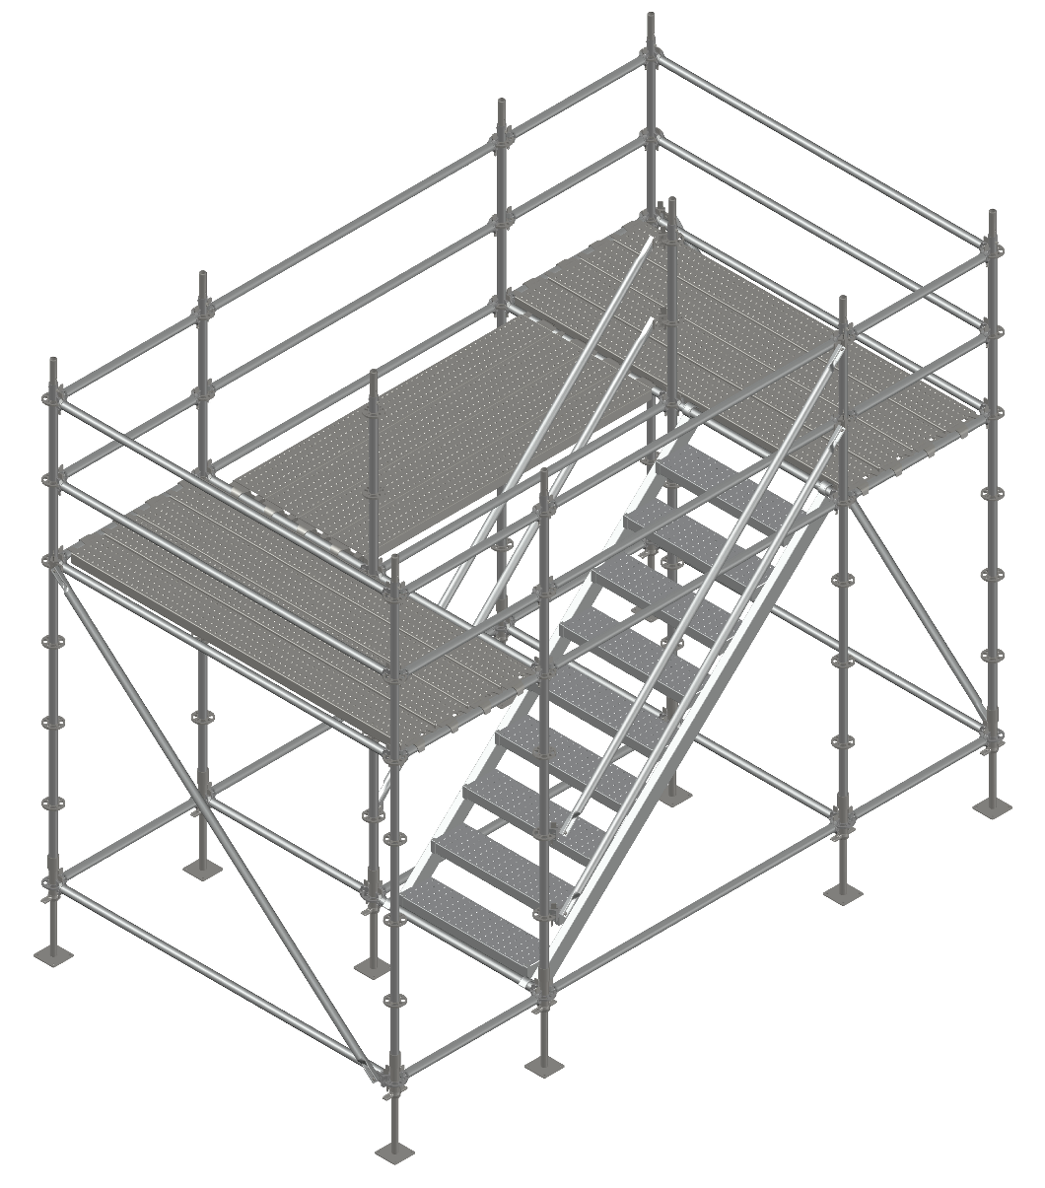
Stairtower REQUIREMENTS Continued
  Installed between 40 and 60 degrees from the horizontal
  Guardrails required on open sides and ends of each landing
  Riser height must be uniform within ¼” for each flight of stairs. Greater variations are allowed for top and bottom steps of the entire system, not for each flight of stairs
  Tread depth must be uniform within ¼” for each flight of stairs

Slide 61
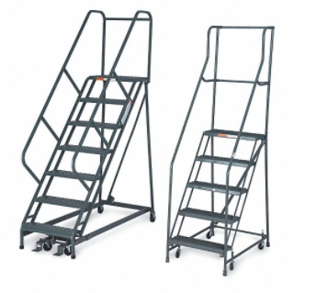
Stairway type ladder REQUIREMENTS
  Positioned so that bottom step is not more than 24” above the scaffold supporting level
  Be provided with rest platforms at 12’ maximum vertical intervals
  Have a minimum step width of 16” except mobile scaffold stairway-type ladders may have 11-1/2” wide steps
  Slip resistant treads are required on all steps and landings

Slide 62

FALL HAZARD PREVENTION
Workers are permitted to climb over or thru the guardrail system but a gate or removable chains are preferred
Guardrail gates must swing INTO the platform
Notes:
Using an access gate will sometimes provide easier access to the work platform.
The access gate must always swing in toward the platform. The access gate must have a top rail and a mid rail.
The access gate must always swing in toward the platform. The access gate must have a top rail and a mid rail.
The gate must be installed so the top of the gate is within 38 to 45 inches above the platform. Ideally, the top of the gate should be installed at the same height as the adjacent toprails.

Slide 63
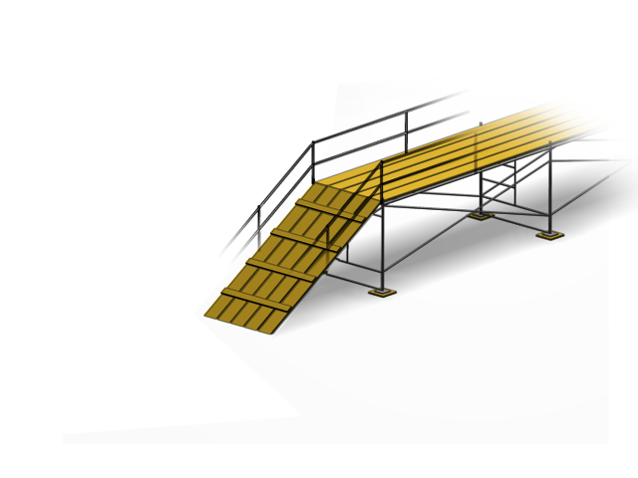

Ramp REQUIREMENTS
Fall protection is required
on Ramps higher than 6’-0”
(OSHA Subpart M applies to Ramps – not Subpart L)
6’
Guardrails required if Ramp above 6 feet.
18” minimum
14”
Maximum Slope is 1 Vertical (Rise) to 3 Horizonal (Run)
Rise
Rise
= 1
Run
Run
= 8
When the slope exceeds 1 (Rise) to 8 (Run), cleats spaced no more than 14” apart are required
© 2018, Glabe Consulting Services, Inc.

Slide 64
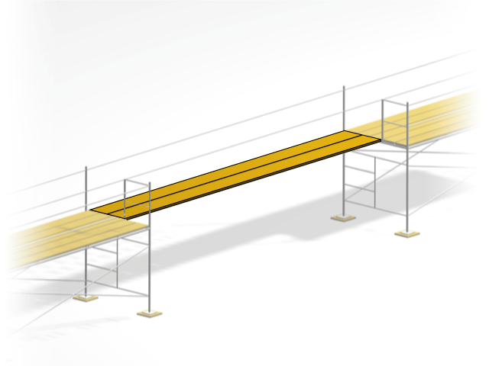
Walkway REQUIREMENTS
Walkway
6’-0”
Minimum
Width = 18”
Fall protection is required on Walkways higher than 6’-0” (OSHA Subpart M applies to Walkways – not Subpart L)
© 2018, Glabe Consulting Services, Inc.

Slide 65
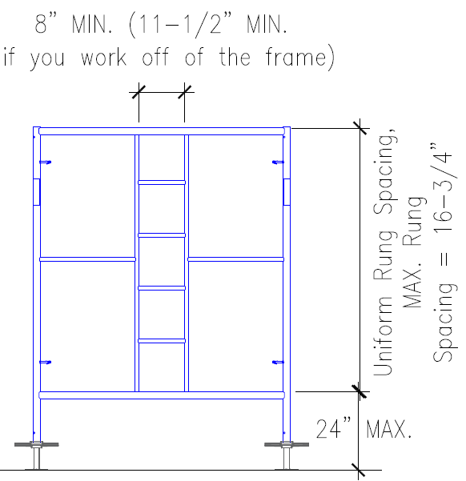
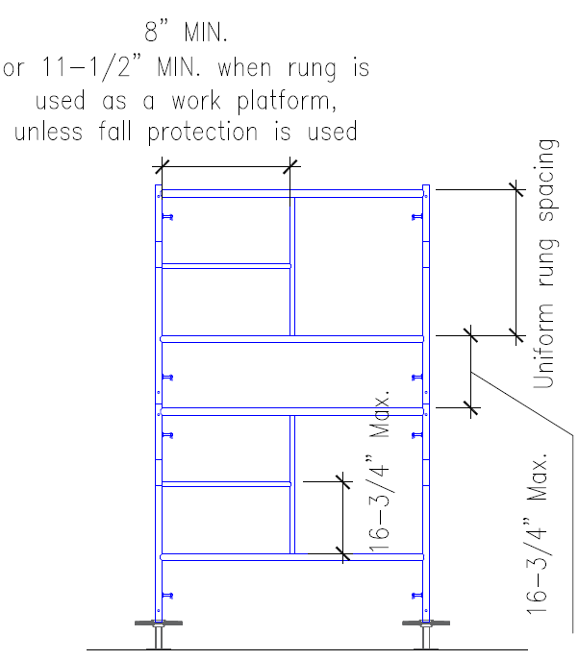
Integral prefabricated scaffold access FRAME REQUIREMENTS
  Positioned so that bottom step/rung
  is not more than 24” above the
  scaffold supporting level
  Must be specifically designed and constructed for use as ladder rungs
  Must have rest platforms at
  35’ Max. vertical intervals
  Steps and rungs of ladder and
  stairway type access must line up vertically with each other between
  rest platforms

Slide 66
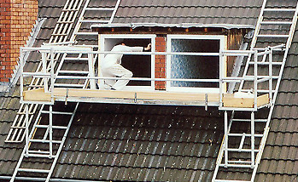
Direct access REQUIREMENTS
  Direct Access to or from another surface is allowable only when the scaffold is not more than 14” horizontally and not more than 24” vertically from the other surface

Slide 67
Key Points
  Access must be no more than 24” vertically and 14” horizontally from the scaffold platform for direct access
  Ladder Rungs must be at least 11-1/2” wide
  Climbing crossbraces is prohibited
  Gates must swing INTO the scaffold platform
  Maximum Ramp slope allowed is 1 vertical to 3 horizontal
  Integral Prefabricated Access Frames rungs must be a minimum of 8” wide unless the rung is used as a work platform, then it must be at least 11-1/2” wide
  Rest platforms are required at 35’ vertical intervals for ladders and access frames
Notes:
Review the key points from this session.

Slide 68
Guardrail Gates must swing inward toward the platform.
True
False
Notes:
Instructor: the answer choices will come in automatically.

Slide 69
Guardrail Gates must swing inward toward the platform.
True
False
Notes:
Answer: True

Slide 70
How high is the allowable first step for safe scaffold access?
12”
18”
24”
No requirement
Notes:
Instructor: the answer choices will come in automatically.

Slide 71
How high is the allowable first step for safe scaffold access?
12”
18”
24”
No requirement
Notes:
Answer: C

Slide 72
Struck by falling objects
F
U
S
E
S
Notes:
S = Struck By

Slide 73
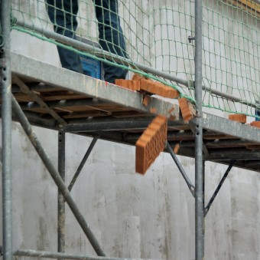
Struck by Falling Objects
Tools, materials can accidentally be dropped, kicked or slip off the scaffold
Falling objects can cause injury and death to workers in addition to causing property damage
Notes:
Discuss falling object protection briefly.
If possible, share a personal experience.

Slide 74
FALLING OBJECT PROTECTION OPTIONS
  Toeboards
  Screens
  Guardrail Systems with Netting
  Debris Nets, Catch Platforms or Canopy
  Barricade the hazard area
  Secure potential falling material to the platform away from the edge
Notes:
Falling object protection is required when there is a danger of tools, materials, or equipment falling from a scaffold and striking employees below. These are the common methods that can provide falling object protection. Hard hats are not considered falling object protection.

Slide 75

FALLING OBJECT PROTECTION
TOEBOARDS
  Toeboards:
  Install where tools, materials, or equipment can fall from a scaffold and strike employees below
  Install along edges of platforms more than 10’ above lower levels for a distance sufficient to protect employees below
  3-1/2” high minimum
  No more than ¼” gap between the bottom of the toeboard and the platform

Slide 76

FALLING OBJECT PROTECTION CONTINUED
  Screens:
  Install where tools, materials, or equipment are piled higher than the toeboard and can fall from a scaffold and strike employees below
  Extend from the toeboard or platform to the top of the guardrail for a distance sufficient to protect employees below
  Guardrail system with openings small enough to prevent passage of falling objects
DEBRIS NETS, CATCH PLATFORMS & CANOPIES
SCREENS & GUARDRAILS
  Install where tools, materials, or equipment is piled higher than the toeboard can fall from a scaffold and strike employees below
  Strong enough to withstand impact forces of falling objects
  Erected between the falling object hazard and the employees
Notes:
Install screening from the work deck to a height sufficient to prevent stacked materials from falling off the scaffold,

Slide 77

FALLING OBJECT PROTECTION continued
BARRICADE BELOW
SECURE MATERIAL
  Barricade:
  Install where tools, materials, or equipment are piled higher than the toeboard and can fall from a scaffold and strike employees below
  Barricade area below the scaffold and prohibit employees from entering the hazard area
  Use when objects are too large or heavy to be contained or deflected by other means
  Place potential falling objects away from the edge where they could fall and secure them from falling
Notes:
Barricade the area around the scaffold to prevent workers and pedestrians from entering the area where there is a possibility of being struck by objects that might fall from the scaffold platform.

Slide 78
Key Points
In addition to wearing hardhats, here are 8 ways to protect against falling objects:
  Toeboards
  Screens
  Guardrail system with openings small enough to prevent objects from falling
  Catch platforms
  Debris Nets
  Barricades
  Canopies
  Securing Material to the deck or platform, away from the edge
Toeboards must be at least 3½in (89mm) high above the platform and
have no more than 1/4 in. (6 mm) gap from the platform
Barricade around the area below the scaffold and create a ‘NO ACCESS
ZONE’ where construction debris or an object dislodged from the scaffold might land
Notes:
Review the key points from this session.

Slide 79
Which of the following can prevent material from being kicked off a work platform?
Midrail
Toeboard
Personal Fall Arrest System
Crossbrace
Notes:
Instructor: the answer choices will come in automatically.

Slide 80
Which of the following can prevent material from being kicked off a work platform?
Midrail
Toeboard
Personal Fall Arrest System
Crossbrace
Notes:
Answer: TOEBOARD
Ask them what else can prevent material from being kicked off – Screening.
Note that the USER cannot add a Toeboard, but simply must be aware that a Toeboard/Screening can prevent material from being kicked off.

Slide 81
Which of the following is a way to provide falling object protection?
Guardrail System
Attachable Ladder
Barricade
Personal Fall Arrest System
Notes:
Instructor: the answer choices will come in automatically.

Slide 82
Which of the following is a way to provide falling object protection?
Guardrail System
Attachable Ladder
Barricade
Personal Fall Arrest System
Notes:
Answer: BARRICADE

Slide 83
Electrocution
F
U
S
E
S
Notes:
E = Electrocution

Slide 84

Electrocution
Electrocution is a common scaffold hazard
Electricity can energize a scaffold without making contact
Stay a safe distance from power lines
Scaffolds making accidental contact with power lines have caused many injuries and fatalities
Before moving any scaffold, including rolling towers, check the path of travel for proper clearance from power lines
Notes:
Discuss Electrocution and Electrical Hazards and share a related story (or ask trainees to share one). Make sure to discuss minimum safe distances according to locally applicable regulations. Minimum Safe Approach Distances (MSAD) will be outlined later in this section.

Slide 85
ELECTRICAL HAZARDS
Contact with Power Lines
Faulty Equipment
Electrical Storms
Notes:
Scaffolds can become Energized during electrical storms (can become part of an electrical circuit)
Most Scaffold is a conductive material
Faulty electrical tools, welding electrodes, faulty power cords
– Regular electrical tool inspections
– Do not ground welding electrodes to scaffold
GFI Protection Requirements – For power tools, some jurisdictions require GFCI Protection by law (Ground Fault Circuit Interrupter).
Proximity of Electrical Lines
Minimum Safe Approach Distances (MSAD) apply to scaffold and conductive equipment that could come closer to exposed power lines or power sources (refer to next slide)

Slide 86
MINIMUM SAFE APPROACH DISTANCES (MSAD)
Insulated Lines MSAD
< 300 V 3 Feet
300 V to 50 kV 10 Feet
> 50 kV 10 Feet Plus 0.4 inches for Every 1 kV Over 50 kV
Uninsulated Lines MSAD
< 50 kV 10 Feet
> 50 kV 10 Feet Plus 0.4 inches for Every 1 kV Over 50 kV
Alternative – 2 times length of line insulator but never less than 10 feet.
Notes:
The instructor should explain MSAD
There may be jurisdictional variations on MSAD
Electricity can and does jump (arc) to any metallic or semimetallic object (including you) within MSAD.
Stress the importance of maintaining the required MSAD
If the worker has any question or does not understand the MSAD, a Competent Person should always be consulted.
.4 inches is equal to 13/32 of an inch
Insulated means that the line is separated from other conducting surfaces by a dielectric (including air space) offering a high resistance to the passage of current. RUBBER COATING ON POWER LINES IS NOT INSULATION!

Slide 87
Key Points
Electrocution is a common scaffold hazard
Electricity can energize a scaffold without making contact
Stay a safe distance from power lines Minimum Safe Approach Distance (MSAD)
Never work from a scaffold during an electrical storm
Before moving a rolling scaffold, check the path of travel to ensure that the scaffold can maintain the Minimum Safe Approach Distance to power lines
Notes:
Review the key points from this session.

Slide 88
How far should the scaffold be kept away from uninsulated power lines of less than 50kV?
3 Feet
10 Feet
6 Feet
5 Feet
Notes:
Instructor: the answer choices will come in automatically.

Slide 89
How far should the scaffold be kept away from uninsulated power lines of less than 50kV?
3 Feet
10 Feet
6 Feet
5 Feet
Notes:
Answer: B. 10 feet

Slide 90
Scaffold collapse
F
U
S
E
S
Notes:
S = Scaffold Collapse

Slide 91

Scaffold Collapse
Scaffolds collapse for many reasons:
  inadequate foundation
  overloading
  improper erection, including improper bracing or removal of braces and/or ties
  use of damaged or poorly maintained
  components
  Any combination of the above
Notes:
List and explain some of the reasons scaffolds collapse
(If anyone asks about the collapse in this image: This collapse was in Houston. One of the companies was fined $14,700 for the following violations: support scaffold poles were missing base plates, the footing of scaffolds was not rigid or sound and the scaffolding wasn't inspected by a Competent Person before each work shift or after an occurrence that could affect the scaffolding's structural integrity. The second company involved was fined $6300 for not initiating and maintaining a safety program that regularly inspects job sites, materials and equipment and because the scaffold and scaffold components weren't inspected).

Slide 92


SCAFFOLD COMPONENTS
Foundation
Scaffold Structure
Platform Construction and Allowable Loads
Scaffold Leg Strength
Scaffold Bracing
Notes:
When any scaffold component is overloaded or not correctly installed, the risk of failure is greatly increased. Once the failure begins, the dynamic force created can cause other components or the entire system to collapse.
Users must be aware of the allowable loads that can be placed on scaffolds to prevent overloading components. For example, the legs will support more load than planks when properly braced.

Slide 93

FoundationS
Foundation is the surface that supports the scaffold. It can be Concrete, Asphalt, Rock, Soil, Building Floor or Roof, etc. and must provide adequate support for the scaffold
Base plates are ALWAYS required under each scaffold leg to provide stability, spread the leg load and protect the bottom of the scaffold leg
A sill is required when the foundation is not strong enough to support the load transmitted through the base plate. Sill size and material will vary and are dependent on the Leg Load, Strength of the Foundation, and Strength of the Sill
BASE PLATE
FOUNDATION
SILL
Notes:
Discuss briefly how these basic components are put together.
FOUNDATION
BASEPLATES – Help distribute the load of the scaffold leg to the foundation.
SILL
While OHSA does not require baseplates to be nailed to sills, it is a Best Practice.

Slide 94
sillS
Sill material must be strong enough to transfer scaffold leg load to the supporting surface or ground
Ensure that the sills have not been washed out
Check that sill/foundation has not been undermined by digging near the sill or by placing the sill near a trench
Baseplates are always required to help spread the scaffold leg load
Stacked, unstable objects must never be
used as a sill
SILL

Slide 95








Foundation Wall of Shame
Notes:
Show each of the photos and discuss the problems with each of the foundations – (Don’t forget to point out the cluttered and messy work areas as also being hazards).
The USER has no control over the foundation or how it is used. If the USER finds such a situation, the supervisor should be made aware and the worker should refuse to go on the scaffold.

Slide 96
Scaffold Platform Construction
Distance from front edge of platform and the face of work:
Outrigger Scaffold = 3”
Plastering & Lathing = 18”
All others = 14”
Platform shall be fully planked or decked between the front uprights and the guardrail supports
Guardrail Supports
Fully Planked Platform
Front Uprights
1”
Maximum Space between Platform units = 1”
Exception:
Space can be greater to fit around uprights.
1”
Maximum space between back edge of Platform and Guardrail system is 9 ½”
Notes:
96
Explain that OSHA requires platforms to be fully planked. Review the slide contents to further explain when openings in platforms are allowed.
Based on the type of scaffold or certain trades, the platforms must be within 14” inches from the face of the work, unless guardrails or PFAS systems are in place.

Slide 97

Platform Construction
Overlap
2 x 10 Plank Scaffold Platform Construction
12”
Bearer
L
Span of Plank
*
Overhang
Bearer
*
Minimum = 6”
*
Maximum:
L = 10’ or less = 12”
L = Greater than 10’ = 18”
L = Span of plank
*
or Secured from Movement
DO NOT DO THIS!
This is not Overlap
Notes:
Point out the plank deflection and explain that users should only walk or stand on unoccupied planks whenever practical.

Slide 98

Scaffold Loads
BEFORE USING A SCAFFOLD, YOU MUST KNOW LOADS

Slide 99
Scaffold Loads
Dead Loads
What’s a Load?
A load is any object that is placed on a scaffold. It includes:
Materials such as brick, block, stucco, windows, insulation, mortar, enclosures, sand and debris
Tools such as wrenches, hammers, compressors, saws, vacuum cleaners and job boxes
Workers such as you and all other people being supported by the scaffold
Environmental loads such as wind, rain, snow, hail and ice
Live Loads
scaffold & components

Slide 100



Scaffold Loads
Dead Loads
Loads can be divided into three categories:
Live Loads
Dead Loads
Environmental Loads
scaffold & components
workers, tools, materials
scaffold components & platforms
wind, rain, snow, ice
Notes:
There are different types of loads on scaffolds that must be taken into consideration to prevent scaffold collapse.
Live Loads – the weight of the workers and materials (these are called live loads because they are designed to move on, off, and around the scaffold) Note: OSHA states that each worker accounts for 250 lbs. of live load.
Dead Loads – the weight of the scaffold components and the planking materials (These are called dead loads because they should not move).
Environmental Loads – These loads are caused by wind, snow, ice, etc. that may put additional loads on scaffolds.

Slide 101
Scaffold Loads
Dead Loads
Why should I care about loads??
Here is why you should care:
If you overload the scaffold you could die
If you overload the scaffold you could kill others
Regulations and Standards require you to know this stuff
If you overload the scaffold you’d be in trouble
You will be cited and fined by OSHA
All the above
Live Loads
scaffold & components

Slide 102
Scaffold Loads
Dead Loads
Here is what you need to know about loads before using your scaffold:
There are two types of loads:
1. ALLOWABLE LOADS
2. MAXIMUM INTENDED LOAD—also known as the ACTUAL LOAD
You need to know the SCAFFOLD ALLOWABLE LOAD
You need to know the PLATFORM ALLOWABLE LOAD
You need to know the MAXIMUM INTENDED/ACTUAL LOAD
You need to know the PROPER MATERIAL HANDLING OF LOADS ON YOUR SCAFFOLD
Live Loads
scaffold & components
I don’t know these terms --- What does all this mean??

Slide 103
Scaffold Loads
Dead Loads
Here’s what these terms mean:
Live Loads
Allowable Loads: The maximum safe amount of weight the scaffold or platform
can support
Maximum Intended Load/Actual Load: The load you are placing on the scaffold
scaffold & components
The First Rule of Loads:
The Maximum Intended/Actual Load can NEVER be more than the Allowable Load

Slide 104
Scaffold Loads
- Allowable Loads
Dead Loads
Here is how you find the Allowable Load:
Ask your boss
Ask the scaffold erector
Ask the company that erected the scaffold
Ask the scaffold supplier
Ask the manufacturer
Live Loads
scaffold & components
The Second Rule of Loads:
Do not guess at what the Allowable Load might be.

Slide 105
Scaffold Loads
- Allowable Loads
Dead Loads
What affects the Allowable Load:
Live Loads
Foundation
Bracing
Stability
Plumb and Level
Quality of the Equipment (Is the equipment in good shape?)
scaffold & components
The Third Rule of Loads:
Allowable Loads are based on a properly constructed scaffold; do NOT modify scaffolds.

Slide 106
Scaffold Loads
- Allowable Loads
Dead Loads
How does the manufacturer determine the Allowable Load?
The scaffold is tested according to standardized test procedures
The scaffold is tested to failure
The manufacturer applies a safety factor
The manufacturer publishes a load chart
For some products, the Allowable Load is indicated on the product
Live Loads
scaffold & components
The Fourth Rule of Loads:
Make sure you use the Allowable Load for the scaffold brand you are using.

Slide 107
Scaffold Loads
- Maximum Intended/Actual Loads
Dead Loads
Maximum Intended Load/Actual Load: The load you are placing on the platform and the scaffold.
Live Loads
You are responsible for determining the weight of the materials, tools and workers you expect the scaffold to support
You must not overload the platform or the scaffold
If you don’t know what your stuff weighs, ask you boss what it weighs, or
Weigh it
scaffold & components
Do Not violate the First Rule of Loads:
The Maximum Intended/Actual Load can NEVER be more than the Allowable Load

Slide 108
Scaffold Loads
Dead Loads
Before using a scaffold, you should do this:
When you arrive at your job, you are told you will be working on a scaffold.
Here is what you do:
You ask your boss what you will be doing
You ask how much the platform can support
You ask how much the scaffold can support
You ask how much the materials and tools you are using weigh
You ask how many fellow workers will be on the scaffold
You ask your boss to determine that the actual load is less than the allowable load
Once your boss tells you that the actual load is less than the allowable load, you can use the scaffold
scaffold & components

Slide 109
Scaffold Loads
Dead Loads
Load Example # 1
- You are told that the 4-leg scaffold you will be using has a capacity of 2,000
pounds per leg
- You are told the platform can support 1,000 pounds
- You are told the mortar tub will weigh 800 pounds
- Is the scaffold safe?
Yes, the scaffold is safe. The platform can hold 1,000 pounds, 200 pounds more than you are placing on it. The scaffold has 4 legs, where each leg can support 2,000 pounds. Assuming the platform is supported by 4 legs, you are only placing 200 pounds on each leg [800 pounds/4 legs = 200 pounds per leg].
scaffold & components

Slide 110
Scaffold Loads
Dead Loads
Load Example # 2
- You are told that the 4-leg scaffold you will be using has a capacity of 1,000
pounds per leg
- The platform consists of 4 wood planks; each plank can support 250 pounds
- There will be 6 workers, each weighing 250 pounds, on the platform
- Is the scaffold safe?
The scaffold is NOT safe because the platform is overloaded. The platform can hold 1,000 pounds [4 planks x 250 pounds per plank = 1,000 pounds]. 6 workers x 250 pounds = 1,500 pounds, 500 pounds more than the platform can support. However, the scaffold structure is not overloaded. 4 legs x 1,000 pounds per leg = 4,000 pounds, which is more than the workers’ weight of 1,500 pounds.
scaffold & components

Slide 111
Key Points
The First Rule of Loads:
The Maximum Intended/Actual Load can NEVER be more than the Allowable Load
The Second Rule of Loads:
Do not guess at what the Allowable Load might be.
The Third Rule of Loads:
Allowable Loads are based on a properly constructed scaffold; do NOT modify
scaffolds.
The Fourth Rule of Loads:
Make sure you use the Allowable Load for the scaffold brand you are using.
Notes:
Review the key points from this session.

Slide 112

SCAFFOLD Overloading
Overloading the scaffold can cause the platform to collapse
Place materials OVER the frame header or ledger whenever possible
Separate materials into smaller/lighter loads to distribute loads evenly over the plank
Excessive deflection is an indication that this plank is overloaded.
Notes:
Point out the plank deflection and explain that users should only walk or stand on unoccupied planks whenever practical.

Slide 113


SCAFFOLD Overloading
Where point loading is necessary it should be directed over the verticals or frames.
Equally distribute the load as a best practice
Unsafe Practice for material storage
Notes:
Workers must have an 18” walking working surface which means that it will require at least two unoccupied scaffold planks. Scaffold decks are over 18” wide, and only one unoccupied plank would be required.
The materials should be stored in a manner to allow for the worker to pass and be evenly distributed throughout the platform.

Slide 114
Platform load
  EXAMPLE Nominal 2 x 10 Scaffold Grade Wood Plank Only
  6’ span maximum 75 psf. Heavy Duty
  8’ span maximum 50 psf. Medium Duty
  10’ span maximum 25 psf. Light Duty
5’
5’ x 5’ = 25 sq. ft.
25sq.ft. x 75 psf. = 1875 pounds per platform
5’
The manufacturer provides the ratings for all other materials used for platforms
7’
5’ x 7’= 35 sq. ft.
35 sq ft x 50 psf. = 1750 pounds per platform
5’
10’
5’ x 10’= 50 sq. ft.
50 sq ft x 25 psf. = 1250 pounds per platform
5’
Notes:
Here is an easy way for users to calculate the allowable load on a scaffold platform. These numbers are based on using scaffold grade wood plank. Figure the square foot area of the platform (width of the frame multiplied by the distance to the next frame (or span)) and then multiply by the duty rating of the platform material.
When using other planking materials, such as metal or aluminum, the manufacturer of the plank lists the rating on the plank since this type of plank is designed for a specific span and made from other materials.

Slide 115
Overload Prevention
Ensure that the weight of the materials plus any anticipated Live Load from workers etc. will not exceed the rated capacity of the scaffold and work platform components
Keep in mind that snow and ice buildup on the scaffold also contributes to the load on the scaffold - Always remove snow and ice buildup

Slide 116

FALL HAZARD PREVENTION
Complete Decking - The scaffold platform must completely cover the area on which you are working
DECK ENTIRE AREA
HOOKS
Notes:
Decking material can be lumber, LVL or fabricated.
Decking materials must be able to support the loads.
Damage to decking materials is not acceptable.
Decking materials must overhang the horizontal member of the frame by at least 6“ (unless restrained by hooks or other means) and if the platform is continuous must overlap by at least 12".
If there is any danger of the decking lifting or teetering up or sliding along the deck, the decking must be restrained or tied down to the scaffold members.

Slide 117

Improper Scaffold Erection
Improper scaffold erection can include utilizing the wrong components, not fully planking the work level or removing components that are needed to support the scaffold load
NEVER remove scaffold ties, guys, braces or other components.
Never put enclosure material on a scaffold that has not been engineered for enclosure. Adding enclosure increases the amount of wind load acting on the scaffold and if the scaffold system is not designed for these additional loads, the results can be catastrophic
WALL TIE
Notes:
Removal of ties and/or guys can lead to catastrophic collapse of the scaffold system.

Slide 118
Damaged or poorly maintained Components

Slide 119
Key Points
Scaffolds collapse for many reasons
Always ensure that there is an adequate foundation
Always ensure that the scaffold is not overloaded
Always ensure that the scaffold is properly erected
Never remove scaffold ties, guys or braces/bracing
Never use a scaffold that contains damaged or poorly maintained scaffold components
Never work from scaffolds in high winds or extreme weather conditions
Never enclose a scaffold with netting or tarps unless it has been designed for enclosure
Notes:
Review the key points from this session.

Slide 120
Which of the following is not a foundation component of a scaffold?
Sill
Crossbrace
Baseplate
Screwjack
Notes:
Instructor: the answer choices will come in automatically.

Slide 121
Which of the following is not a foundation component of a scaffold?
Sill
Crossbrace
Baseplate
Screwjack
Notes:
Answer: CROSSBRACE

Slide 122
Scaffold Plank must be approved by OSHA.
True
False
Notes:
Instructor: the answer choices will come in automatically.

Slide 123
Scaffold Plank must be approved by OSHA.
True
False
Notes:
Answer: False

Slide 124
What Load cannot exceed the Allowable Load?
Live Load
Dead Load
Maximum Intended/Actual Load
Notes:
Instructor: the answer choices will come in automatically.

Slide 125
What Load cannot exceed the Allowable Load?
Live Load
Dead Load
Maximum Intended/Actual Load
Notes:
Instructor: the answer choices will come in automatically.
C. Maximum Intended/Actual Load

Slide 126

Summary & REVIEW
Scaffold User Hazard Awareness training is required for anyone who performs work while on a scaffold
Only a Competent Person can direct workers who build, dismantle, move, or alter scaffolds
A scaffold is any temporary elevated work platform and its supporting structure used to support workers, materials or both
Notes:
Review the key points from this session.

Slide 127
Summary & REVIEW
There are basically 3 types of scaffolds:
Supported, Suspended and Mobile Elevated Work Platforms
Three types of supported scaffolds are:
Frame & Brace, System Scaffold, and Tube & Clamp
The five most common scaffold hazards are FUSES:
Falls, Unsafe Access, Struck by, Electrocution, and Scaffold Collapse
Notes:
Review the key points from this session.

Slide 128
Summary & REVIEW
Workers positioned above the ground are EXPOSED TO POSSIBLE FALLS
Utilize Guardrail Systems or Personal Fall Protection systems
Completely deck the scaffold
Keep walking and working surfaces free of ice, snow and debris
Always utilize proper and safe access
Notes:
Review the key points from this session.

Slide 129
Summary & REVIEW
  Never climb crossbraces or work from a ladder on top of a scaffold
  Never carry anything while climbing
  Gates must swing INTO the scaffold platform
  Falling Object protection can be accomplished with the use of
  Toeboards, Nets, Screens, Canopy Structures or a Barricade Zone
Notes:
Review the key points from this session.

Slide 130
Summary & REVIEW
  Electricity can energize a scaffold without making contact
  Maintain a Minimum Safe Approach Distance from all power lines and check the path of a rolling tower before moving it
  Never work from a scaffold during an electrical storm
Notes:
Review the key points from this session.

Slide 131
Summary & REVIEW
  Ensure the scaffold foundation is adequate
  Never overload a scaffold
  Never remove braces, ties or guy wires
  Never use poorly maintained or damaged equipment
  Never enclose a scaffold that has not been designed for enclosure
Notes:
Review the key points from this session.

Slide 132
Which term is an acronym for the 5 most common scaffold hazards?
SAIA
ASAP
FALLS
FUSES
Notes:
Instructor: the answer choices will come in automatically.

Slide 133
Which term is an acronym for the 5 most common scaffold hazards?
SAIA
ASAP
FALLS
FUSES
Notes:
Answer: D. FUSES

Slide 134
What is the most common scaffold hazard?
Falls
Unsafe Access
Struck by Falling Object
Electrocution
Scaffold Collapse
Notes:
Instructor: the answer choices will come in automatically.

Slide 135
What is the most common scaffold hazard?
Falls
Unsafe Access
Struck by Falling Object
Electrocution
Scaffold Collapse
Notes:
Answer: A. Falls

Slide 136

Questions?
Notes:
Please ask the class if they have any questions regarding scaffold safety.
If you have any concerns regarding the safety of a scaffold, report your concerns to your Supervisor/Boss and do NOT get on to the scaffold!

Slide 137

Contact Us:
Scaffold & Access Industry Association
816.595.4860 training@saiaonline.org

