Slide 1


Slide 2
TUBE & CLAMP SCAFFOLDS
VERSATILE AND EASY TO PUT TOGETHER
1

Slide 3
Learning Outcomes:
By the end of this part of the course you will be able to:
TUBE & CLAMP SCAFFOLDS
1
MULTI-BAY SCAFFOLDS
Identify different components of a Tube & Clamp Scaffold. You will also learn to select and inspect Tube & Clamp Scaffold equipment.
4
Build area scaffolds and scaffold runs by adding additional bays lengthwise and widthwise and sketch a scaffold design,
BUILDING TUBE & CLAMP SCAFFOLDS
MULTI-BAY & LIFT SCAFFOLDS
2
5
Stabilize higher scaffolds using ties, identify important considerations when building enclosed scaffolds and develop more detailed sketches.
Describe the process of building a basic Tube & Clamp Scaffold unit and how to install additional lifts.
SCAFFOLD PLAN
6
Dismantling & Storage
3
Describe the different types of Tube & Clamp Scaffold configurations. Select appropriate equipment and sketch a scaffold design for the purposes of planning.
Prepare to dismantle scaffolds safely. Store scaffold equipment properly to prevent damage.
Notes:
Briefly go over the Learning Outcomes for the Tube & Clamp portion of the course.

Slide 4
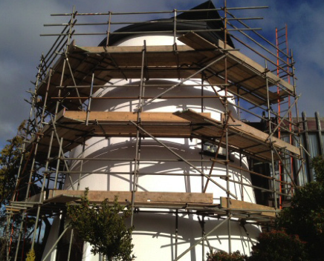
TUBE & CLAMP SCAFFOLDS
Tube & Clamp Scaffolds provide a very flexible method of accessing irregular work areas.
No restrictions as to where connections can be made.
Vertical posts can be placed in any pattern, and horizontal tubes can be clamped at any point on the post.
Tubes are available in a wide range of lengths or can be cut to any length.
Notes:
Describe the features and range of uses for Tube & Clamp Scaffolds

Slide 5
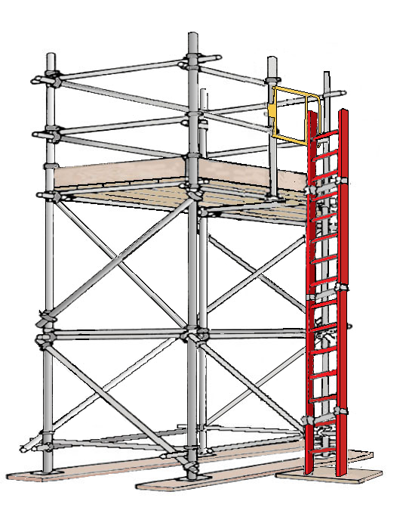













TUBE & CLAMP
SCAFFOLD
Notes:
Briefly review the various components of a basic Tube & Clamp Scaffold and describe their function. CLICK for each component to appear.

Slide 6
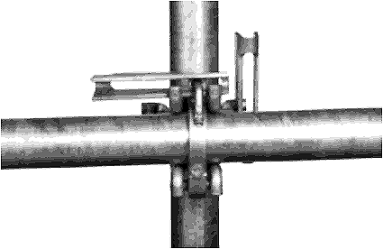
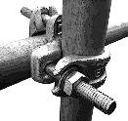
STYLES OF CLAMPS
WEDGE CLAMP
BOLT CLAMP
Notes:
Describe the two styles of clamps and explain how each of them are attached.
Discuss the advantages and disadvantages of each type.

Slide 7
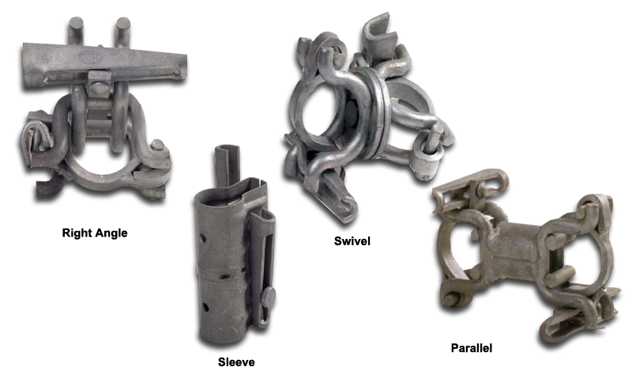
CLAMPS
RIGHT-ANGLE
Notes:
Describe the types of clamps/connectors shown and explain when they are used.

Slide 8
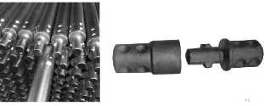
TUBES WITH END-CONNECTORS
Notes:
Describe the type of tubes that have special end-connectors and explain how they are attached together.

Slide 9
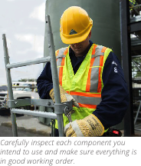
INSPECTING YOUR EQUIPMENT
Always properly inspect your equipment.
Many accidents occur due to damaged or faulty equipment.
Before building a scaffold – you MUST inspect all the components to ensure they are safe.
Do NOT use any damaged or defective equipment.
Notes:
Discuss the importance of inspecting equipment before beginning to build a scaffold.

Slide 10
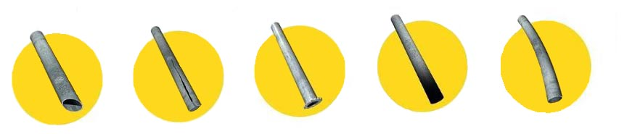
INSPECTING TUBES
MUSHROOM- HEADED
CROSSCUT
SPLIT END
FLAME CUT
BEND
Notes:
Describe the different defects that could affect a scaffold tube and what to look for when inspecting tubes.

Slide 11
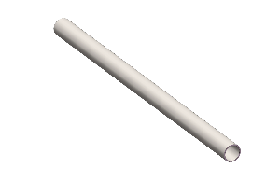
INSPECTING TUBES
Notes:
Describe what to look for when inspecting tubes.

Slide 12
INSPECTING WEDGE CLAMPS
Notes:
Explain the most important points to inspect when using Wedge Clamps.

Slide 13
INSPECTING BOLT CLAMPS
Notes:
Explain the most important points to inspect when using Bolt Clamps.

Slide 14

BASES
Baseplates distribute leg or post loads over a larger area.
There are different types of baseplates available for use with Tube & Clamp Scaffolds.
Notes:
Describe the types of bases available and review how they are used.

Slide 15
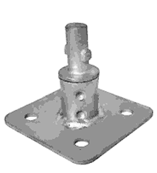
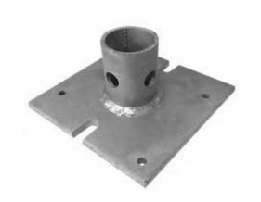
INSPECTING BASES
1A STEM/SPIGOT (PLAIN END TUBE): Fits inside vertical post.
1B STEM/SPIGOT (TUBE with END CONNECTOR): Ends twist and lock together properly
PLATE: Flat, no curled corners.
General appearance: Must be straight, free of excessive rust, or foreign materials
Notes:
Describe what to look for when inspecting bases.

Slide 16

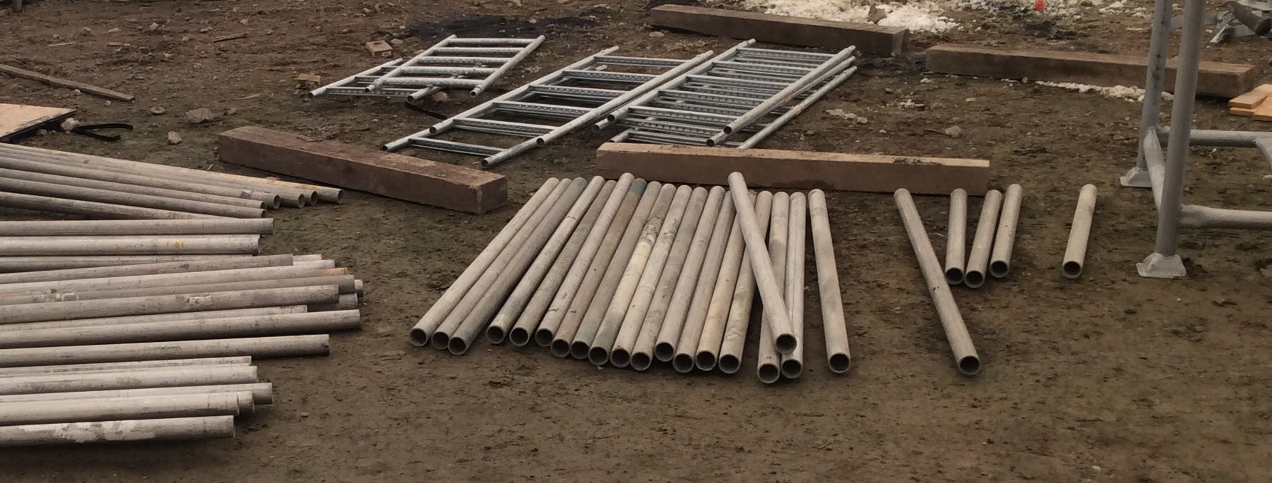
LEARNING ACTIVITY
Inspect the scaffold equipment that has been provided for the practical (hands-on) component of this course.
Notes:
Have trainees get up and go inspect the equipment that is to be used for the Practical Assessment.

Slide 17
Key points
Tube & Clamp Scaffolds can be adapted to suit many sizes and shapes because there are no restrictions as to where connections can be made.
Tube & Clamp Scaffold consists of 4 basic elements:
    vertical tubes,
    horizontal tubes,
    diagonal tubes and
    clamps (or couplers).
Do NOT use Aluminum and steel tubes together.
Some tubes have special connectors that allow them to be firmly connected end-to-end.
Notes:
Review the key points from this session.

Slide 18
Key points
Tubes are connected with either bolt clamps, or wedge clamps.
Do NOT drive the wedge in too deeply. This weakens the whole clamp making it dangerous to use.
Be sure to position WEDGE CLAMP so that the post wedge is driven downward, and the other wedge is driven outward.
Thoroughly inspect scaffold equipment or components before use to ensure they are safe.
Check for: structural damage, modification, missing parts or pieces, damage, excessive corrosion, discoloration and other types of damage or physical defects.
Notes:
Review the key points from this session.

Slide 19
Building TUBE & CLAMP Scaffolds
A basic TUBE & CLAMP Scaffold is the building block for all configurations
2

Slide 20
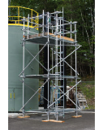
TUBE & CLAMP TOWERS
Spacing of the posts, are determined by the application, the load and the required configuration.
Guardrails are required on all open sides and ends of work platforms.
The scaffold leg is supported by the foundation, the sill, and the baseplate.
Platforms must be fully planked or decked.
Proper access is required
Notes:
Point out the different components of the basic Tube & Clamp Scaffold and discuss the importance of including guardrails, fully-planked platforms and providing proper access

Slide 21
1
Select and inspect the equipment
2
Prepare the foundation
3
Set the sills
5
CREATE THE
BASE LIFT*
6
INSTALL A PLAN BRACE
4
POSITION THE BASEPLATES
8
PLUMB POSTS
9
Attach RIGHT
ANGLE CLAMPS
10
PLACE RUNNERS
11
CONNECT
BEARERS
12
INSTALL
& SECURE THE PLATFORM
7
INSTALL BRACES
14
INSTALL
GUARDRAIL
SYSTEM &
TOEBOARDS
(IF REQUIRED)
13
ATTACH ACCESS & TAG
15
INSPECT THE SCAFFOLD
Powerful
Suitable for all categories business and personal presentation
Notes:
Briefly describe each step in the process of building a basic Tube & Clamp Scaffold unit. *STEP 5 - Explain the process of building the base lift in detail. Discuss the importance of inspecting the scaffold before it is used and how often it should be inspected afterwards.

Slide 22

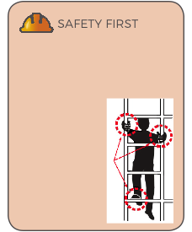
access
Proper access is required for all scaffolds. This access must safely permit a worker to gain access to the platform.
It is good practice to extend your ladder 36in (914 mm) above the platform so that the worker has a hand hold as he/she climbs onto or off of the platform.
If the climb is higher than 30ft to 35ft (9.1m to 10.7m), a rest platform may be required.
Approximately 15% of scaffold-related injuries occur when workers are climbing up and down.
Use safe
climbing
techniques
(3-point
contact
as shown).
Notes:
Discuss proper access and best practices when installing access. Refer to any relevant regulations related to access (these should already have been discussed in Scaffold Fundamentals Section 2 so just a brief reminder). Discuss the importance of 3 points of contact when climbing ladders.

Slide 23
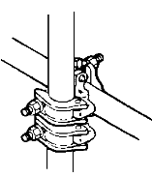
CHECK CLAMP
A check clamp is a “back-up” clamp that prevents slipping if the load bearing clamp becomes overloaded.
Usually connected, directly beneath, and in contact with, a load-bearing clamp.
The two clamps must be in contact with each other.
When the bearer is installed above the runner, and the bearer clamp bears against the runner clamp, the runner clamp acts as a “check or safety “ clamp, in case the bearer clamp slips.
Notes:
Describe check clamps and when they should be used.
Explain where the placement of the check clamp must be (above or below depending on whether scaffold is hanging or not). Explain the importance of the clamps being on contact with each other.

Slide 24
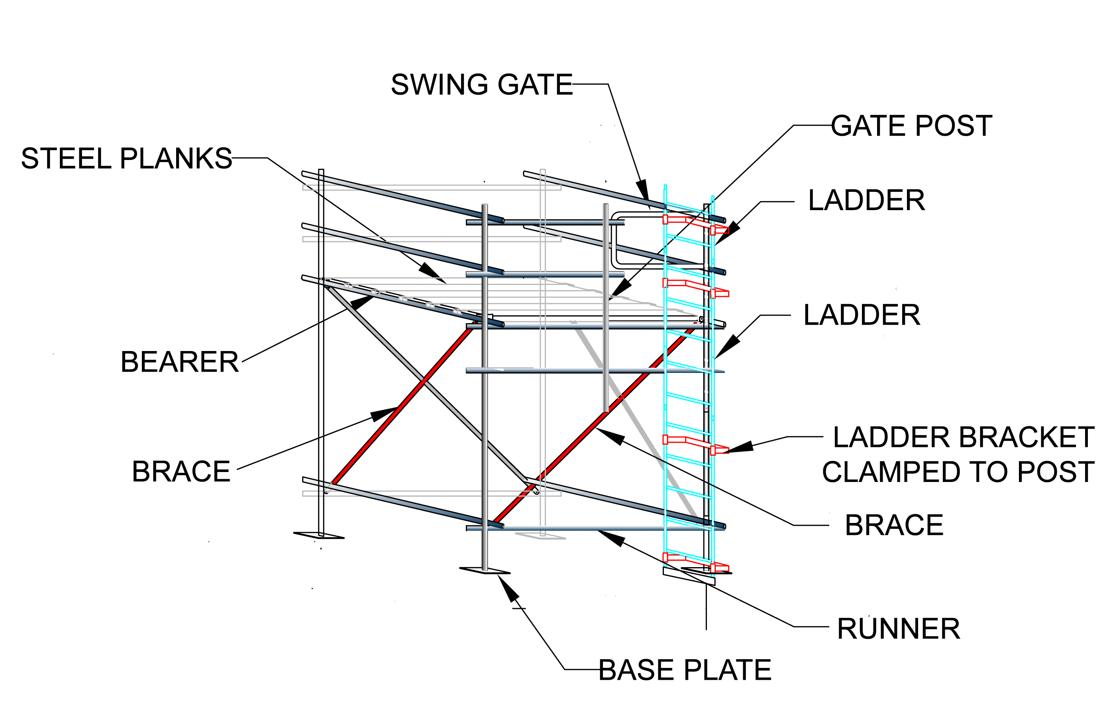
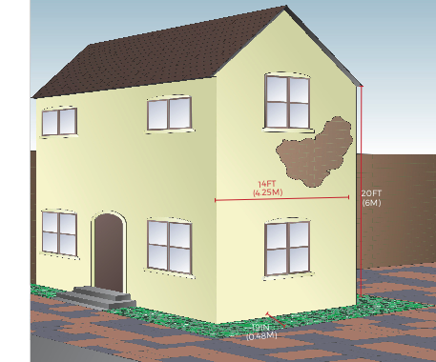
LEARNING ACTIVITY
Notes:
Discuss the learning activity as a group or have trainees work in pairs to answer the questions on page 38.

Slide 25
Key points
Make sure clamps are properly tightened.
Make sure bearers are clamped inside the posts above the runners.
Clamps should be as close to each other as possible. Bearers should be supported by at least two clamps.
Do not exceed the vertical locations of runners 6ft 6in (2 m) or the load capacity of the scaffold will be reduced.
If connecting a bearer to a runner, the clamp should be as close to the post as possible.
A sway brace must be clamped to each post or runner that it crosses to minimize posts bending, and to ensure they stay plumb.
Notes:
Review the key points from this session.

Slide 26
Key points
Guardrails are required on ALL OPEN SIDES AND ENDS on any scaffold more than 10ft (3m) above the ground (or lower in some jurisdictions).
All working platforms must be fully planked or decked.
Provide proper access for workers.
Build the scaffold on a clear, firm foundation.
The three-colored tag system is widely recognized and used on many job sites.
Before the scaffold can be used it must be inspected by a Competent Person to ensure it is safe.
Scaffold inspections must be made after the scaffold has been built and before it is used, before each shift and “periodically” afterwards.
Notes:
Review the key points from this session.

Slide 27
SCAFFOLD PLAN
A SCAFFOLD PLAN will save you time & Prevent Errors
3

Slide 28

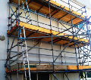
TUBE & CLAMP SCAFFOLD CONFIGURATIONS
Notes:
Discuss the different types of configurations that Tube & Clamp Scaffolds are built into. Describe some of the most common uses for Tube & Clamp Scaffolds. Remind trainees that the configuration depends on the intended use and the nature of the project.

Slide 29
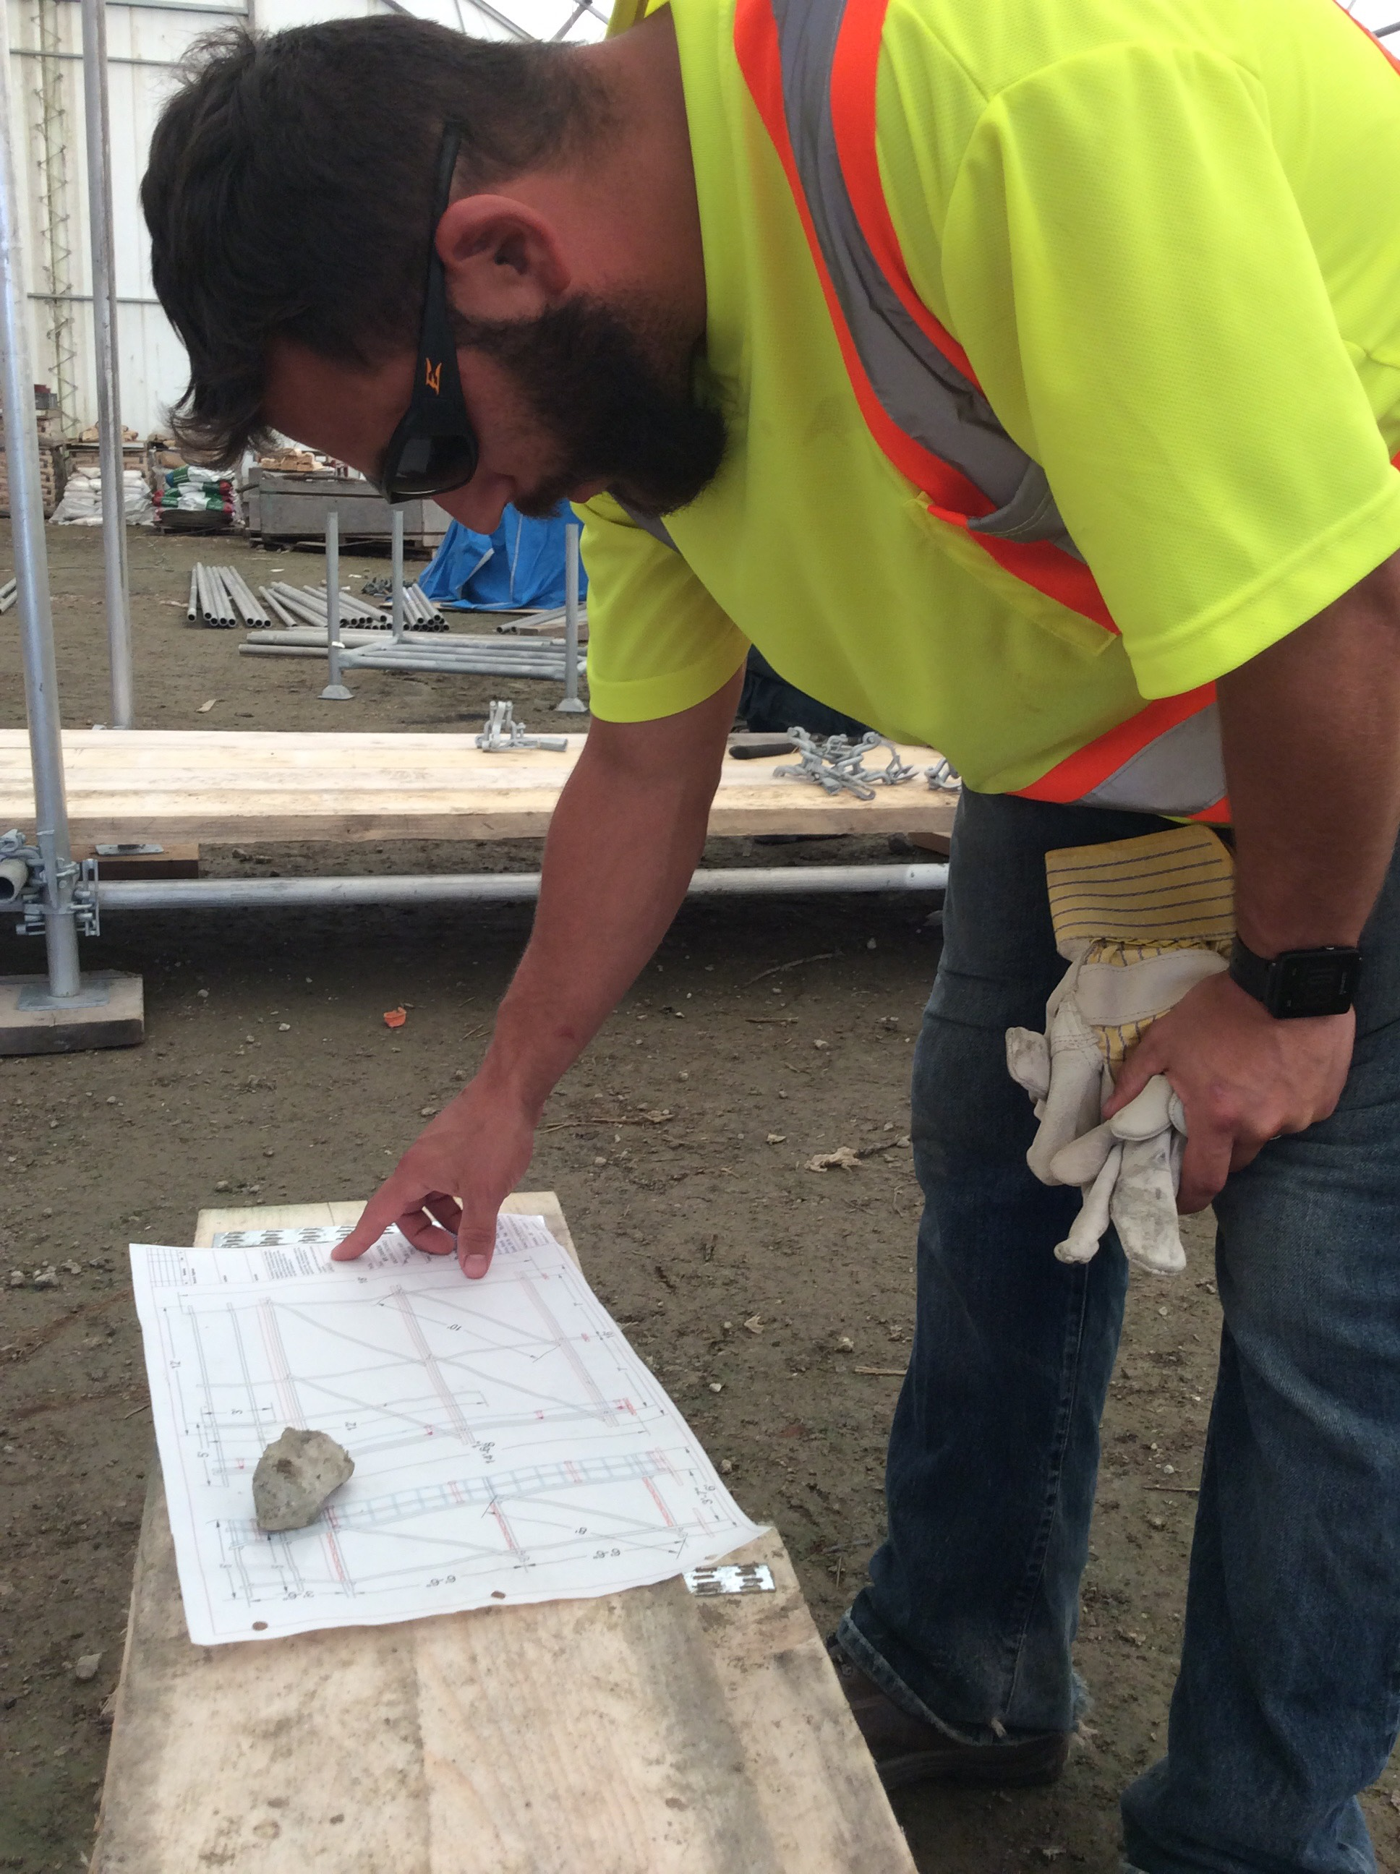
Your Scaffold Plan
Once you know the requirements of the project, you can develop a plan.
A plan, is a sketch or drawing, that allows you to figure out the scaffold design on paper.
You can develop your equipment list from a sketch or drawing of the scaffold configuration.
Notes:
Discuss the ways in which plans can be helpful for scaffold builders. Explain that a plan can be as simple as a sketch or drawing. Describe how an equipment list can be developed once the sketch or plan has been made.

Slide 30
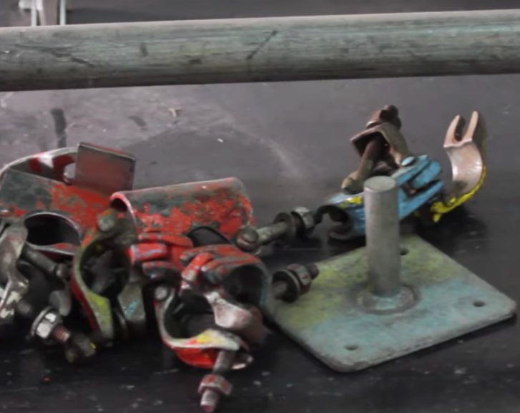
SELECTING YOUR EQUIPMENT
Once you have a good understanding of the job, you can determine the following:
  Scaffold height
  Scaffold width
  Scaffold length
  Type of platform
  Number of platforms
  Type of Access
Notes:
Discuss the factors that influence the selection of Tube & Clamp Scaffold equipment. Explain that decisions can be made about what equipment is needed but a sketch or plan will help determine how much of each component is required.

Slide 31
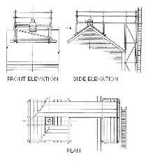
SKETCH OF SCAFFOLD
A good sketch of a scaffold shows PLAN view and ELEVATIONS (front, side)
PLAN VIEW: Shows scaffold from ABOVE
ELEVATIONS: Show scaffolds from the FRONT and SIDE
Sketches don’t have to be perfect.
Sketches should also show IMPORTANT DETAILS such as tie design & placement (if required).
Notes:
Point out the three views on the image (you may need to help some trainees visualize these three views by pointing to a feature of the drawing – like the point of the roof – and show where it is located in each view).

Slide 32
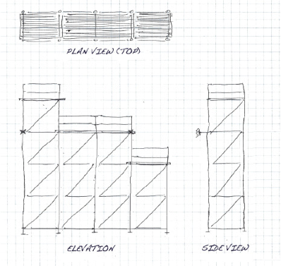
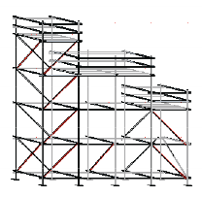
SKETCHING
Notes:
Explain how sketching a plan of the scaffold can be helpful when preparing equipment lists and communicating with scaffold builders and users. Point out the different types of views shown here (elevation, plan view, side view etc.)

Slide 33
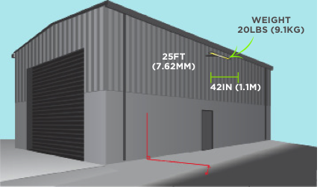
LEARNING ACTIVITY
Notes:
Discuss the learning activity on page 49 and (if possible) sketch how the scaffold for this scenario should look.

Slide 34
Key points
Tube & Clamp Scaffolds can be constructed many ways:
Single Bay (Tower) Scaffold, Scaffold Runs or Area Scaffolds.
Often used for circular scaffolds and around circular structures.
A plan, (in the form of a sketch or drawing), helps you figure out the scaffold design on paper.
Develop your equipment list from a sketch or drawing of the scaffold.
It is possible to make an equipment list from a mental picture of what is required, but errors can easily result.
Your sketch should show different views of the scaffold and include important details such as tie design and placement (if required).
Notes:
Review the KEY POINTS from this session.

Slide 35
Key points
Plan view: how the scaffold looks as seen from above
Elevation: how a scaffold looks from the front or the side
Graph paper can be a helpful tool to allow you to draw your scaffold to scale.
Adding lifts above the first level requires workers to hand scaffold components up to a worker on the platfom. As you build higher, a hoisting line or a wheel pulley may be required.
Buttresses provide stability when a scaffold’s height-to-base width ratio exceeds 4:1 (or 3:1 depending on your jurisdiction).
Notes:
Review the key points from this session.

Slide 36
MULTI-BAY SCAFFOLDS
SYSTEM scaffolds can be BUILT in different configurations
4

Slide 37
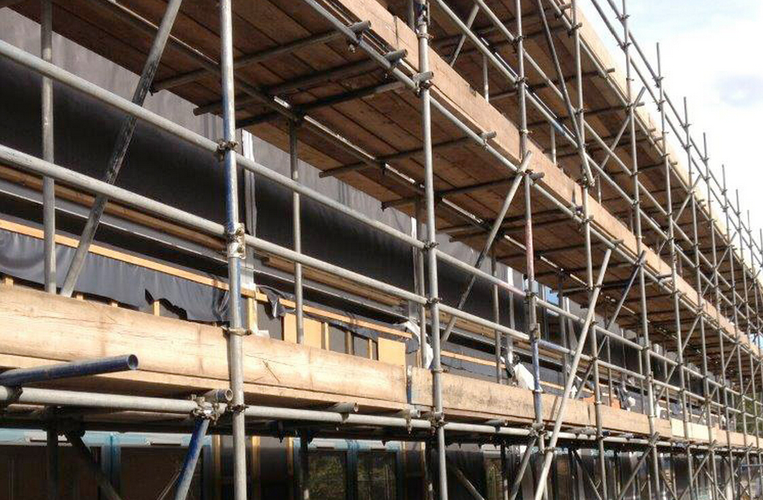
SCAFFOLD RUN
A scaffold run can be built to any length and height.
Building a scaffold run involves attaching bays lengthwise.
Once the run is built to the desired length, additional lifts can be added.
Scaffold Runs may have working platforms at several levels.
Notes:
Describe scaffold runs and where they are typically used.
Describe the process of adding bays and lifts.

Slide 38
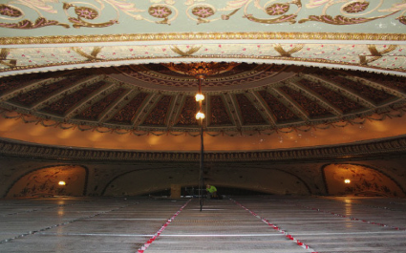
AREA SCAFFOLDS
Area scaffolds, provide a large working area. The top level is planked to form the platform for work on/near ceilings.
Except for the working levels in the perimeter bays, an Area Scaffold should have only one working level, at the top.
PUTLOG (TRUSSES)
STRINGER & JOISTS
Notes:
Describe area scaffolds and what types of jobs they are typically used for. Explain how area scaffolds are constructed.

Slide 39
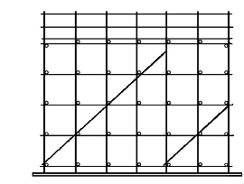
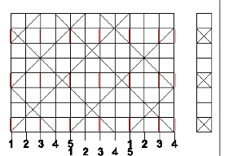
BRACING
Notes:
Explain the importance of bracing and describe how and where to install bracing on Tube & Clamp Scaffolds. Emphasize the importance of following manufacturer’s instructions for bracing of specific Tube & Clamp Scaffold Equipment.

Slide 40
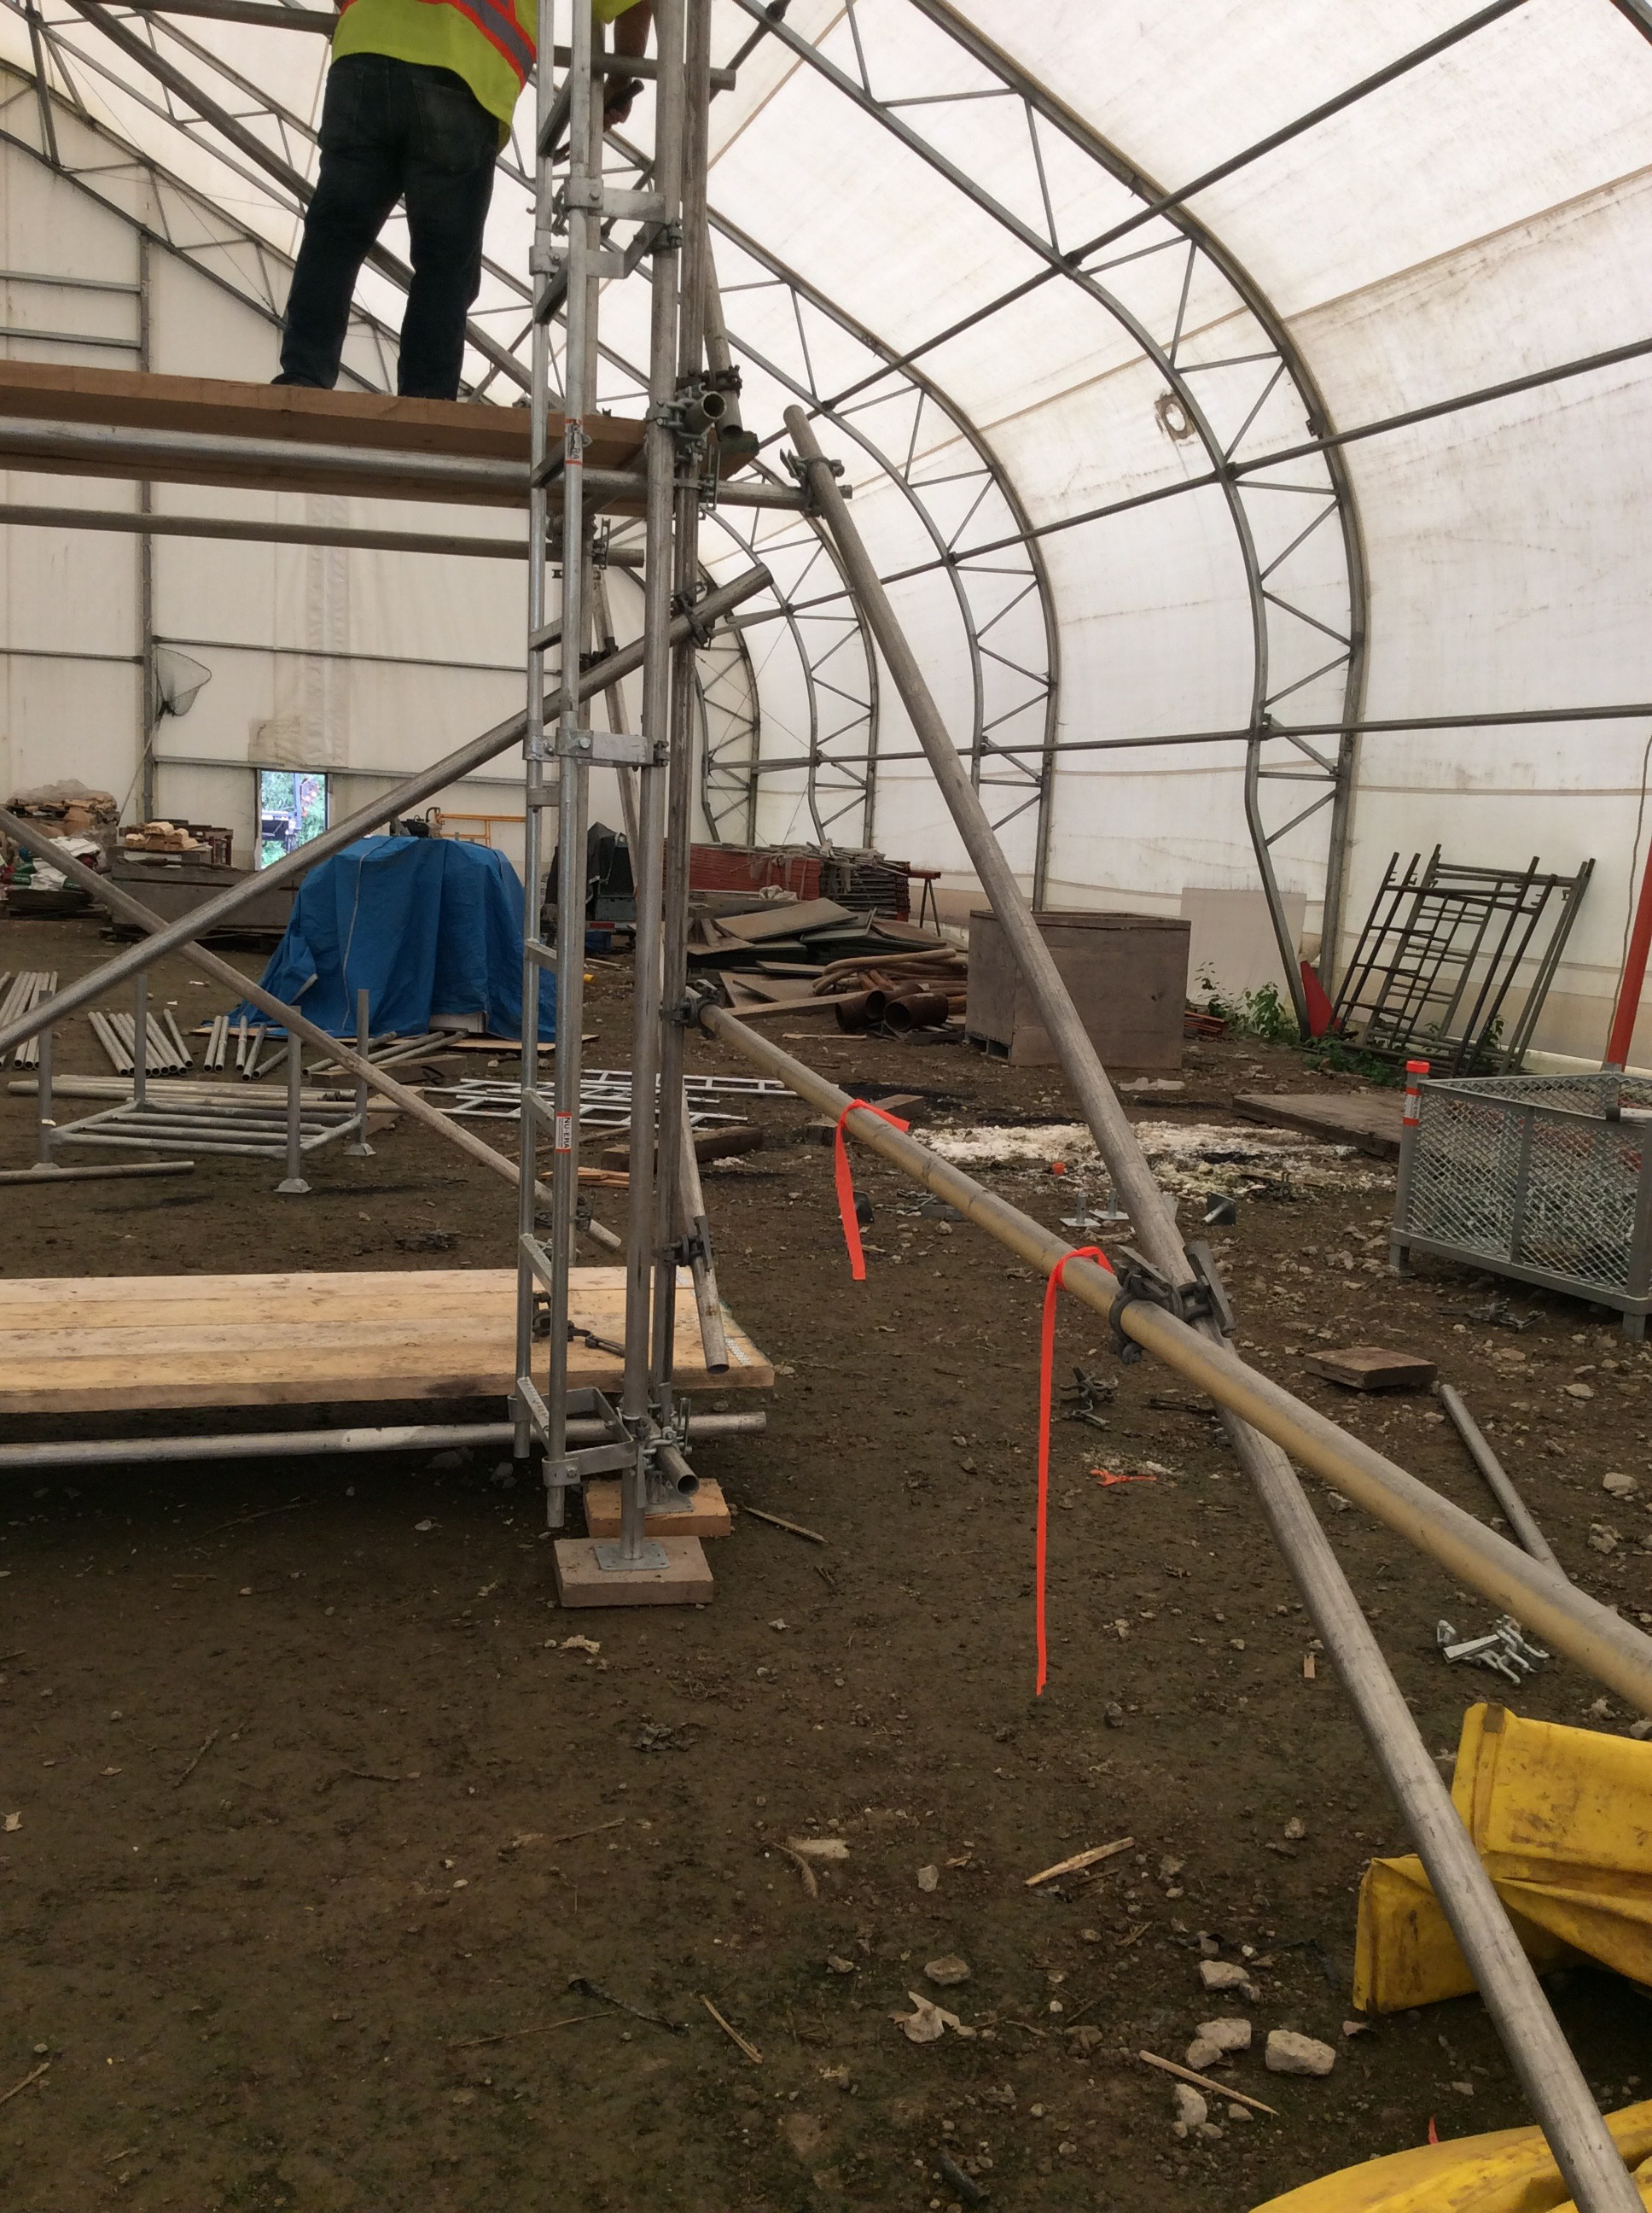
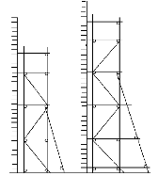
BUTTRESSES
Buttresses provide support to act against lateral (sideways) forces by enlarging the base.
Allows you to build higher scaffolds.
Regulations call for a scaffold to be secured whenever you exceed a 4:1 height-to-base width ratio (or 3:1 in some jurisdictions).
Notes:
Explain that as the scaffold gets higher it may be necessary to secure the scaffold. Discuss buttresses and how they are attached to the scaffold tower. Explain the diagram shown here and discuss why the buttresses are built differently for each tower.

Slide 41
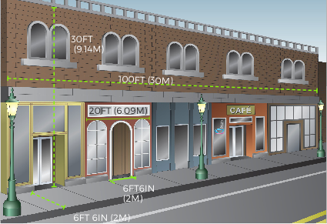
LEARNING ACTIVITY
Notes:
Discuss the Learning Activity on page 60 and roughly sketch out (if you have a whiteboard) what the design of the scaffold for this scenario should look like. Discuss what equipment will be needed for this scaffold.
Note for instructor: This scaffold could be considered to be a pedestrian walkway. There are specific requirements for Pedestrian walkways: This scaffold could be considered as such and would be subject to different requirements, usually dependent on local building codes. Be Sure to check. We will not deal with that for this exercise.

Slide 42
LEARNING ACTIVITY
Notes:
Discuss the Learning Activity on page 64 and roughly sketch out (if you have a whiteboard) what the design of the scaffold for this scenario should look like. Discuss what equipment will be needed for this scaffold.

Slide 43
Key points
Scaffold Runs consist of multiple bays one bay wide. Building a scaffold run involves attaching bays lengthwise
Once the run is built to the desired length, additional lifts can be added.
Scaffolds higher than the allowable height-to-base ratio, must be secured with ties or guy wires or the minimum base width must be increased using buttresses.
Area Scaffolds usually have only one platform at the top
Braces must be connected at every lift. Internal braces in every third bay (or according to regulations), and with sway braces starting in every fifth bay.
Notes:
Review the key points from this session.

Slide 44
Key points
Bracing for Tube & Clamp Scaffolds must always be installed as you build. Always follow manufacturer’s instructions regarding bracing.
Transverse braces (bracing between the front and back of the scaffold) should be installed to keep the scaffold plumb.
Sway bracing, or facade bracing, starts first, last and on 5 post increments. It may be located in a single bay or extend across several bays.
The configuration of the scaffold will determine the best layout arrangement for all ties and bracing.
Notes:
Review the key points from this session.

Slide 45
MULTI-LIFT & BAY SCAFFOLDS
SYSTEM scaffolds can be built to any height, length or width
5

Slide 46
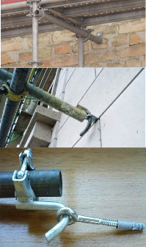
HIGHER MULTI-LIFT SCAFFOLDS
Ties ensure the stability of a scaffold.
Ties must be used when the scaffold exceeds a permissible height- to-base ratio.
A tie must be capable of restraining the scaffold from falling or leaning away from the wall or leaning toward the wall.
Notes:
Discuss the different types of ties and the different ways ties can be constructed. Emphasize the importance of ties for stabilizing higher multi-lift scaffolds.

Slide 47
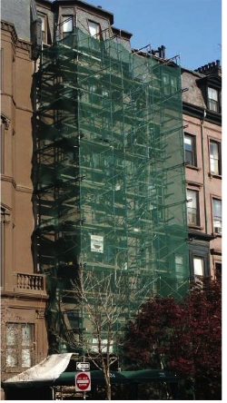
ENCLOSED SCAFFOLDS
Enclosed Scaffolds are usually covered with netting, tarpaulins, plastic sheeting, or plywood.
Enclosed Scaffolds are used for: weather protection, preventing materials from spreading or debris falling.
Enclosed Scaffolds are subjected to much greater loads than standard scaffolds.
When using scaffold equipment used for hazardous material abatement the entire scaffold structure must be tightly enclosed to keep the hazardous material in.
Notes:
Discuss the increased loads that enclosed scaffolds are subjected to and the importance of having a qualified person design the scaffold (including the ties required).

Slide 48
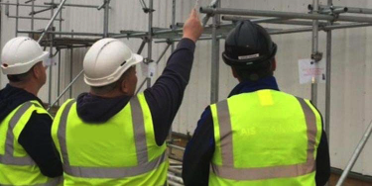

INSPECTING COMPLETED SCAFFOLDS
The Competent Person must inspect the completed scaffold to ensure it is safe.
Scaffold inspections must be made after the scaffold is built, before it is used and at minimum once a day, at the change of each shift, or after something happens that could have altered the scaffold.
The three-colored tag system notifies workers of the construction or modification status of the scaffold to maximize safety.
Notes:
Clearly outline the Competent Person’s responsibilities regarding scaffold inspections.
Explain how often scaffolds must be inspected and that this is a MINIMUM.
Describe the three color tag system and how it works.

Slide 49
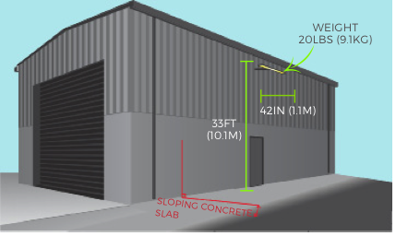
LEARNING ACTIVITY
Notes:
Discuss the Learning Activity on page 49. If possible sketch out the scaffold design (on a whiteboard) and the type of tie that should be used in this scenario.

Slide 50
Key points
Enclosed Scaffolds are used for: weather protection, preventing materials from spreading or debris falling.
Enclosed Scaffolds are subjected to much greater loads.
protect scaffold equipment from contamination.
Before the scaffold can be used, the Competent Person must review regulations and inspect the scaffold to ensure it is safe and can support intended loads.
Codes of Safe Practices are good references for building safe scaffolds.
A Scaffold Inspection Checklist can be a helpful tool.
Notes:
Review the key points from this session.

Slide 51
Key points
Ties to a STABLE existing structure ensure the scaffold’s stability.
Ties are required when the scaffold is enclosed or exceeds allowable HEIGHT-TO-BASE RATIO.
Tension COMPONTENT (prevent the scaffold falling away from the structure), and compression COMPONENT (prevents the scaffold falling into the structure).
Check your local regulations for the required spacing of ties and MAKE SURE all the required ties are in place.
Ties should be placed near the top bearer or horizontal member of the frame.
Notes:
Review the key points from this session.

Slide 52
DISMANTLING & STORAGE
Dismantling scaffolds exposes workers to the same hazards as building them
6

Slide 53
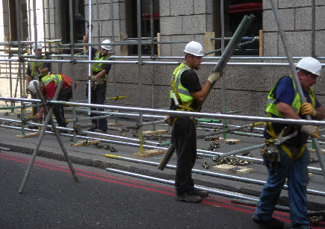
Dismantling
Dismantling scaffolds requires the same knowledge, skills and planning as building them.
You MUST visually inspect the scaffold and address potential hazards before dismantling.
Remove top tie first (all other ties must be removed last at each tie level).
Components should be removed in reverse order of how they were built.
Carefully lower components down to workers below (make sure they are standing in a safe position). DO NOT throw/drop components down.
VISUAL INSPECTION
Cerebelum
Notes:
Discuss the most important points to remember when dismantling Tube & Clamp Scaffolds.
Remind the trainees that the dismantling of the scaffold is as important a part of the PRACTICAL ASSESSMENT as the building and you expect them to work safely and remove components in the correct order. No matter how short you are on time – DO NOT allow them to rush the dismantling process.

Slide 54
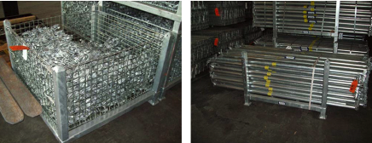
STORAGE
Improperly stored equipment can cause damage and make equipment unsafe
Store equipment to provide easy access
Provide proper support (dunnage)
Provide proper blocking between layers of equipment
Store different size parts in separate stacks
Provide bins for small parts
Separate damaged equipment (discard or repair)
Do not stack equipment too high
Notes:
Explain that while trainees may not be responsible for the storage of the equipment they are using, it is still important to stack equipment neatly and group similar sized components together for easy pick-up and storage. It may be important to compare what is there with the original shipment list to ensure nothing has gone missing. Emphasize the importance of separating and tagging any damaged components so they are not re-used.

Slide 55
Key points
Dismantling should be done carefully.
A Competent Person must inspect the scaffold before dismantling to make sure the scaffold is stable.
Workers at lower levels MUST not get ahead of the dismantlers by removing braces, planking, or guardrails to “speed up the job.”
Wear the proper personal protective equipment when dismantling.
Notes:
Review the key points from this session.

Slide 56
Key points
Check platforms for loose items that could fall off during dismantling.
Remove the guardrails and posts first (workers should be tied off to prevent falls).
Workers below should stand in a safe position during dismantling.
Never leave partially-dismantled scaffold unguarded or without proper barricades.
Examine components for damage and separate them for later disposal or repair.
Once all the scaffold components have been inspected it is important to store them properly.
Notes:
Review the key points from this session.

Slide 57

TIME FOR THE PRACTICAL ASSESSMENT
Review the scaffold drawing/plan before you begin to build.
You MUST wear all appropriate Personal Protective Equipment.
Work safely and communicate/collaborate with your team.
When you have finished building your scaffold, use the Scaffold Inspection Checklist in your Tube & Clamp Scaffolds Study Guide (page 35) to ensure that your scaffold has been built safely and correctly.
Notes:
Stop the presentation here and review the requirements of the Practical Assessment with the trainees.
Provide them with a drawing or plan for the scaffold you want them to build.
Ensure they are wearing all appropriate Personal Protective Equipment.
After the scaffold(s) have been built – have the trainees inspect their scaffold using their Inspection Checklists.

Slide 58
PRACTICAL ASSESSMENT DEBRIEF
What went well?
What could we have done better?
What did you learn that you will do differently from now on?
What (if anything) did you find during your inspection that needed to be addressed?
Did you discuss and make a plan before dismantling? (why or why not?)
Notes:
After the equipment has been stacked or put away. Share your observations of the build with the trainees (what you saw that they did well and what you feel they could have improved). Allow them the opportunity to share their answers to these debrief questions. REMEMBER – THIS IS YOUR OPPORTUNITY TO CORRECT ANY UNSAFE OR INCORRECT PRACTICES.

Slide 59
REVIEW
In preparation for the Written Assessment, let’s go over some of the KEY POINTS of the course…
Notes:
REMEMBER – THIS IS YOUR OPPORTUNITY TO CLARIFY ANY INFORMATION OR EXPLAIN ANY CONCEPTS TRAINEES SEEM UNCLEAR ON.

Slide 60

Contact Us:
Scaffold & Access Industry Association
400 Admiral Blvd. KC, MO 64106
816.595.4860 info@saiaonline.org

