Slide 2
SYSTEM SCAFFOLDS
VERSATILE AND EASY TO PUT TOGETHER
1

Slide 3
Learning Outcomes:
By the end of this part of the course you will be able to:
SYSTEM SCAFFOLDS
MULTI-BAY SCAFFOLDS
1
4
Recognize, identify and inspect components of a basic System Scaffold and related accessories.
Build area scaffolds and scaffold runs by adding additional bays lengthwise and widthwise and sketch a scaffold design,
BUILDING SYSTEM SCAFFOLDS
MULTI-BAY & LIFT SCAFFOLDS
2
Build a basic System Scaffold and add additional lifts. Inspect a completed scaffold before use.
5
Stabilize higher scaffolds using ties, identify important considerations when building enclosed scaffolds and develop more detailed sketches.
ROLLING TOWER SYSTEM SCAFFOLDS
Dismantling & Storage
3
Identify components of a basic rolling tower System Scaffold and learn how to build a rolling tower scaffold and prepare an equipment list.
6
Prepare to dismantle scaffolds safely. Store scaffold equipment properly to prevent damage.
Notes:
Briefly go over the Learning Outcomes for the Systems portion of the course.

Slide 4
SYSTEM SCAFFOLDS
System Scaffolds are versatile and fairly easy to put together.
Made from steel or aluminum tubes with special connections for joining the different components together.
Multiple connection points allow work platforms to be located at different levels.
Flexibility in the connections, and the ability to use different length members, allow System Scaffolds to fit around non-rectangular shapes.
Notes:
Describe the features and range of uses for System scaffolds

Slide 5
SYSTEM SCAFFOLD COMPONENTS
Notes:
Briefly review the various components of a basic System Scaffold and describe their function.

Slide 6
CONNECTION TYPES
V-LOCK: Fittings on the ends of the horizontal members fit into the four V locks and held in place with a wedge
V-LOCK
DOUBLE RING
DOUBLE RING: Up to 8 horizontal members can be connected to the rings at any position.
CUPLOCK: Allows horizontal members to be connected at any position around the post.
RING/ROSETTE: Eight holes allow flexibility in where members can be connected.
CUPLOCK
RING/ROSETTE
Notes:
Describe the different System Scaffold connection types, how they work and the advantages of each.

Slide 7
INSPECTING YOUR EQUIPMENT
You must properly inspect your equipment.
Many accidents have occurred due to damaged or faulty scaffold equipment.
Before you begin building your scaffold – you MUST inspect all the components you plan to use to ensure they are safe and work properly.
Do NOT use any damaged or defective equipment.
Notes:
Discuss the importance of inspecting equipment before beginning to build a scaffold.

Slide 8
INSPECTING POSTS
Posts must be straight. No splits, cracks, dents, kinks or dimples.
No missing or broken connection points.
No cracked or broken welds at connection points.
Bottom must be open, free of debris and suitably round to fit over a coupling pin.
COUPLING PIN
POST
Connection POINTS
WELD AREAS
UNAUTHORIZED MODIFICATIONS
GENERAL APPEARANCE
BOTTOM
Notes:
Describe what to look for when inspecting posts.

Slide 9
INSPECTING HORIZONTALS/DIAGONALS
Learn to recognize possible defects or unsafe conditions:
structural damage
modification (field welds)
missing parts or pieces,
damage (splits, cracks, holes and/or broken welds)
excessive corrosion (pitting or flaking)
discoloration due to caustic chemicals.
TUBE
CONNECTION
POINTS
WELD AREAS
UNAUTHORIZED MODIFICATIONS
GENERAL APPEARANCE
Notes:
Explain the significance of the frame dimensions shown.

Slide 10
BASES
Screwjacks are used for leveling the scaffold when the foundation is uneven.
When the lower level of runners and bearers are in place, the structure can be leveled.
System Scaffolds should be built using screwjacks.
A base collar provides lateral bracing to the base of the scaffold and can be useful for setting up and leveling the scaffold base.
Notes:
Describe the types of Screwjacks available and review how they are used.
Describe Base Collars and explain their function and how they must be installed.

Slide 11
INSPECTING BASES
Fixed Heads
ENDS
WELDS
SPIGOT
ADJUSTMENT
HANDLE
PIN HOLE
THREADS
PLATE
GENERAL APPEARANCE
GENERAL APPEARANCE
Notes:
Describe what to look for when inspecting bases.

Slide 12
BRACKETS
Brackets are a common component used to extend the length and/or width of the scaffold platform. They are designed to carry workers only.
Brackets attach the same way as other System Scaffold components.
The width of the bracket varies from one, two and three planks wide, allowing the scaffold builder to choose the right width for the specific project.
Notes:
Discuss when brackets might be needed and explain that they are to be used to support workers only.

Slide 13
INSPECTING BRACKETS
HOOK
Equipment manufacturers often provide inspection guidelines for their products. You should use manufacturer’s inspection guidelines for any equipment you plan to use.
LEDGER, BRACE & BACK
WELDS
GUaRDRAIL POST ATTACHING MEMBER
BOTTOM UNIT
GENERAL APPEARANCE
Notes:
Point out the parts of brackets and explain what to look for when inspecting them.

Slide 14
LATTICE GIRDERS
Lattice girders are used for spanning larger openings.
Platforms may be built above the lattice girders to provide a working
surface.
Notes:
Describe what lattice girders are, and describe situations where these would be required.

Slide 15
Inspect the scaffold equipment that has been provided for the practical (hands-on) component of this course.
Notes:
Have trainees get up and go inspect the equipment that is to be used for the Practical Assessment.

Slide 16
Key points
Intermixing of System Scaffold equipment from different manufacturers is discouraged.
Brackets extend the length and/or width of the scaffold platform. They are designed to carry workers only.
Lattice girders are used for spanning openings.
Selecting the right equipment for the job is important for safety and efficiency.
Notes:
Review the key points from this session.

Slide 17
Key points
Jobsite conditions, equipment availability and user requirements determine what equipment to use.
When components are missing or incompatible Accidents can happen.
Thoroughly inspect scaffold equipment or components before use. Learn to recognize defects or unsafe conditions.
Inspect scaffold for: structural damage, modification, missing parts, damage, corrosion and other defects.
Notes:
Review the key points from this session.

Slide 18
Building SYSTEM Scaffolds
A basic SYSTEM Scaffold unit is the building block for all configurations
2

Slide 19
SYSTEM TOWERS
Spacing of the posts are determined by the application, the load and the required configuration.
Guardrails are required on all open sides and ends of work platforms.
The scaffold leg is supported by the foundation, the sill, and the baseplate.
Platforms must be fully planked or decked.
Proper access is required
Notes:
Point out the different components of the basic System Scaffold and discuss the importance of including guardrails, fully-planked platforms and providing proper access

Slide 20
1
Select and inspect the equipment
2
Prepare the foundation
3
Determine the highest starting point
5
Position
the bases
6
Position
the HORIZONTALS
4
Set the sills
8
AttACH RUNNERS
&
BEARERS
9
Attach BRACES
10
ATTACH ACCESS & TAG
11
INSTALL &
SECURE THE PLATFORM
12
INSTALL
GUARDRAIL
SYSTEM & TOEBOARDS
7
Position the
POSTS
13
INSPECT THE SCAFFOLD
Powerful
Suitable for all categories business and personal presentation
Notes:
Briefly describe each step in the process of building a basic System Scaffold unit. Discuss the importance of inspecting the scaffold before it is used and how often it should be inspected afterwards.

Slide 21
access
Proper access is required for all scaffolds. This access must safely permit a worker to gain access to the platform.
It is good practice to extend your ladder 36in (914 mm) above the platform so that the worker has a hand hold as he/she climbs onto or off the platform.
If the climb is higher than 30ft to 35ft (9.1m to 10.7m), a rest platform may be required.
Approximately 15% of scaffold-related injuries occur when workers are climbing up and down.
Use safe
climbing
techniques
(3-point
contact
as shown).
Notes:
Discuss proper access and best practices when installing access. Refer to any relevant regulations related to access (these should already have been discussed in Scaffold Fundamentals Section 2 so just a brief reminder). Discuss the importance of 3 points of contact when climbing ladders.

Slide 22
Notes:
Discuss the learning activity as a group or have trainees work in pairs to answer the questions on page 34.

Slide 23
Key points
A basic SYSTEM Scaffold unit is the building block for all scaffold configurations.
The length of posts and horizontal members depends on: application, required height, required platform size, and available space.
Tube & Clamp components can be used with System Scaffolds
System Scaffolds must be built according to the steps provided to insure that the scaffold is structurally sound, strong, safe and in compliance with the regulations
A guardrail system or personal fall arrest system is required on all open sides and ends of working platforms
Notes:
Review the key points from this session.

Slide 24
Key points
Platforms must be FULLY PLANKED OR DECKED.
Begin with a firm foundation and clear the area.
Level, square, and plumb the scaffold to avoid problems.
The three-colored tag system is used on many job sites to let workers know when the scaffold is and isn’t safe to use.
The Competent Person MUST INSPECT the scaffold BEFORE IT IS USED, AT THE CHANGE OF EACH SHIFT, and at minimum, it should be inspected ONCE A DAY, or after something happens that could have affected the scaffold’s stability.
Notes:
Review the key points from this session.

Slide 25
ROLLING TOWER SCAFFOLDS
Rolling Tower Scaffolds can be easily moved
3

Slide 26
ROLLING SCAFFOLDS
Bases use casters instead of baseplates
Requires a Horizontal Diagonal Brace (or Plan Brace).
The foundation must be a hard flat level surface that can support the anticipated loads.
Notes:
Describe situations when it is advantageous to use a Rolling Scaffold Tower. Point out the elements that differ from a stationary System Scaffold tower.

Slide 27
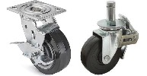
CASTERS
Casters can be inserted into a scaffold post or attached to a screwjack. If used with a screwjack, the maximum screw extension can be no more than 12in (305mm) for the scaffold to be safe.
The caster is fitted with a double acting brake that prohibits the wheel from rolling and the wheel from swiveling.
At least two of the casters on a Rolling Tower Scaffold must be steerable.
It is important not to exceed the rated load capacity of the casters.
Notes:
Describe the features of a proper scaffold caster.
Explain the proper way to attach casters to System Scaffold legs.

Slide 28
HORIZONTAL DIAGONAL BRACE
A horizontal diagonal brace (plan brace) is attached diagonally across the tower from the leg of one frame across to the opposite leg on the adjacent frame.
Provides stiffness to the tower, keeps the tower square while it is being moved, and prevents the tower from “folding up” and collapsing.
The first horizontal diagonal brace is attached at the very bottom of the tower, as close to the casters as possible.
Notes:
Explain the purpose of a horizontal brace and why it is needed for Rolling Towers.

Slide 29
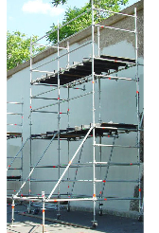
OUTRIGGERS
Outriggers are components that clamp on to the scaffold enlarging the base and allow the tower to be built higher
Outriggers provide stability by increasing the base dimension of a scaffold whenever you are exceeding a 4:1 or 3:1 height-to-base width ratio (depending on the jurisdiction).
Outriggers are commonly used on Rolling Scaffolds but they are also used on stationary towers.
Notes:
Explain the purpose of outriggers and how they help stabilize scaffolds and when they should be used.
Describe the proper placement and process for installing outriggers.

Slide 30
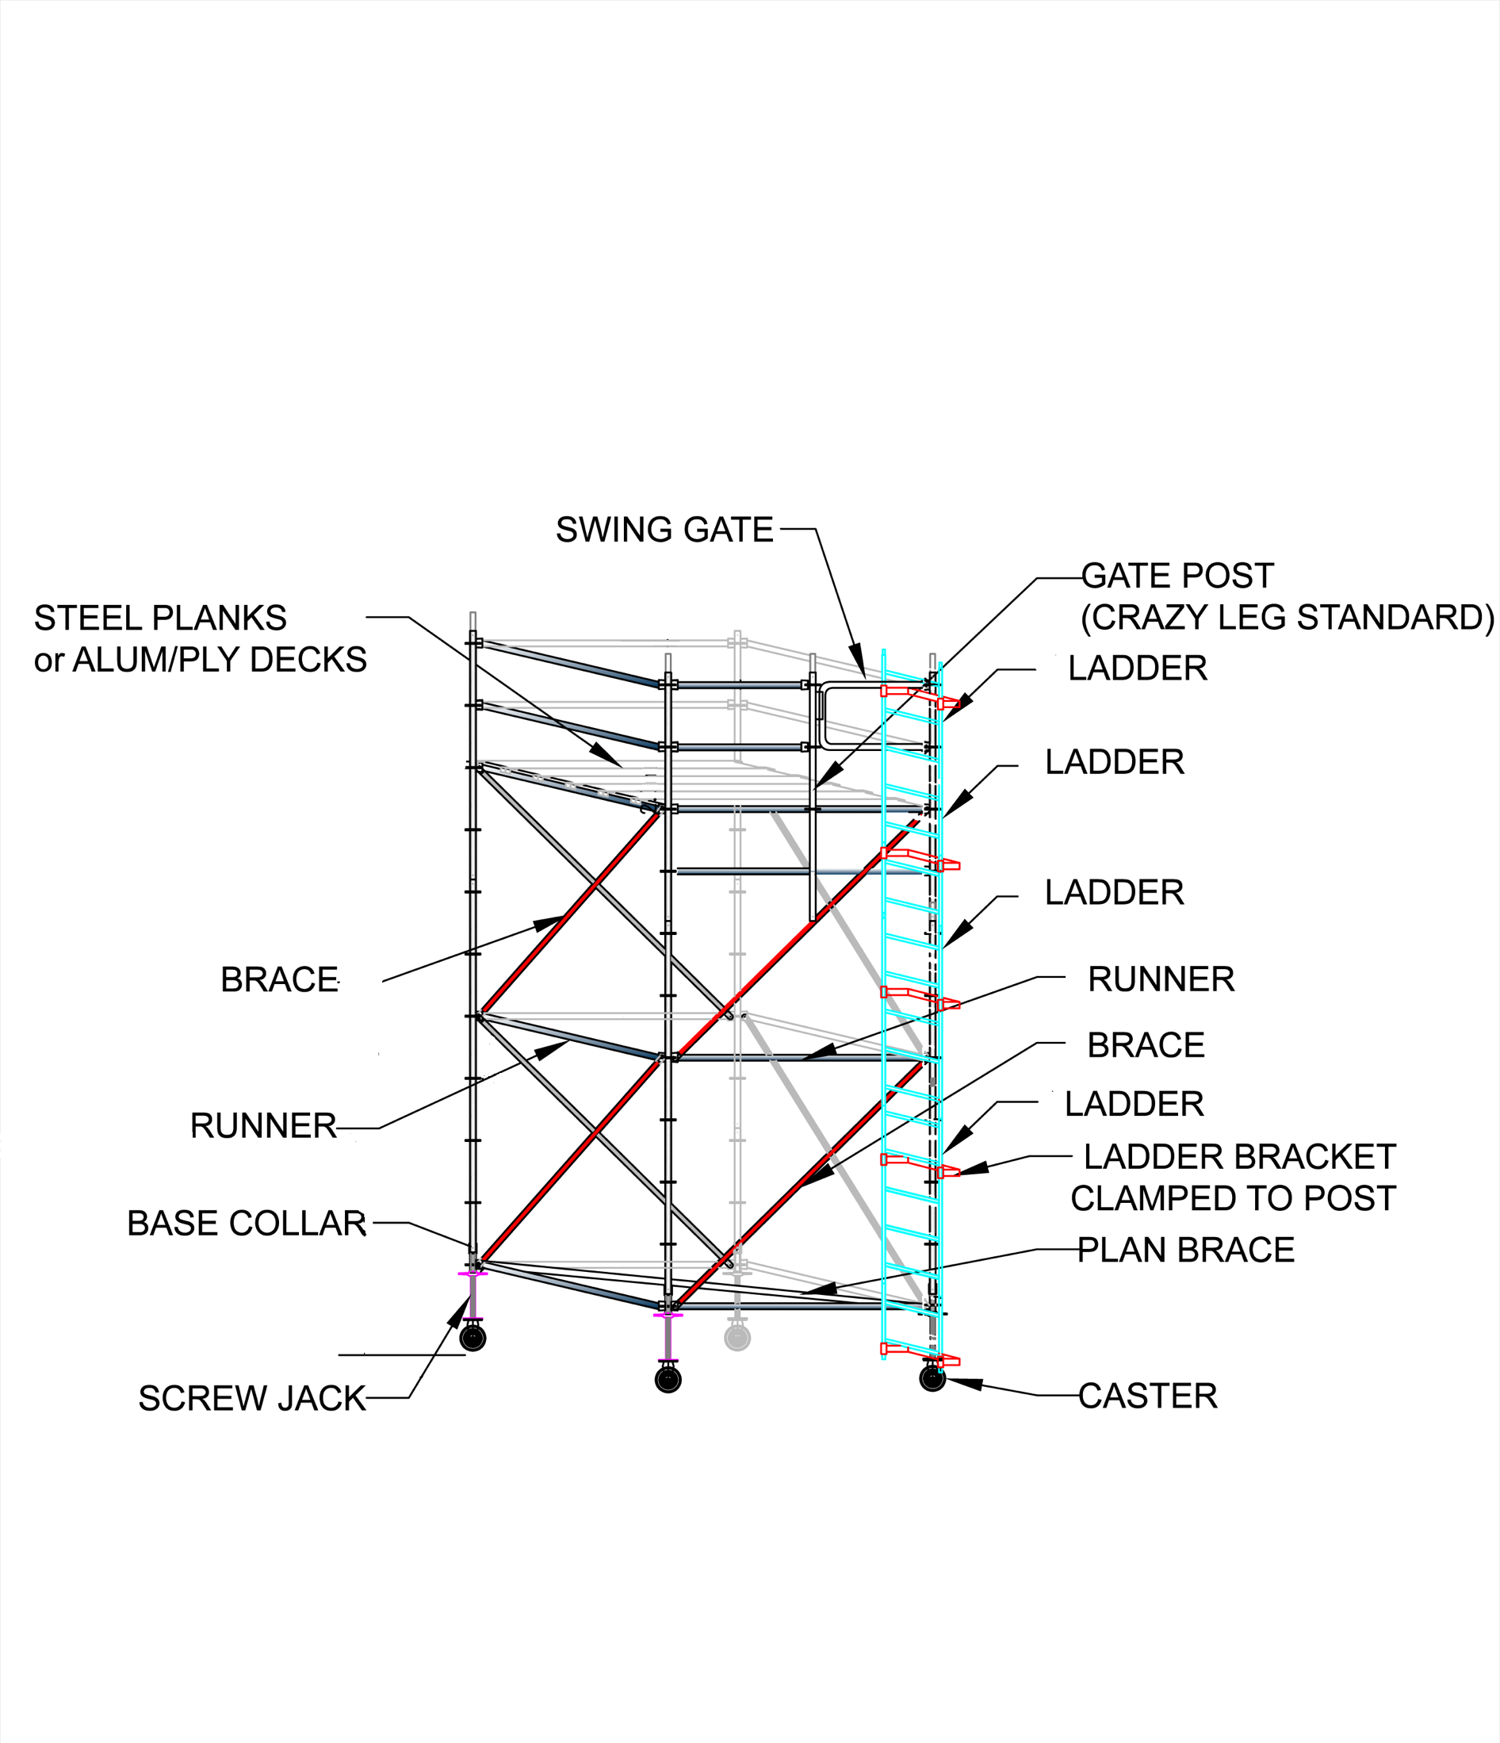
Notes:
Go through the Learning Activity with the group and discuss the equipment required (referring to the equipment list on page 46).

Slide 31
Key points
Rolling Scaffold Towers have casters instead of baseplates and require horizontal diagonal (plan braces)
The foundation must be a hard flat level surface capable of supporting anticipated loads
The caster’s DOUBLE ACTING brake prohibits the wheels from rolling and from revolving (or swiveling)
At least two casters on a Rolling Tower Scaffold must be steerable
Notes:
Review the KEY POINTS from this session.

Slide 32
Key points
A horizontal diagonal brace provides stiffness to the tower, keeps it square while it is being moved, and prevents it from racking (folding up) and collapsing
Outriggers are important safety devices designed to provide stability when a scaffold height-to-base width ratio exceeds 4:1 or 3.1 (depending on your local regulations)
Notes:
Review the key points from this session.

Slide 33
MULTI-BAY SCAFFOLDS
SYSTEM scaffolds can be BUILT in different configurations
4

Slide 34
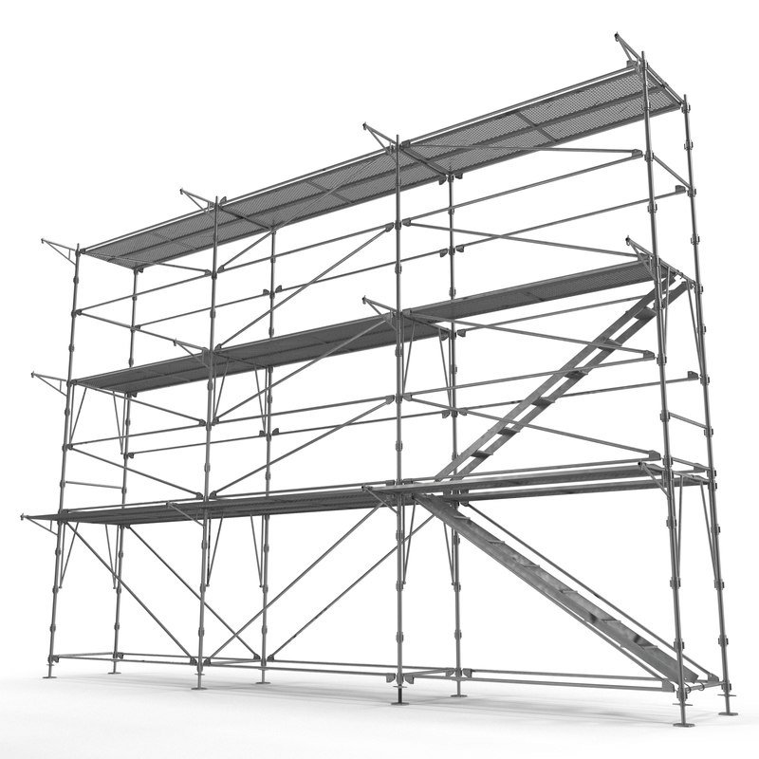
SCAFFOLD RUN
A scaffold run can be built to any length and height.
The process of building a scaffold run involves attaching bays lengthwise to an existing system scaffold tower unit.
Once the run is built to the desired length, additional lifts can be added to reach the desired height.
Scaffold Runs may have working platforms at several levels.
Notes:
Describe scaffold runs and where they are typically used.

Slide 35
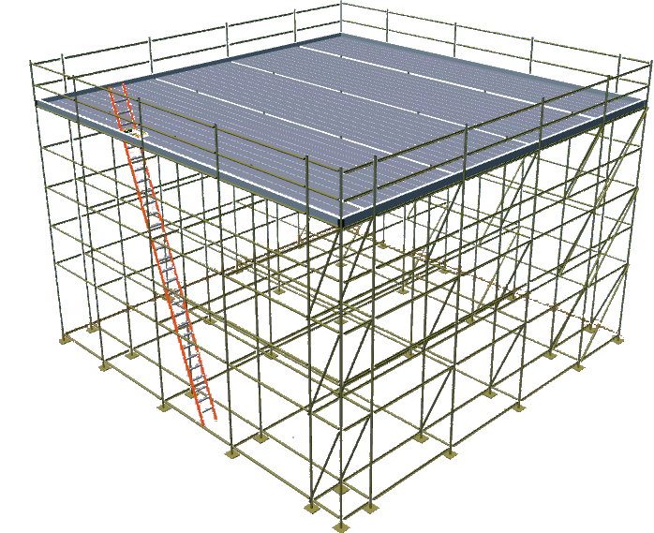
AREA SCAFFOLDS
Area scaffolds, are used to provide a large working area. The top level is planked to form the platform for work on/near ceilings.
Except for the working levels in the perimeter bays, an Area Scaffold should have only one working level, at the top.
PUTLOG (TRUSSES)
STRINGER & JOISTS
Notes:
Describe area scaffolds and what types of jobs they are typically used for.

Slide 36
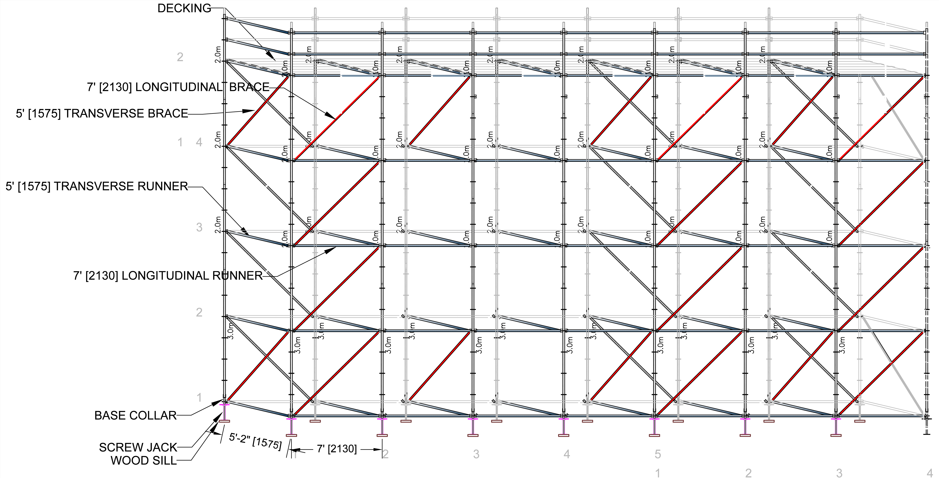
BRACING
Bracing must always be installed as you build.
Bracing should be installed on the first and the last post and on 5 post increments. It may be located in a single bay or across several bays.
Always follow manufacturer’s instructions regarding bracing.
Notes:
Explain the importance of bracing and describe how and where to install bracing on System Scaffolds. Emphasize the importance of following manufacturer’s instructions for bracing of specific System Scaffold Equipment.

Slide 37
SKETCHING
Notes:
Explain how sketching a plan of the scaffold can be helpful when preparing equipment lists and communicating with scaffold builders and users. Point out the different types of views shown here (elevation, plan view, side view etc.)

Slide 38
Notes:
Discuss the Learning Activity on page 62 and roughly sketch out (if you have a whiteboard) what the design of the scaffold for this scenario should look like. Discuss what equipment will be needed for this scaffold.

Slide 39
Notes:
Discuss the Learning Activity on page 66 and roughly sketch out (if you have a whiteboard) what the design of the scaffold for this scenario should look like. Discuss what equipment will be needed for this scaffold.

Slide 40
Key points
System Scaffolds can be constructed many ways including the following three fundamental ways: A Single Bay (Tower) Scaffold, Scaffold Runs or Area Scaffolds. They are often used for circular scaffolds and around odd-shaped or irregular structures.
Square bays by placing a horizontal diagonal brace (plan brace) between two diagonally opposite corner posts or some other method such as a squaring tool (if available).
The specific configuration of the scaffold will determine the best layout arrangement for all ties and bracing. Always follow manufacturer’s instructions regarding bracing requirements for your scaffold equipment.
Notes:
Review the key points from this session.

Slide 41
Key points
Once you know all the requirements of the project, you can develop a plan. This plan, in the form of a sketch or drawing, allows you to figure out the scaffold design on paper.
You can develop your equipment list from a sketch or drawing of the scaffold configuration.
Your sketch doesn’t have to be perfect but it should show different views of the scaffold such as: the plan view and elevations (front and side). It should also include important details.
Graph paper can be a helpful tool to allow you to draw your scaffold to scale
Notes:
Review the key points from this session.

Slide 42
MULTI-LIFT & BAY SCAFFOLDS
SYSTEM scaffolds can be built to any height, length or width
5

Slide 43
HIGHER MULTI-LIFT SCAFFOLDS
Ties ensure the stability of a scaffold.
Ties must be used when the scaffold exceeds a permissible height-to-base ratio.
A tie must be capable of restraining the scaffold from falling or leaning away from the wall or leaning toward the wall.
Notes:
Discuss the different types of ties and the different ways ties can be constructed. Emphasize the importance of ties for stabilizing higher multi-lift scaffolds.

Slide 44
ENCLOSED SCAFFOLDS
Enclosed Scaffolds are usually covered with netting, tarpaulins, plastic sheeting, or plywood.
Enclosed Scaffolds are used for: weather protection, preventing materials from spreading or debris from falling.
Enclosed Scaffolds are subjected to much greater loads than standard scaffolds.
When using scaffold equipment used for hazardous material abatement, the entire scaffold structure must be tightly enclosed to keep the hazardous material in.
Notes:
Discuss the increased loads that enclosed scaffolds are subjected to and the importance of having a qualified person design the scaffold (including the ties required).

Slide 45
INSPECTING COMPLETED SCAFFOLDS
The Competent Person must inspect the completed scaffold to ensure it is safe.
Scaffold inspections must be made BEFORE IT IS USED, at the CHANGE OF EACH SHIFT, and at minimum ONCE A DAY, or AFTER SOMETHING HAPPENS that could have altered the scaffold.
The three-colored tag system notifies workers of the construction or modification status of the scaffold to maximize safety.
Notes:
Clearly outline the Competent Person’s responsibilities regarding scaffold inspections.
Explain how often scaffolds must be inspected and that this is a MINIMUM.
Describe the three color tag system and how it works.

Slide 46
Notes:
Discuss the Learning Activity on page 74. If possible sketch out the scaffold design (on a whiteboard) and the type of tie that should be used in this scenario.

Slide 47
Key points
Enclosed Scaffolds are used for: weather protection, preventing materials from spreading or debris FROM falling.
Enclosed Scaffolds are subjected to much greater loads.
protect scaffold equipment from contamination.
Before the scaffold can be used, the Competent Person must review regulations and inspect the scaffold to ensure it is safe and can support intended loads.
Codes of Safe Practices are good references for building safe scaffolds.
A Scaffold Inspection Checklist can be a helpful tool.
Notes:
Review the key points from this session.

Slide 48
Key points
Ties to a STABLE existing structure ensure the scaffold’s stability.
Ties are required when the scaffold is enclosed or exceeds allowable HEIGHT-TO-BASE RATIO.
Tension COMPONTENT (prevents the scaffold falling away from the structure), and compression COMPONENT (prevents the scaffold falling into the structure).
Check your local regulations for the required spacing of ties and MAKE SURE all the required ties are in place.
The best location for the ties is near the top bearer or horizontal member.
Notes:
Review the key points from this session.

Slide 49
DISMANTLING & STORAGE
Dismantling scaffolds exposes workers to the same hazards as building them
6

Slide 50
Dismantling
Dismantling scaffolds requires the same knowledge, skills and planning as building them.
You MUST visually inspect the scaffold and address potential hazards before dismantling.
Remove top tie first (all other ties must be removed last at each tie level).
Components should be removed in reverse order of how they were built.
Carefully lower components down to workers below (make sure they are standing in a safe position). DO NOT throw/drop components down.
VISUAL INSPECTION
Cerebelum
Notes:
Discuss the most important points to remember when dismantling System Scaffolds.
Remind the trainees that the dismantling of the scaffold is as important a part of the PRACTICAL ASSESSMENT as the building and you expect them to work safely and remove components in the correct order. No matter how short you are on time – DO NOT allow them to rush the dismantling process.

Slide 51
STORAGE
Improperly stored equipment can cause damage and make equipment unsafe
Store equipment to provide easy access
Provide proper support (dunnage)
Provide proper blocking between layers of equipment
Store different size parts in separate stacks
Provide bins for small parts
Separate damaged equipment (discard or repair)
Do not stack equipment too high
Notes:
Explain that while trainees may not be responsible for the storage of the equipment they are using, it is still important to stack equipment neatly and group similar sized components together for easy pick-up and storage. It may be important to compare what is there with the original shipment list to ensure nothing has gone missing. Emphasize the importance of separating and tagging any damaged components so they are not re-used.

Slide 52
Key points
Dismantling should be done carefully.
A Competent Person must inspect the scaffold before dismantling to make sure the scaffold is stable.
Workers at lower levels MUST not get ahead of the dismantlers by removing braces, planking, or guardrails to “speed up the job.”
Wear the proper personal protective equipment when dismantling.
Notes:
Review the key points from this session.

Slide 53
Key points
Check platforms for loose items that could fall off during dismantling.
Remove the guardrails and posts first (workers should be tied off to prevent falls).
Workers below should stand in a safe position during dismantling.
Never leave partially-dismantled scaffold unguarded or without proper barricades.
Examine components for damage and separate them for later disposal or repair.
Once all the scaffold components have been inspected it is important to store them properly.
Notes:
Review the key points from this session.

Slide 54
TIME FOR THE PRACTICAL ASSESSMENT
Review the scaffold drawing/plan before you begin to build.
You MUST wear all appropriate Personal Protective Equipment.
Work safely and communicate/collaborate with your team.
When you have finished building your scaffold, use the Scaffold Inspection Checklist in your System Scaffolds Study Guide (page 31) to ensure that your scaffold has been built safely and correctly.
Notes:
Stop the presentation here and review the requirements of the Practical Assessment with the trainees.
Provide them with a drawing or plan for the scaffold you want them to build.
Ensure they are wearing all appropriate Personal Protective Equipment.
After the scaffold(s) have been built – have the trainees inspect their scaffold using their Inspection Checklists.

Slide 55
PRACTICAL ASSESSMENT DEBRIEF
What went well?
What could we have done better?
What did you learn that you will do differently from now on?
What (if anything) did you find during your inspection that needed to be addressed?
Did you discuss and make a plan before dismantling? (why or why not?)
Notes:
After the equipment has been stacked or put away. Share your observations of the build with the trainees (what you saw that they did well and what you feel they could have improved). Allow them the opportunity to share their answers to these debrief questions. REMEMBER – THIS IS YOUR OPPORTUNITY TO CORRECT ANY UNSAFE OR INCORRECT PRACTICES.

Slide 56
REVIEW
In preparation for the Written Assessment, let’s go over some of the KEY POINTS of the course…
Notes:
REMEMBER – THIS IS YOUR OPPORTUNITY TO CLARIFY ANY INFORMATION OR EXPLAIN ANY CONCEPTS TRAINEES SEEM UNCLEAR ON.

Slide 57
Contact Us:
Scaffold & Access Industry Association
400 Admiral Blvd. Kansas City, MO 64106
816.595.4860 info@saiaonline.org

