Slide 1

Notes:
Leave this slide on the screen until all trainees arrive or until the official start time.

Slide 2


ACKNOWLEDGEMENTS:
This Competent Person Training update was made possible thanks to the generous support of the Scaffold & Access Industry Association Education Foundation (SAIA EF) and the many SAIA members who volunteered their time and expertise.
COPYRIGHT NOTICE
© Copyright 2018 by the Scaffold and Access Industry Association, Inc.
All rights reserved. This work may not be reproduced or transmitted in any form or by any means, electronically or mechanically, including photocopying, recording, or by an information storage and retrieval system without the prior written permission from the Scaffold and Access Industry Association, Inc.
Notes:
Show this slide briefly

Slide 3
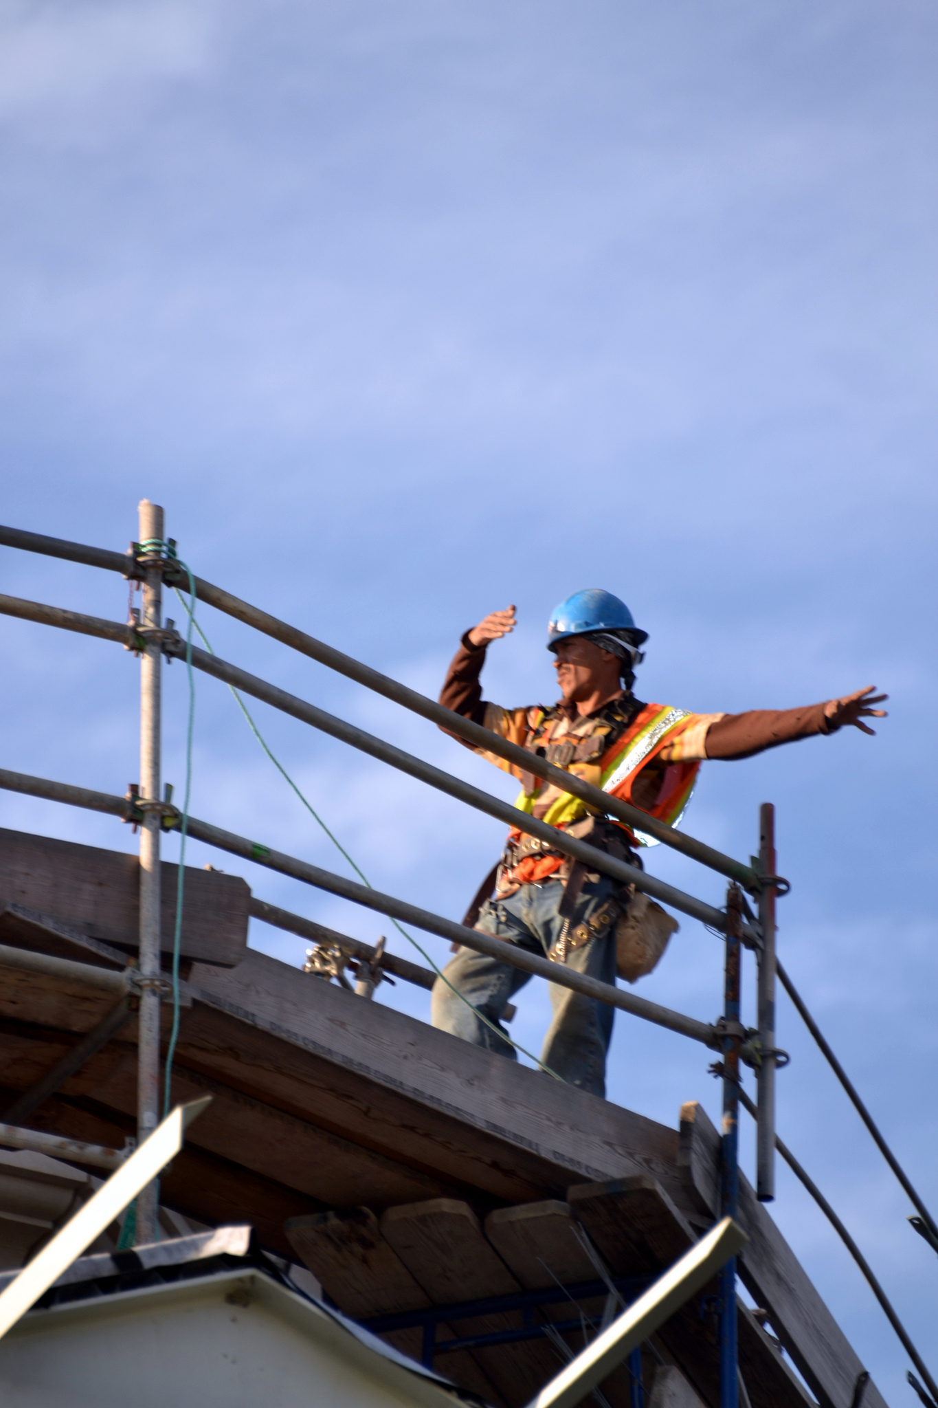


OUR MISSION:
To ensure those who make, install, depend on or govern the use of scaffold and access equipment pursue the highest standards of safety, craftsmanship and ethics.
SAIA provides safety education to thousands of contractors through its training program, SAIA University.
The Scaffold & Access Industry Association (SAIA) is the global leader in advocacy and support on the safe use of scaffold and access equipment. SAIA has provided safety education to thousands of contractors through its renowned seminars and training courses.
Notes:
Explain briefly about the SAIA and the training provided through SAIA University

Slide 4

Welcome to the SAIA Competent Person Training
This course is designed to provide you with the knowledge and skills a Competent Person requires. Only your employer has the authority to designate you as their Competent Person.
A Competent Person is someone capable of identifying existing and predictable hazards and has authority to take prompt corrective measures to eliminate them.
Notes:
Explain that this course is designed to provide trainees with the knowledge and skills they require to be deemed a Competent Person by their employer. EMPHASIZE that ONLY their employer has the authority to designate them as Competent Person.

Slide 5
COURSE AGENDA
Types of Scaffolds
1
Recognize and identify types of supported scaffolds, describe their typical uses and list advantages and disadvantages of each.
2
Scaffold Hazards
Describe the five most common scaffold hazards and explain your responsibilities in relation to Regulations, Codes & Standards.
Notes:
Briefly outline the course agenda and let the trainees know what to expect during the day
CLICK – for each agenda item to appear on screen (continues through to slide 8)

Slide 6
3
Foundations
Describe appropriate supports for scaffolds on different surfaces and explain how to improve poor surface conditions.
4
Platforms
Identify typical platform materials, explain platform regulations, and identify potential platform hazards.
Guardrails & TOEBOARDS
5
Describe guardrail systems and toeboards and explain when they are required. Describe other types of falling object protection.
6
Ties & GUYS
Explain scaffold stability and how ties or guys are used to stabilize scaffolds.

Slide 7


FRAME SCAFFOLDS
Six sessions related specifically to building and inspecting Frame Scaffolds (learning expectations to be described at the start of these sessions)
Practical ASSESSMENT
Demonstrate your ability to build Frame Scaffolds safely and correctly and complete a scaffold inspection.
Review
Briefly review the KEY POINTS from each session to prepare for the written assessment.

Slide 8
WRITTEN ASSESSMENT
Complete a multiple choice written assessment based on KEY POINTS from each session.
Closing
Provide your feedback on our course evaluation form. Have an opportunity to ask any final questions.
End of Course

Slide 9




Listen
Questions
HOUSE-
KEEPING
Practice active listening.
Avoid distractions
It is ok to ask if you don’t understand.
Respect
Time
Safety
Give everyone
your respect.
Keep comments brief. Return from breaks on time.
Work safely and
wear PPE.
Phones
Share
Feedback
Phones on silent. Focus on
the training.
Your knowledge & experiences add
to our training.
Please give honest feedback in your course evaluation.
Notes:
Explain that there are a few ground rules and expectations you want to agree on so everyone benefits from this training. Review each of these ground rules – clarify your expectations around each of these rules
FEEDBACK – explain that at the end there will be a course evaluation and you welcome honest feedback
HOUSEKEEPING – go over any housekeeping details (location of bathrooms, emergency exits etc.)

Slide 10
Types of Scaffolds
Different types of scaffolds and their uses
1
Notes:
Tell the trainees you will begin with a brief introduction to (or review of) the different types of scaffolds.

Slide 11

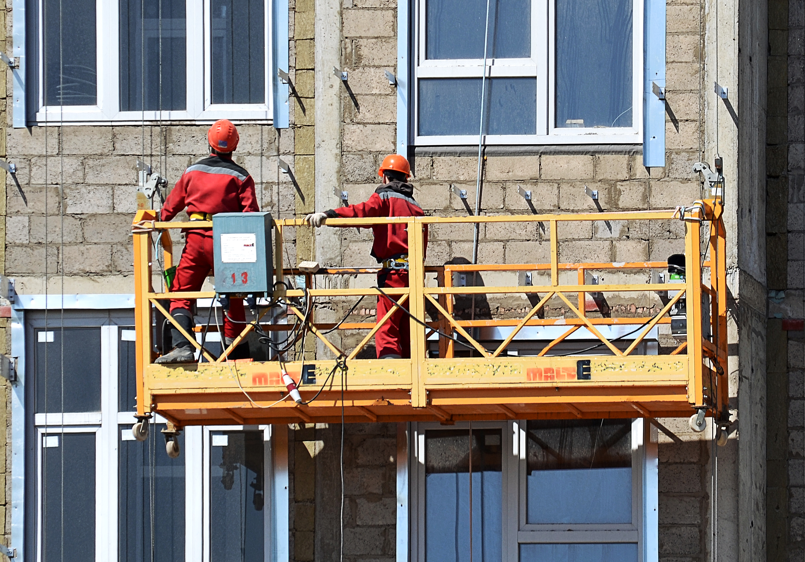
Types of Scaffolds
Supported Scaffold
Suspended Scaffold
Notes:
Explain the difference between Supported and Suspended Scaffolds and give a few examples of each type.

Slide 12
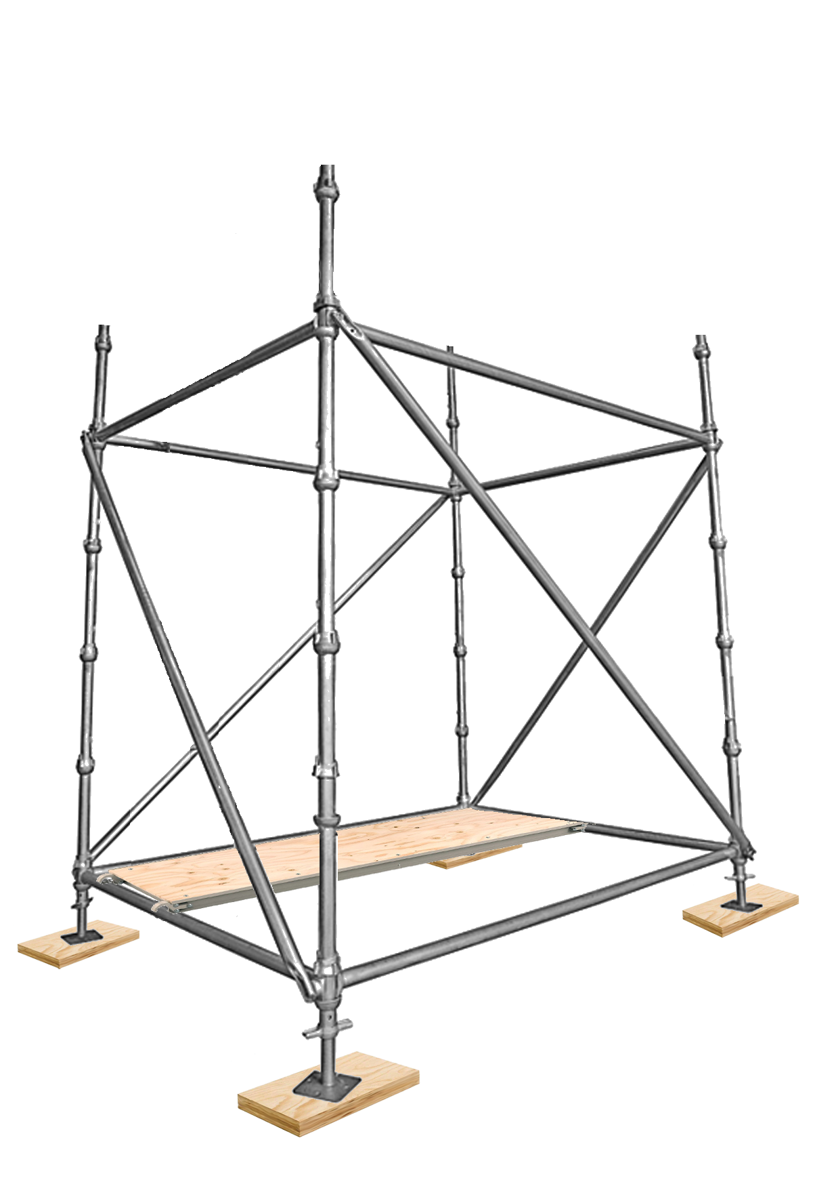
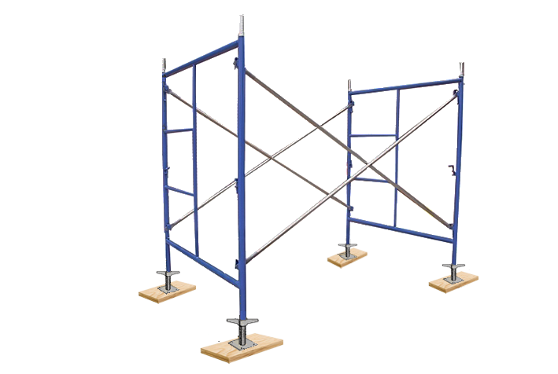
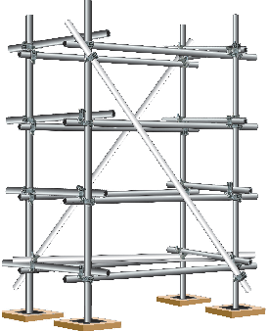
Supported Scaffolds
Platforms supported by rigid structures on the ground or other stable foundation
Frame Scaffolds
System Scaffolds
system Scaffolds
Tube & Clamp Scaffolds
Notes:
Provide the definition of Supported Scaffolds and briefly introduce the three main types of supported scaffolds.

Slide 13




Frame Scaffolds
Frame scaffolds are the most common type of scaffold used in commercial and residential construction.
Notes:
Point out the different components of the frame scaffold. CLICK- once for each label to appear.
Explain the purpose of each component as the label appears.

Slide 14
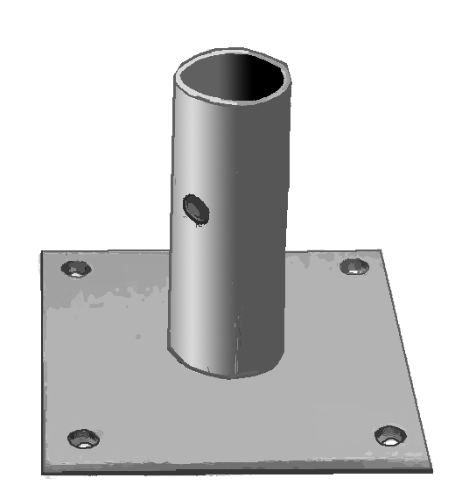
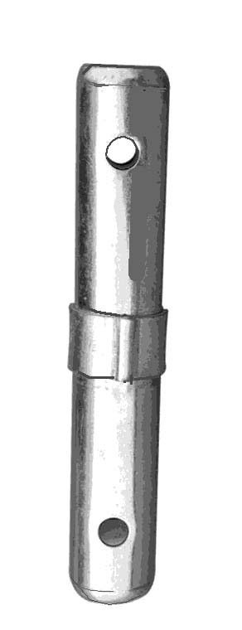
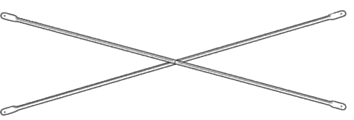
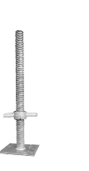
Frame Scaffold Components
The components of a basic frame scaffold include:
Frames
Coupling Pin
Crossbraces
Screwjack
Baseplate
Variety of shapes and sizes to suit different purposes
Connects frames
vertically
Connects two frames Provides stability & strength
Levels scaffold frames on uneven surfaces
Distributes the leg load Protects bottom of the leg
Notes:
Discuss in more detail the function of each Frame Scaffold Component.

Slide 15
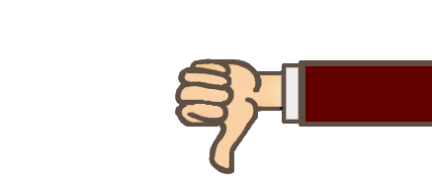

FRAME SCAFFOLDS
Easy to build
Many different frame styles,
sizes and capacities available
Components are widely
available
Minimal expertise is required
Relatively low labor costs
Straightforward system
fewer components required
Less versatile than other
types of scaffolds
Not practical for use in
confined spaces
DIFFICULT to build around
obstructions or irregular
shapes
Notes:
List some ADVANTAGES of Frame Scaffolds
CLICK Discuss some DISADVANTAGES of Frame Scaffolds

Slide 16
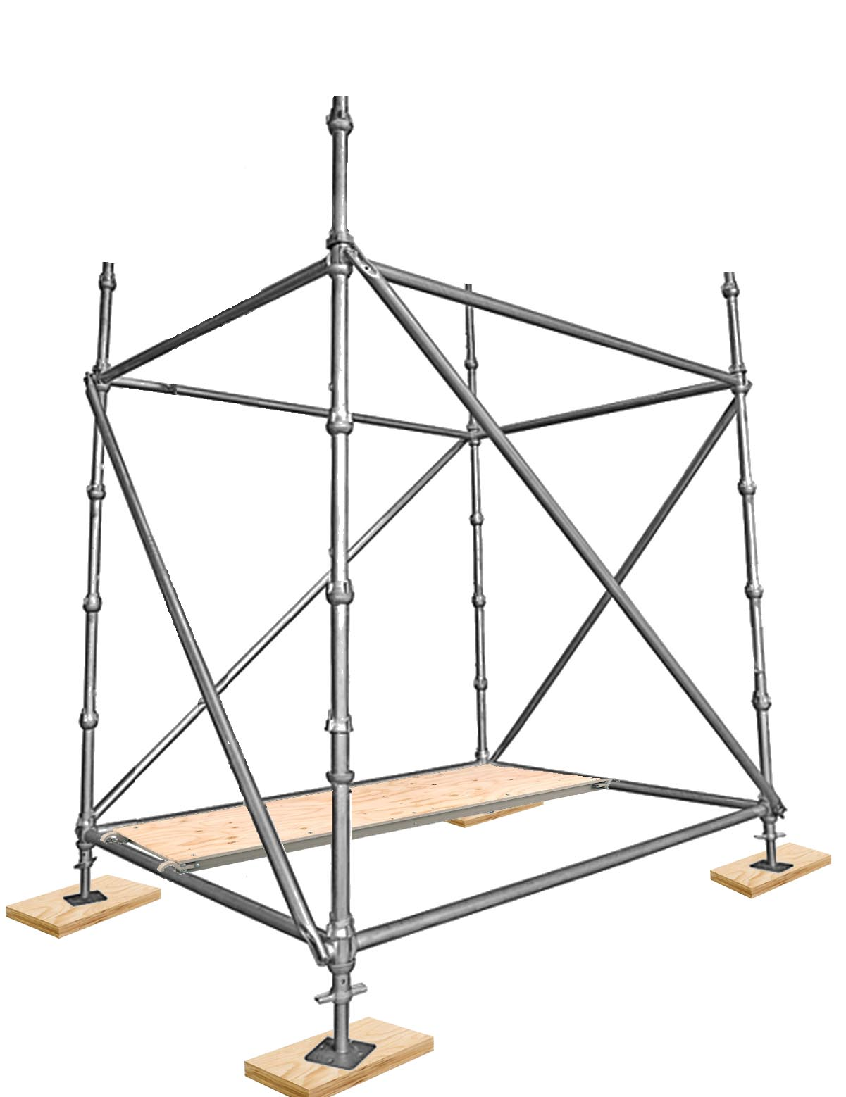





System Scaffolds
System Scaffolds have fixed connection points at equal
intervals along the posts.
Notes:
Describe the different components of Systems Scaffolds – CLICK once for each label to appear.

Slide 17
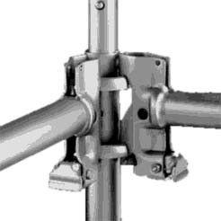
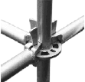
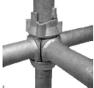
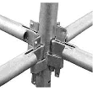
Types of Connections
V-LOCK
DOUBLE RING
CUPLOCK
RING/ROSETTE
Notes:
Describe each of the different types of connections and explain the unique features of each type. CLICK – for each type of connection to appear. Describe how the connection is made and discuss the advantages/disadvantages of each type.
(OPTIONAL) If you have some examples show them to trainees and demonstrate how they work.

Slide 18
SYSTEM SCAFFOLDS
EASY to assemble
STRONG
Easy storage & transport
Can be built without precision
measuring
faster to build than Tube & Clamp
Multiple connection points
Fits around non-rectangular
shapes
Can be used with Tube & Clamp
components
variety of lengths available
needs more skill to build than frame
scaffolds
Requires many components
Not as many possible configurations
Requires many different sizes of
components
some systems can only handle Four
(4) attachments at connection point
Notes:
Discuss the ADVANTAGES of System Scaffolds
CLICK – Discuss the DISADVANTAGES of System Scaffolds

Slide 19








Tube & Clamp
Scaffolds
Tube & Clamp Scaffolds are flexible and suited for access to irregular work areas.
Notes:
Identify the different components of Tube & Clamp Scaffolds and explain their function
CLICK once for each component label to appear and describe the purpose of each component.

Slide 20
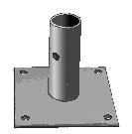

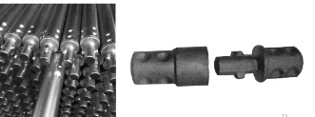
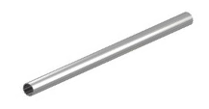
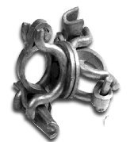

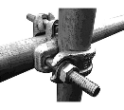
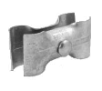
Tube & Clamp Components
Tubes
Right Angle Clamp
Swivel Clamp
Paralell Clamp
Baseplate
Sleeve Connector
Expansion Connector
End Connectors
Notes:
CLICK – for each component to appear and briefly describe how they are used / what they are used for.
(OPTIONAL) If you have some examples show them to trainees and demonstrate how they are used.

Slide 21
Tube & Clamp Scaffolds
Versatile and adaptable
Ideal for jobs with restricted
access, many obstructions
or irregular shapes
Can be used in combination
with Frame and System Scaffolds
More labor intensive than
other types of scaffolds
Takes longer to build
Requires special expertise
More loose fittings and
clamps to deal with, that can be
easily dropped or misplaced
Notes:
Discuss the ADVANTAGES of Tube & Clamp Scaffolds
CLICK – Discuss the DISADVANTAGES of Tube & Clamp Scaffolds

Slide 22
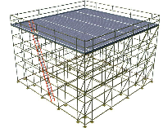
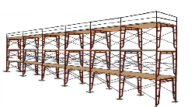
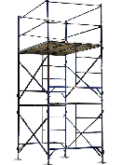
Scaffold Configurations
Scaffold Tower
Scaffold Run
Area Scaffold
Notes:
Describe Scaffold Towers and explain their typical uses.
CLICK- Describe Scaffold Runs and explain their typical uses.
CLICK- Describe Area Scaffolds and explain their typical uses. Explain that we will look at these in more detail later in the course.

Slide 23
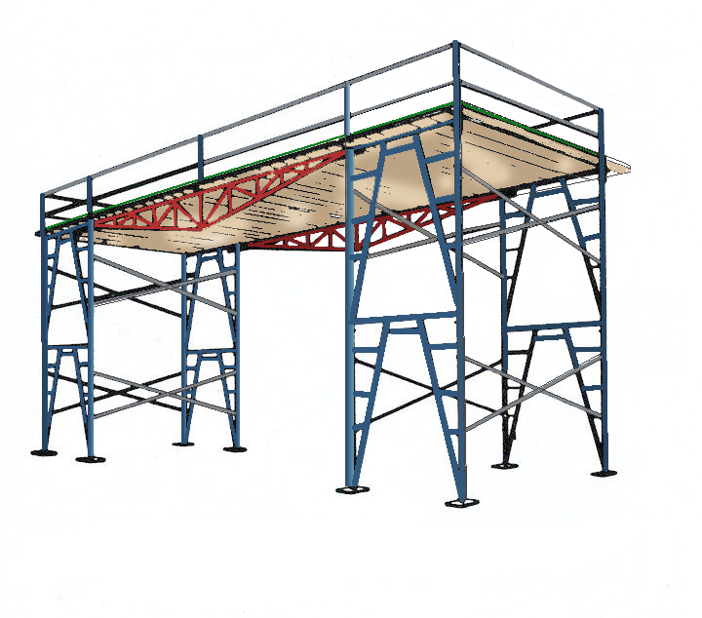
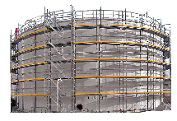
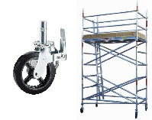
Scaffold Configurations
Rolling Tower
Bridging Scaffold
Circular Scaffold
Notes:
Describe Rolling Towers and explain their typical uses
CLICK- Describe Bridging Scaffolds and explain their typical uses
CLICK – Describe Circular Scaffolds and explain their typical uses.

Slide 24
Choosing the Right Scaffold
WORK/ACTIVITY
STRUCTURE
CONDITIONS
TIME
LOAD
Notes:
List the factors that are considered when choosing a scaffold for a given job. Provide examples to give trainees something to visualize. Ask the trainees to think of what some other considerations might be: (workers’ experience using the type of scaffold, availability, safety etc…)

Slide 25


LEARNING ACTIVITY
WORK/ACTIVITY
Sandblasting
Painting
STRUCTURE
45ft (13.7m) tall lighthouse, round
CONDITIONS
Cliff, high winds, bedrock foundation, narrow space
TIME
Two weeks
4 workers, sandblasting equipment, paint and brushes/rollers
LOAD
Notes:
Tell the trainees that we are going to apply what we have just learned to a specific job scenario. Tell them that this scenario can be found on page 28 in their Study Guide.
CLICK – Ask what is the first thing that needs to be known – pause and wait for the trainees to answer.
CLICK – WORK/ACTIVITY Ask the trainees to read the scenario and tell what work or activity is to be done on the scaffold (wait for the answer then CLICK) – Repeat for each factor then discuss what might be the most appropriate type of scaffold to use. *Remember to point out the need for the scaffold to be enclosed to protect the environment, and point out the need for ties.

Slide 26
Key Points
Two types of scaffolds: supported and suspended
Frame, System and Tube & Clamp are the most common
supported scaffolds.
Frame Scaffolds are easy to build and don’t require much
expertise.
System Scaffolds have fixed connection points along the
posts. They are versatile, quick and easy to use.
Tube & Clamp Scaffolds can be adapted to suit many sizes
and shapes.
Supported scaffolds can be configured many different ways.
Notes:
Review the Key Points from this session

Slide 27
Key Points
Tube & Clamp Scaffold can be used with Frame or System Scaffolds.
Basic factors you should consider when choosing a scaffold for your job:
The type of work or activities that will be done on the scaffold;
The type and shape of the structure you are working on;
The conditions under which the scaffold will be used;
The length of time the scaffold will be needed;
The load the scaffold will need to support.
Notes:
Review the key points from this session.

Slide 28
Scaffold Hazards
The 5 most common scaffold hazards & related regulations
2

Slide 29

COMPETENT PERSON
✔
Directs workers who build, dismantle, move, or alter scaffolds.
Inspects scaffolds and jobsites for potential hazards and takes prompt corrective action to solve them.
✔
✔
Determines if it is safe to work on or from a scaffold during storms or high winds and ensures workers are properly protected from falls.
✔
Determines the feasibility/safety of providing fall protection and access.
✔
Determines if a scaffold will be structurally sound if components from different manufacturers are intermixed.
Notes:
Review this list of responsibilities of the competent person and discuss the importance of continuously training and staying up-to date on local regulations, codes & standards to be able to carry out these responsibilities effectively.

Slide 30
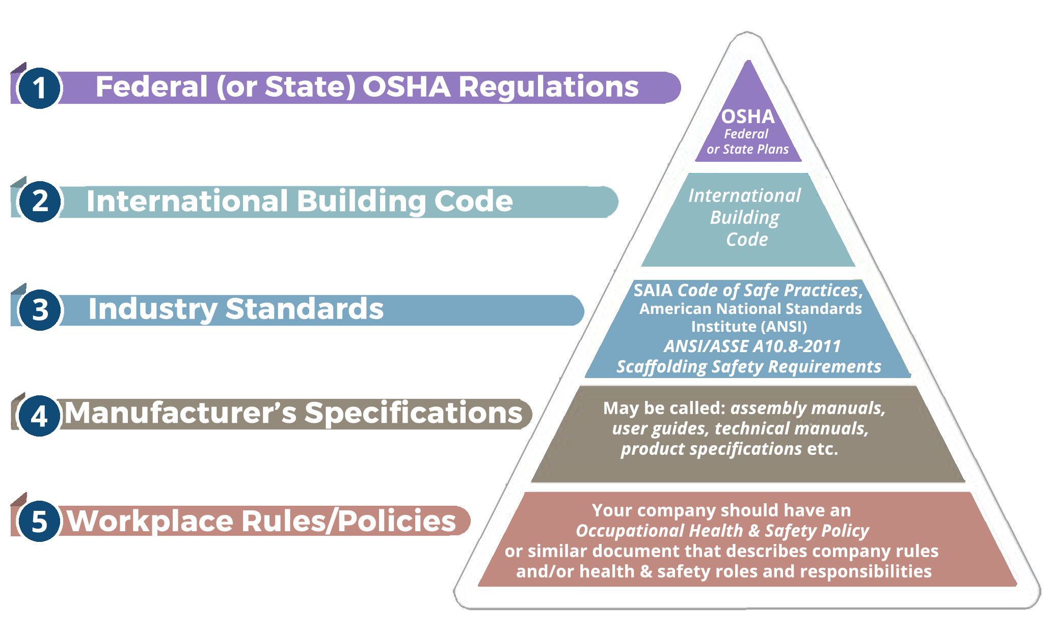
Regulations, Standards & Codes
Notes:
Explain the different Regulations, Codes and Standards that relate to scaffolds (and where to find them). Make it very clear which are enforceable by law and which supersede others.

Slide 31
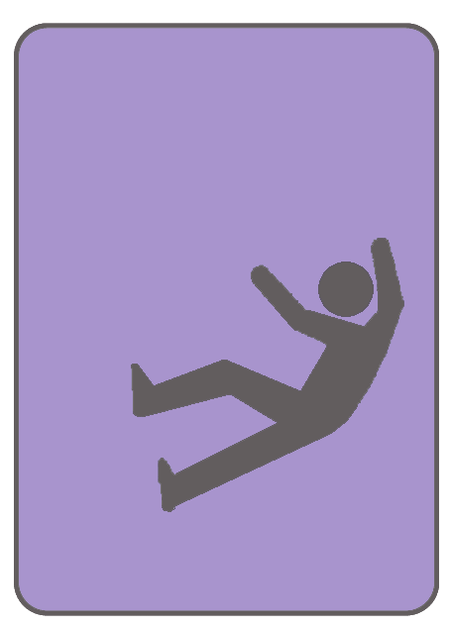
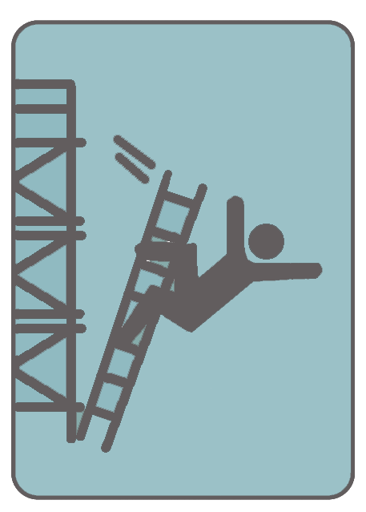
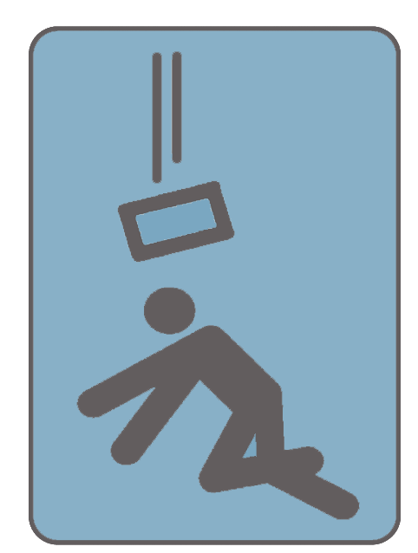
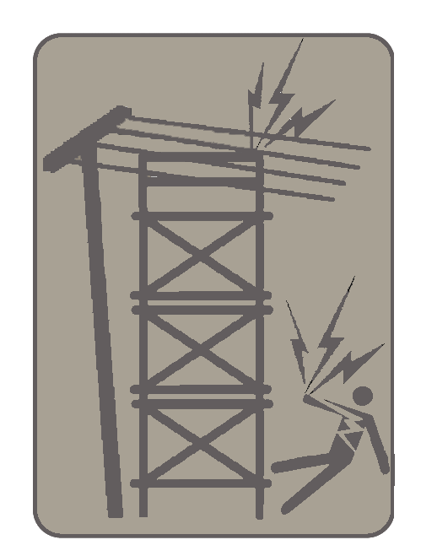
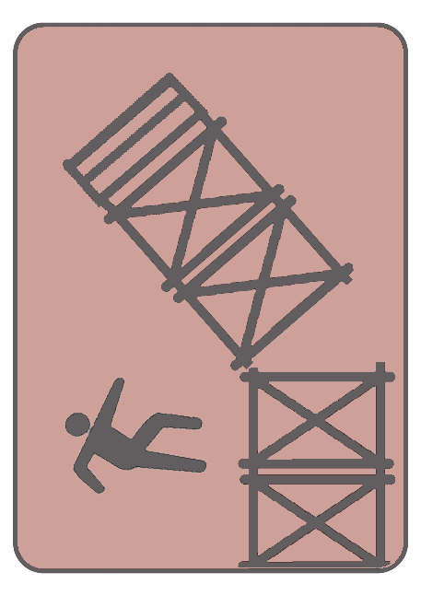
Five Most Common Scaffold Hazards
F
U
S
E
S
Notes:
Tell trainees you are going to list the 5 Most Common Scaffold Hazards.
CLICK – Describe FALLS and how common these are in scaffold/construction industry
CLICK – Describe USAFE ACCESS and provide examples
CLICK – Describe how scaffold builders can be STRUCK BY FALLING OBJECTS
CLICK – Describe ELECTROCUTION hazards
CLICK – Describe SCAFFOLD COLLAPSE and give an indication of how common this is.

Slide 32
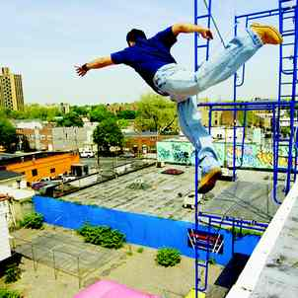
Falls
The most common scaffold
hazard
Falls from heights are the leading
cause of death in construction
Falls on the same level (slips and
trips) are the leading causes of
injuries
Notes:
Discuss Falls in more detail and share a personal story or ask trainees to share a fall-related story.

Slide 33
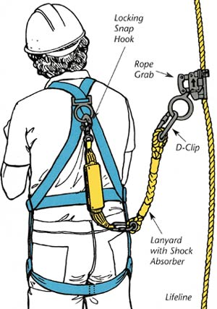



PERSONAL FALL PROTECTION
Notes:
Discuss Personal Fall Protection and the Competent Person’s responsibilities in relation to fall protection on scaffolds. Point out the different components of the personal fall protection system and briefly explain how they work.

Slide 34
Write down important fall-related regulations from your local jurisdiction in the space provided on page 44 of your Scaffold Fundamentals Study Guide.
Notes:
Provide trainees with the relevant FALL-RELATED REGULATIONS and have them write them into the space provided in their Study Guides.

Slide 35
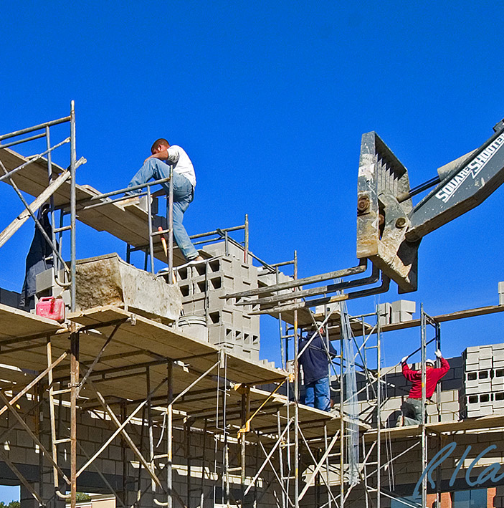
Unsafe Access
Examples of unsafe access include:
  climbing crossbraces or other
  parts of scaffold not meant to
  be climbed
  ladders with rungs too far apart
  carrying something while
  climbing
Notes:
Describe some other examples of unsafe access that you have seen.
Discuss available options and important considerations for safe access.

Slide 36
Write down important ACCESS-related regulations from your local jurisdiction in the space provided on page 39 of your Scaffold Fundamentals Study Guide.
Notes:
Provide trainees with the relevant ACCESS-RELATED REGULATIONS and have them write them into the space provided in their Study Guides.

Slide 37
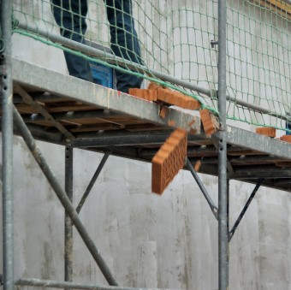
Struck by Falling Object
Tools, materials can accidentally be
dropped, kicked or slip off the
scaffold.
Falling objects can potentially
cause damage to property, injuries or
death.
Scaffold builders can use various
types of restraint, protection, or close
off areas where objects may fall.
Notes:
Discuss falling object protection briefly
If possible share a personal experience.
Tell participants we will get into more detail about falling object protection in Section 5

Slide 38
Write down important FALLING OBJECT-related regulations from your local jurisdiction in the space provided on page 39 of your Scaffold Fundamentals Study Guide.
Notes:
Provide trainees with the relevant FALLING OBJECT-RELATED REGULATIONS and have them write them into the space provided in their Study Guides.

Slide 39
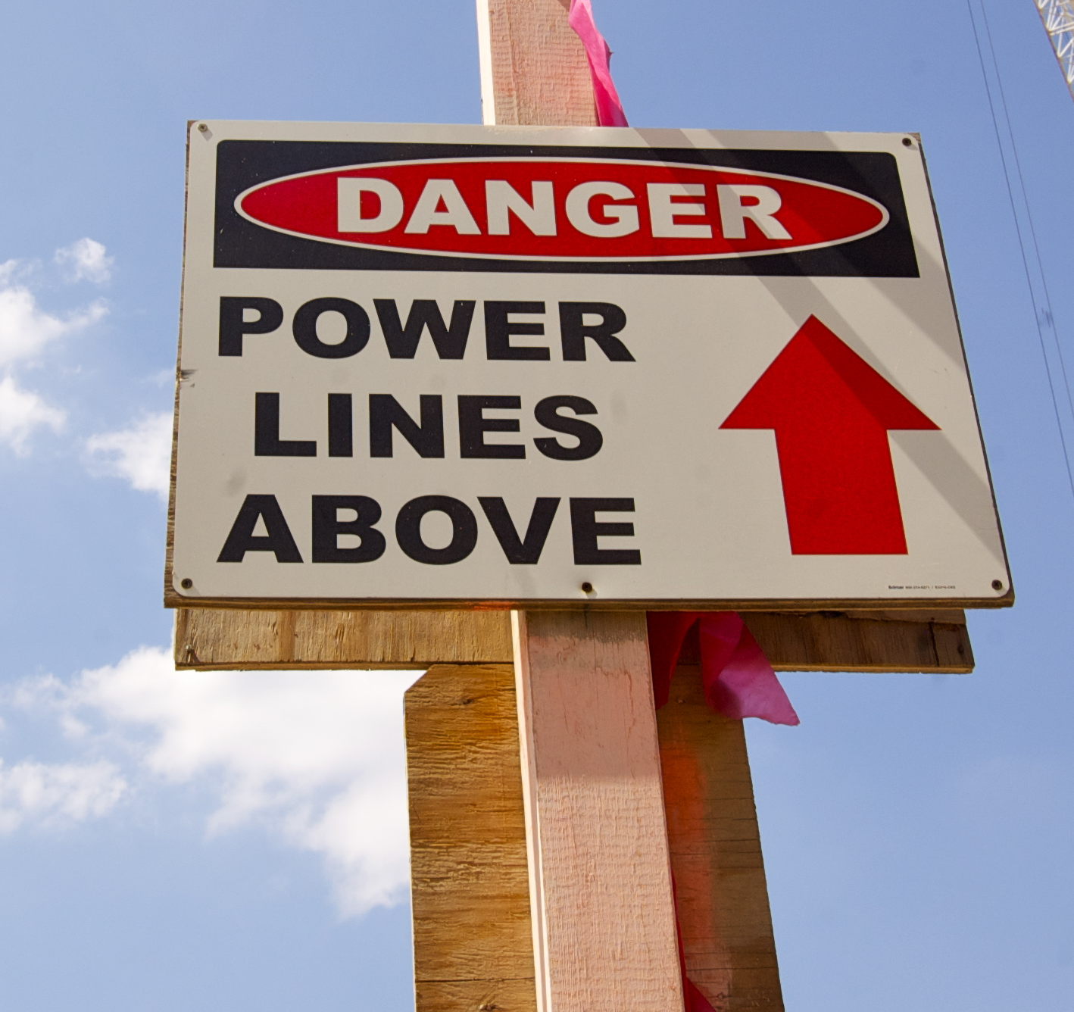
Electrocution
Electrocution is a common scaffold
hazard.
Wire can pass a current without
touching the scaffold.
Stay safe distance from power line.
Scaffolds making accidental contact
with power lines have caused many
deaths.
Before moving a rolling scaffold, check
path of travel.
Notes:
Discuss Electrocution and Electrical Hazards and share a related story (or ask trainees to share one). Make sure to discuss minimum safe distances according to locally applicable regulations.

Slide 40
Write down important ELECTICITY-related regulations from your local jurisdiction in the space provided on page 40 of your Scaffold Fundamentals Study Guide.
Notes:
Provide trainees with the relevant ELECTRICITY-RELATED REGULATIONS and have them write them into the space provided in their Study Guides. Make sure to let trainees know if the minimum safe distances in their jurisdiction differs from those listed in the chart on page 40.

Slide 41
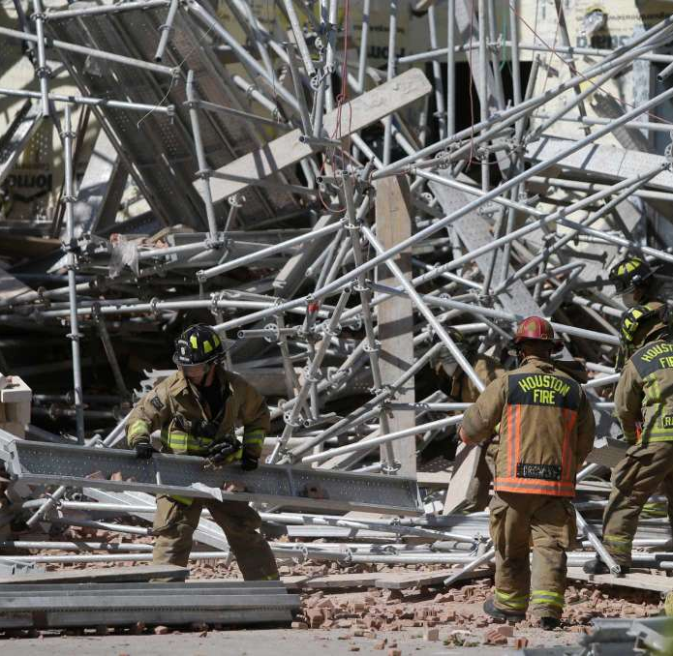
Scaffold Collapse
Scaffolds collapse for many reasons:
  overloading
  improper erection
  improper bracing
  inadequate foundation
  improperly tied, guyed
  use of damaged or poorly maintained components
  extreme weather conditions (high winds)
Notes:
List and explain some of the reasons scaffolds collapse
(If anyone asks about the collapse in this image: This collapse was in Houston. One of the companies was fined $14,700 for the following violations: support scaffold poles were missing base plates, the footing of scaffolds was not rigid or sound and the scaffolding wasn't inspected by a competent person before each work shift or after an occurrence that could affect the scaffolding's structural integrity. The second company involved was fined $6,300 for not initiating and maintaining a safety program that regularly inspects job sites, materials and equipment and because the scaffold and scaffold components weren't inspected.)

Slide 42
Write down important local regulations related to scaffold collapse in the space provided on page 41 of your Scaffold Fundamentals Study Guide.
Notes:
Explain that because there are many reasons scaffolds collapse, there are several related regulations. There may not be space in their Study Guides to write in all the regulations but they should at least write in the regulation page numbers or standard numbers in the space provided.

Slide 43

LEARNING ACTIVITYG
Notes:
Have trainees work in pairs and assign each pair a few questions from the learning activity.
Provide them with copies of locally applicable regulations and have the pairs practice looking through the regulations to find the answers
Ask the trainees to share the answers they have found

Slide 44
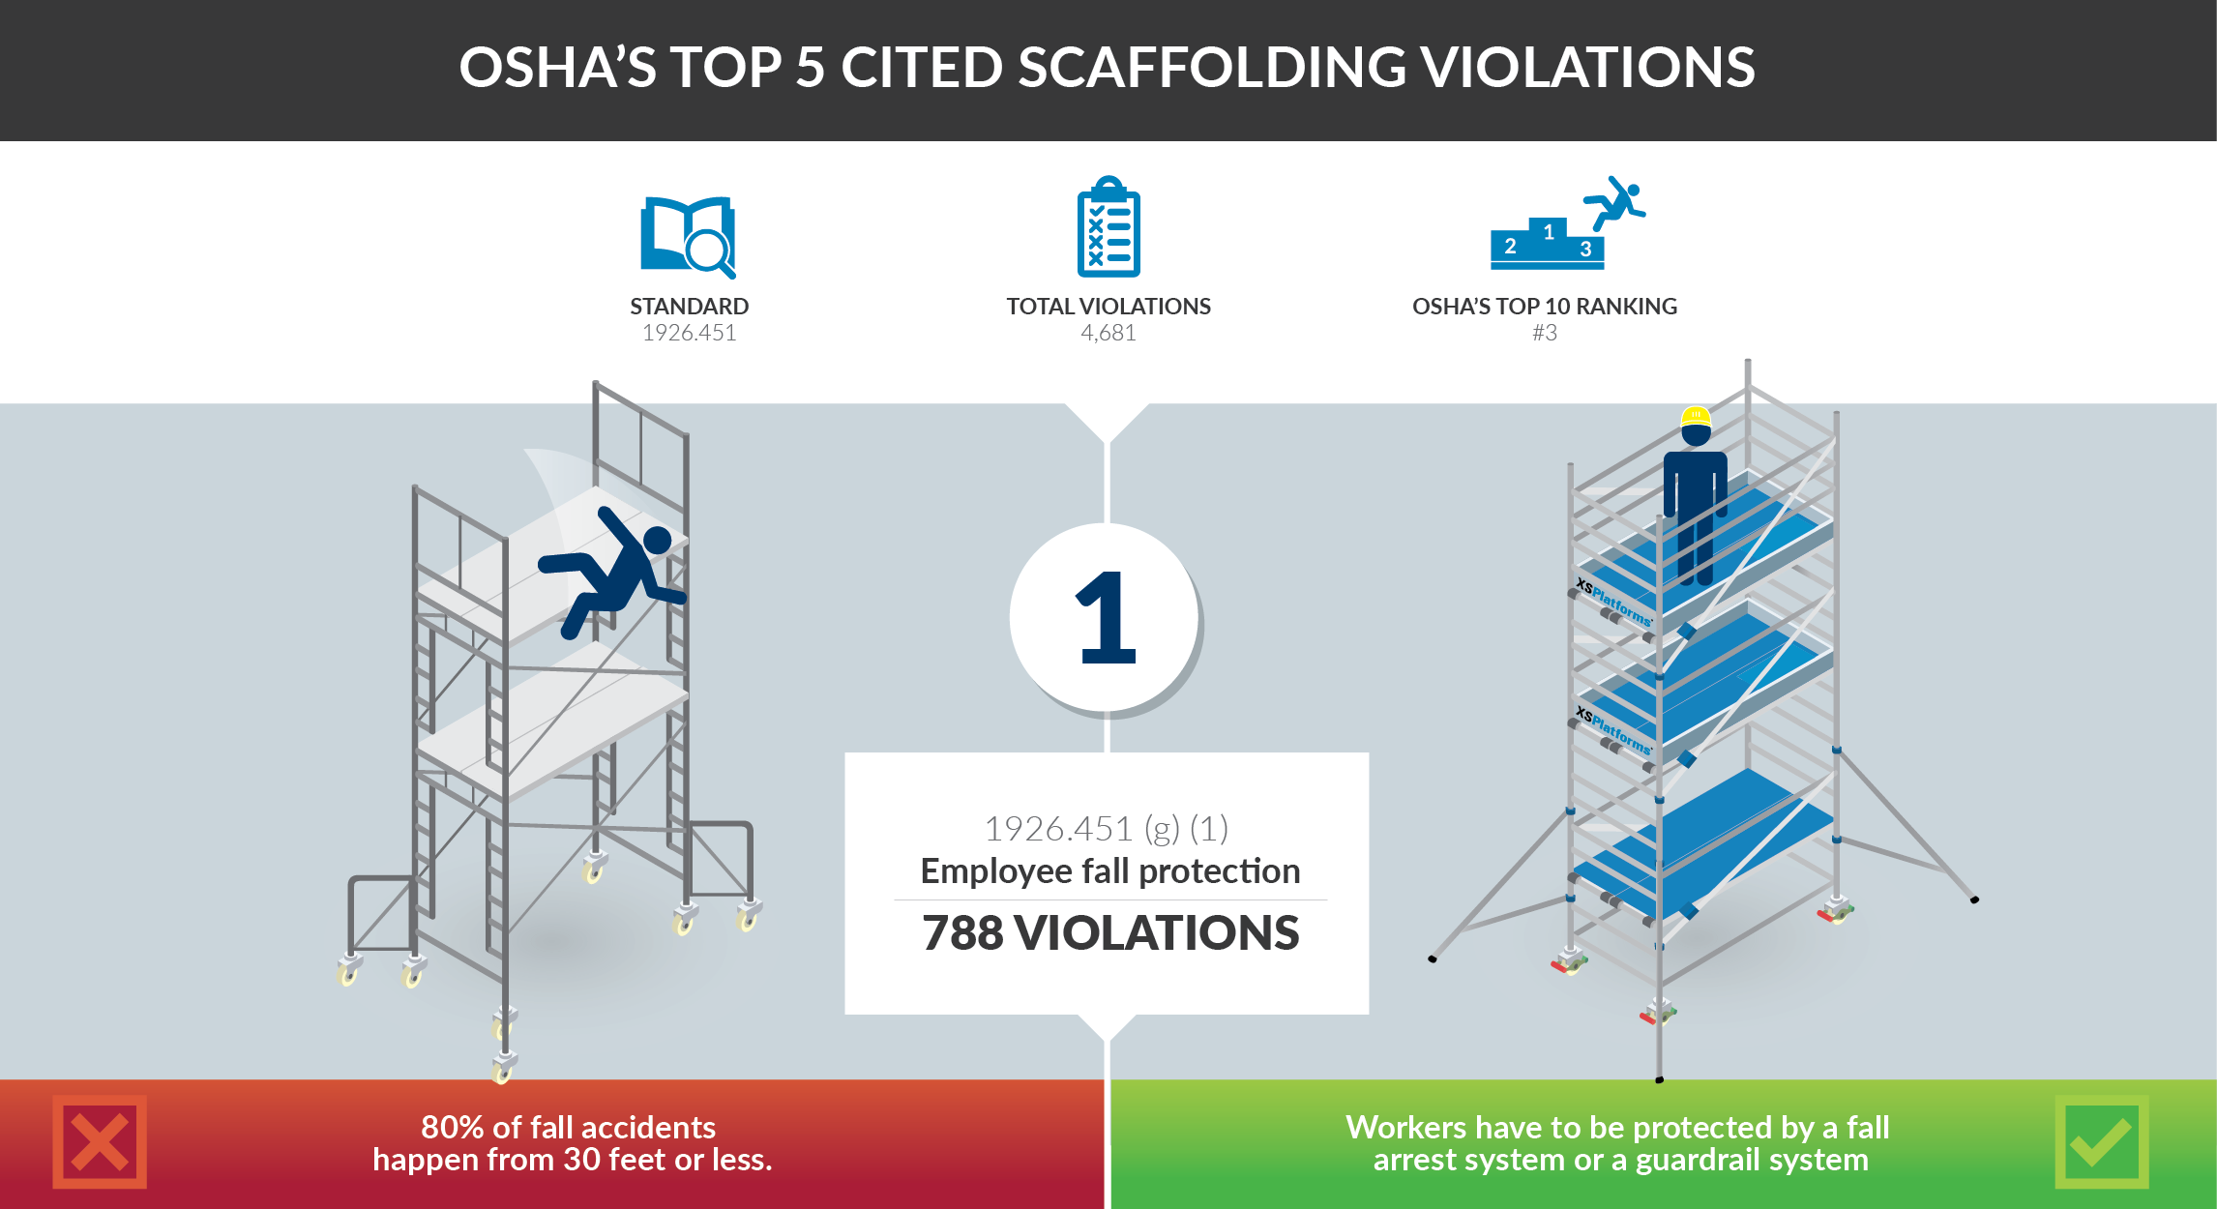
Notes:
Explain to participants that every year OSHA publishes the top ten most common violations. Scaffolding violations rank third on OSHA’s top 10. On the list of the most serious violations scaffolding even ranks second. On average, a violation is detected with five percent of OSHA´s inspections.

Slide 45
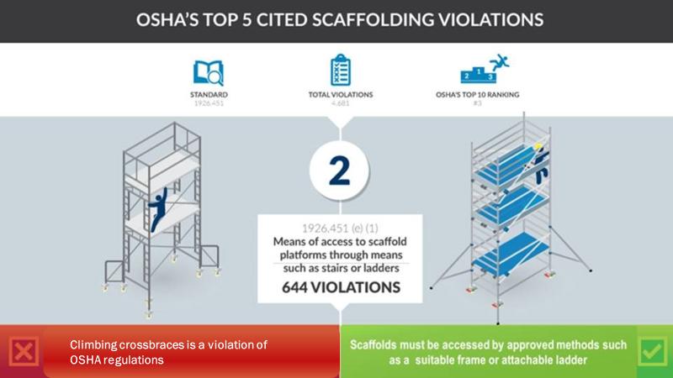
Notes:
OSHA states that when a platform is more than 2 feet above or below a point of access, an approved means of access (stairs, integrated ladders or ramps) shall be used. Discuss access and describe common access-related violations and possible consequences.

Slide 46
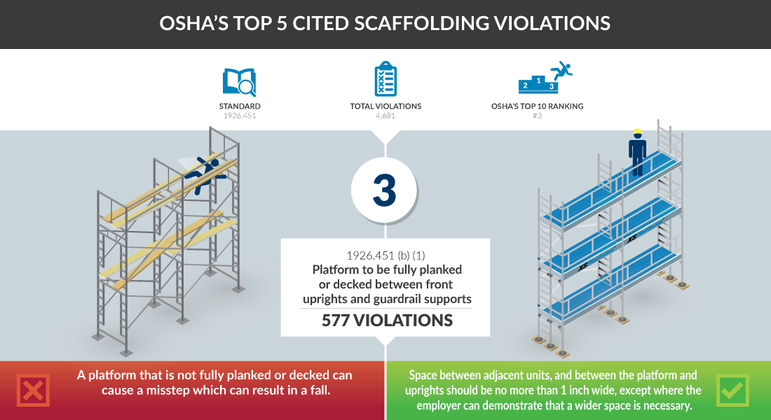
Notes:
Explain regulations regarding scaffold platforms and describe briefly some unsafe platform practices and possible consequences.

Slide 47
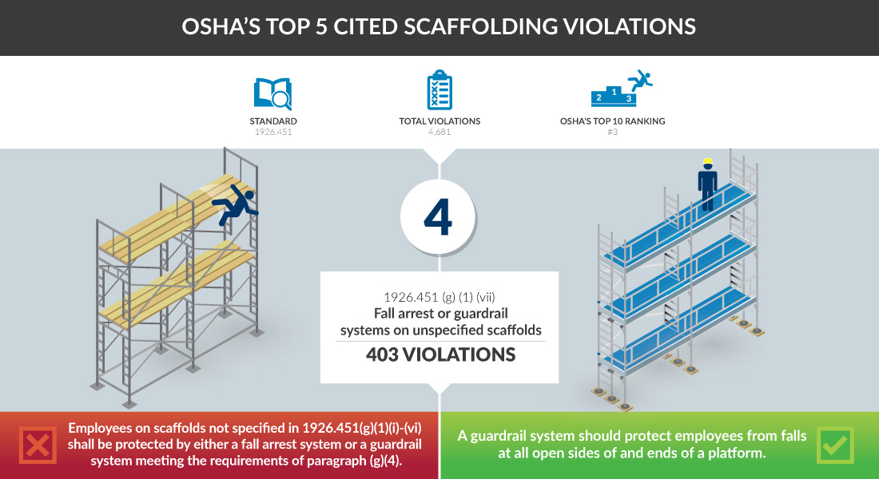
Notes:
Explain the regulations regarding fall protection and the Competent Person’s responsibilities in relation to fall protection on scaffolds.

Slide 48
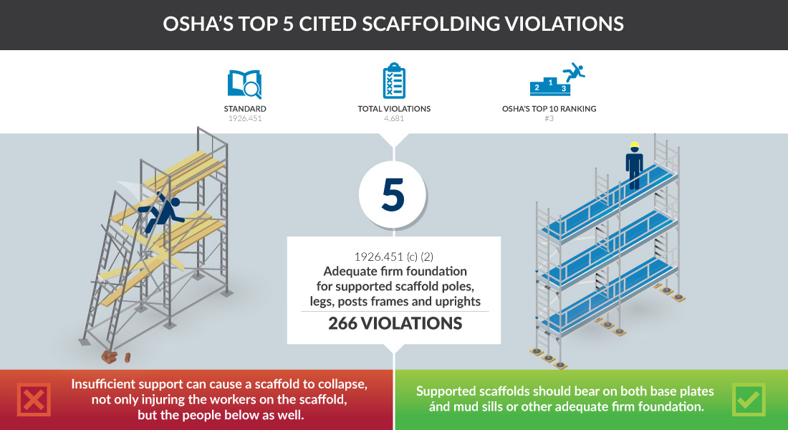
Notes:
Describe some common foundation-related violations and their potential consequences.

Slide 49
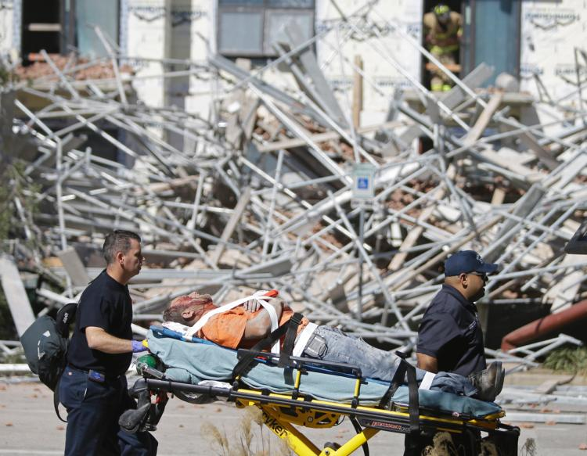

LEARNING ACTIVITY
Notes:
Ask the trainees to list the possible consequences of violating regulations (injury, death, fines, damage to reputation etc.)
Discuss reasons why scaffold builders violate these regulations.
Ask trainees if they believe the potential consequences are worth the risk.

Slide 50
Key Points
Workers positioned above the ground are exposed to possible falls.
One method of fall protection on scaffolds is the use of a guardrail system.
A guardrail is a barrier consisting of toprails, midrails and posts, erected to prevent workers from falling to lower levels.
Toeboards prevent materials or tools from accidentally being kicked or dropped off the work platform. They also keep workers’ feet from slipping over the edge.
Notes:
Review the key points from this session.

Slide 51
Key Points
Guardrail systems are required on all open sides and ends of working platforms unless an alternate fall prevention system is used.
Include safe movement from the access area onto or off of the platform.
Swing gates must always swing INTO the platform.
Toeboards, Debris Nets, Screening and/or canopy structures are forms of falling object protection.
Notes:
Review the key points from this session.

Slide 52
Foundations
The bases on which scaffolds are built
3

Slide 53
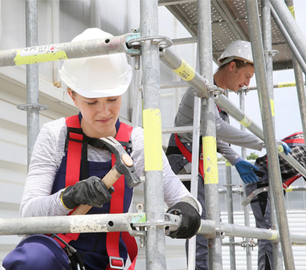
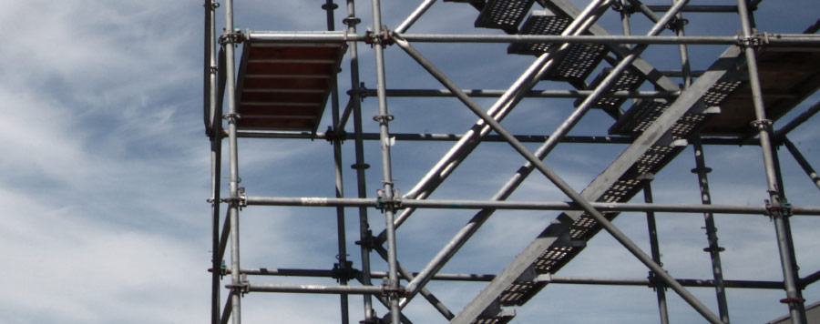
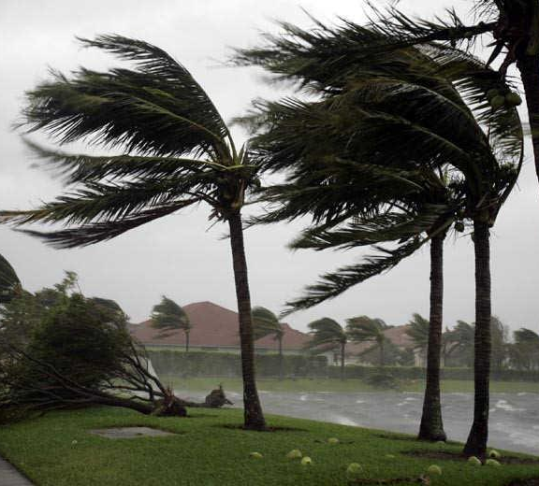
Types of Loads
Loads can be divided into three categories:
Live Loads
Dead Loads
Environmental Loads
workers, tools, materials
scaffold & components
wind, rain, snow, ice
Notes:
Describe the three types of loads

Slide 54
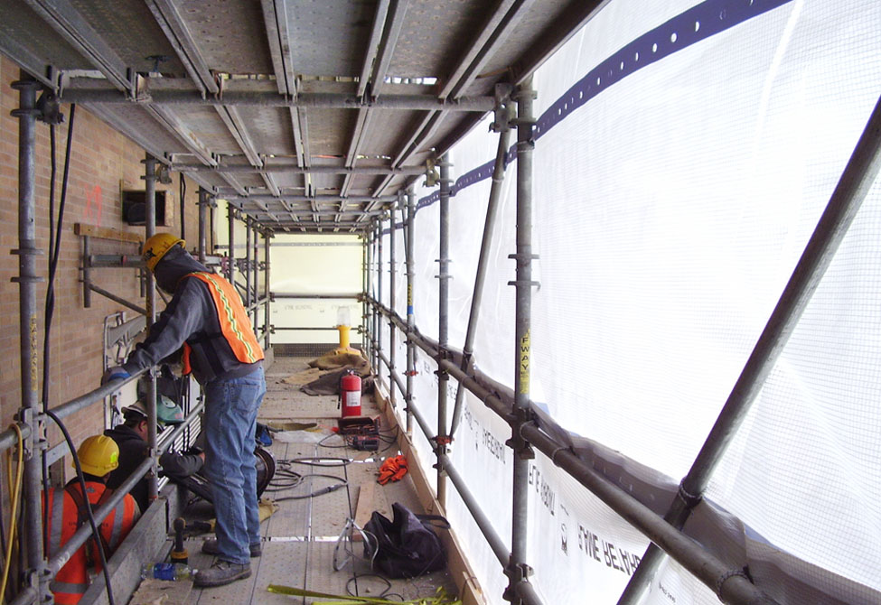
Kue Pukis & Cingcaw Kapucino
Product Design
Notes:
Ask the trainees to identify the different loads on this scaffold.
(Make sure to discuss the effect of wind on an enclosed scaffold)

Slide 55
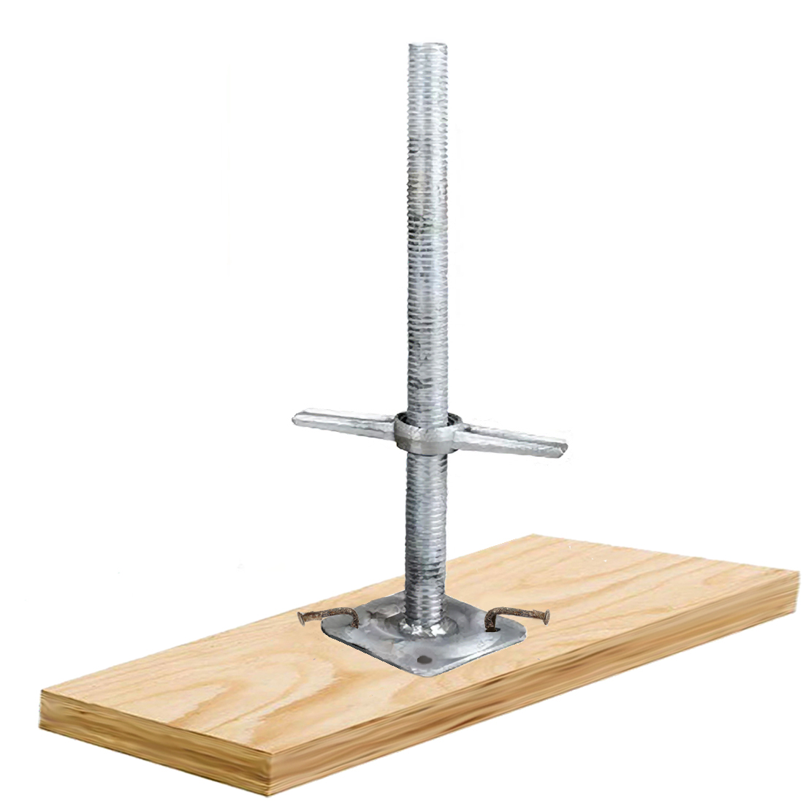





Foundation
Components
Notes:
Discuss briefly how these basic components are put together.
1st click: SCREWJACKS - Point out that there are screwjacks that do not have baseplates attached
2nd click: BASEPLATES – Remind trainees that it is good practice to nail the baseplates to the sills
3rd click: Circle – Explain where the holes are located on a baseplate
4th click: Arrows – Explain the nails should be placed in opposite diagonal holes as shown

Slide 56

Sills
Sills should be of sufficient size and strength
to support the loads transmitted to them
Notes:
Explain that sills are usually cut from 2in x 10in scaffold planks.
Sills should be of sufficient size and strength to support the loads transmitted to them. The length will depend on the planned use. If a scaffold plank is used as a sill it must NEVER be used as part of a platform again.

Slide 57



How Sills Spread Loads
Notes:
Explain how loads are transferred down through the scaffold leg or upright. Tell trainees we will look at how the spread of that load changes when bases are added.
Click to show the first example – explain that the load is concentrated onto a very small area
Click to show the next example – explain that the load is spread when a baseplate is added
Click to show the next example – explain that the load is spread even further when a sill is added
Explain why it is important to spread the load.

Slide 58
How Sills Spread Loads

Slide 59

Foundation Preparation
Notes:
Spend a minute to discuss the importance of preparing a foundation before building a scaffold.
Give examples of what type of preparation may be needed.

Slide 60
Write down important FOUNDATION-related regulations from your local jurisdiction in the space provided on page 58 of your Scaffold Fundamentals Study Guide.
Notes:
Provide trainees with the relevant FOUNDATION-RELATED REGULATIONS and have them write them into the space provided on page 58 in their Study Guides.

Slide 61







Foundation Wall of Shame
Notes:
Show each of the photos and discuss the problems with each of the foundations – (Don’t forget to point out the cluttered and messy work areas as also being hazards)

Slide 62


Ground Surfaces
STRONGEST
Concrete
400,000 psf
19,152 kPa
Asphalt
98,000 psf
4692 kPa
Notes:
Define bearing capacity as it relates to ground surfaces
Describe foundation properties and considerations for concrete (very strong/high bearing capacity, sills may not be required)
CLICK – Describe foundation properties and considerations for asphalt (softens when heated, bearing capacity lowers)

Slide 63




Bedrock
4000 -12000 psf
191.5 - 574.5 kPa
Gravel
2000 psf
96 kPa
Coarse Sand
1500 psf
72 kPa
Clay
0 - 8000 psf
4.7 - 383 kPa

Slide 64


Fine Sand
1000 psf
48 kPa
Peat
0 - 400 psf
0 - 19 kPa
WEAKEST
Notes:
Discuss what can be done to be able to safely build scaffolds on ground surfaces with lower bearing capacity.

Slide 65
CHALLENGING FOUNDATIONS
BACKFILLED SOIL
MUD & SOFT SOIL
EMBANKMENT
FROZEN OR THAWING SOIL
SLOPED GROUND
EXCAVATIONS
excavate & replace with compacted material and use large sills
to distribute load
distance from edge of sill to edge of the bank must be at least equal to the height of the bank
set scaffold far enough back to avoid settlement or failure of the embankment
excavate and level sill area by cutting ‘steps’18in (450mm) into the soil
must be well compacted and leveled
replace with compacted gravel or crushed stone
Notes:
Go through the list of Challenging Foundations one by one (describing what needs to be done to prepare the foundation to build the scaffold safely) (You may need to refer trainees to the corresponding images in the Study Guide for clarification)

Slide 66



SCENARIO #1
SCENARIO #2
SCENARIO #3
Notes:
Divide trainees into three groups and assign each group one of the three scenarios
Give trainees 10 - 15 minutes to read over the scenario and discuss what preparations (if any) and what foundation components they would use. Ask the groups to share their solutions to the problems outlined in the scenarios.

Slide 67
Key Points
Foundations greatly affect a scaffolds stability.
The type of supports depends on:
  the function of the scaffold
  the loads it must carry
  the surface on which it is being built.
Loads include:
  the total weight of all workers
  equipment, tools, materials,
  environment-related weight or pressure
Sills and baseplates to distribute the load of the scaffold.
Foundation preparation is important with all scaffolds.
Notes:
Review the key points from this session.

Slide 68
Key Points
Different ground surfaces have different bearing capacities.
Backfilled soils must be well compacted and leveled.
Replace mud and soft soil with gravel or crushed stone.
Do not use bricks, pieces of lumber, pallets or other scrap materials, under scaffold feet or under sills.
On sloping ground, level the sill area by excavating.
Near an excavation, the leg should be at least as far away from the edge of the excavation as the excavation is deep.
Notes:
Review the key points from this session.

Slide 69
Platforms
Elevated work surfaces composed of one or more platform units
4

Slide 70




PLATFORM MATERIALS
Loads can be divided into three categories:
WOOD
METAL
COMPOSITE
Solid Sawn or Laminated
Aluminum or Steel
Fiberglass, other materials
Notes:
Discuss the three types of platform materials
List some advantages and disadvantages of each type

Slide 71


Solid Sawn Wood Planks
cut from a “solid” piece of timber
common size is 2in x 10in (50mm x 250mm)
Regulations apply to the type and quality of
wood used for scaffold planks
Must be stamped by an independent
inspection agency
Laminated scaffold planks
manufactured from smaller pieces of wood edge-glued 1 ½in (38mm) side by side
can also be made from layers of laminated veneer like plywood
Notes:
Discuss Solid Sawn Wood Planks and their characteristics/properties (explain why you can’t just use any type of plank)
CLICK – Discuss Laminated Scaffold Planks and their characteristics/properties.

Slide 72

Identifying Scaffold Grade Planks
Notes:
Point out the mandatory markings found on a scaffold grade plank
Explain some reasons why a scaffold grade plank might not have a visible stamp (fading, cut off when plank trimmed etc.)
CLICK – Discuss false grade stamps and what to look out for and what to do if you are unsure if a plank is scaffold grade

Slide 73





PLANK INSPECTION
SPLITS
KERFS
DELAMINATION
DENTS
FACE BREAKS
Notes:
Discuss the different types of damage that can make wood planks unsafe. Explain what to do if you see any of these signs of damage (remove from service or check with a qualified person before using). Also discuss warping, chemical contamination and other types of damage not shown here.

Slide 74

PROTECT YOUR PLANKS
Proper storage & handling will prevent damage to scaffold planks
Notes:
Provide tips or Do’s and Don’ts pertaining to plank storage and handling.
Remind trainees that dropped planks or planks that have been used as sills must never be used as a platform.

Slide 75




USE IT OR LOSE IT ?
☒
☒
☑
☒
SPLIT
KERF
CHECK
FACE BREAK
Notes:
The purpose of this game is to inspect scaffold planks and determine if it is safe to use or should be removed from service.
CLICK - Show the first image, ask trainees to vote whether to use it or lose it after they decide
CLICK to show the result ✖ = Lose it and ✓ = USE IT (explain why and point out what is wrong in the lose it pictures)
Repeat for each subsequent picture. Discuss how proper storage can prevent some damage.

Slide 76



USE IT OR LOSE IT ?
☒
☒
☒
☑
CUP
OK!
TWIST
DELAMINATION
Notes:
The purpose of this game is to inspect scaffold planks and determine if it is safe to use or should be removed from service.
CLICK - Show the first image, ask trainees to vote whether to use it or lose it after they decide
CLICK to show the result ✖ = Lose it and ✓ = USE IT (explain why and point out what is wrong in the lose it pictures)
Repeat for each subsequent picture. Discuss how proper storage can prevent some damage.

Slide 77
Metal Planks
usually made from aluminum or steel
typically 9.5in (240mm) wide
have a non-skid surface
available with either end hooks or square ends
vary in length up to 10ft (3.05m) to fit in a single bay
Notes:
Describe the different types of metal planks
Share tips on proper storage and handling.
Explain how to find out their duty rating

Slide 78

Scaffold Decks
manufactured platform modules usually 19in (483mm) wide
have end hooks to fasten to scaffold bearers
can span only one bay
most common designs consist of aluminum side rails with plywood tops or all aluminum construction
rated by uniform loads, usually 50 psf (2.5 kN/m²) or 75 psf (3.6 kN/m²)
Notes:
Describe Scaffold Decks – also discuss other styles available (ones with hatches etc). Discuss their advantages/disadvantages.
Explain that scaffold decks are rated by uniform loads, (usually 50 psf (2.5 kN/m²) or 75 psf (3.6 kN/m²).

Slide 79

COMPOSITE PLANKS
made from fibreglass or other composite materials
lightweight, durable and strong
do not rust, corrode or rot
can be cut to size
can have either end caps or end hooks
must be labeled and the load rating must have a 4 to 1 safety factor
must also have a slip resistant surface
Notes:
Describe composite planks and their advantages/disadvantages. Provide tips on proper storage and handling as well as how to recognize if they are damaged.

Slide 80

Loads on Platforms
A scaffold MUST be capable of supporting its own weight and at least 4 times the maximum intended load applied or transmitted to it.
Notes:
Explain the importance of scaffold platforms being able to support its own weight and at least 4 times the maximum intended load. Explain that manufacturers of decks and metal planks provide load capacity for their products in their specifications.

Slide 81
Calculating Plank Capacity
Start with the width of the plank (inches)
Divide by 12 (1 foot = 12 inches)
Multiply by the length of the plank
(8 foot plank)
Multiply by pounds per square foot (usually 50 psf or 75 psf)
= total allowable LOAD for the plank
9.5in
÷ 12
× 8ft
× 50psf
= 316.7lbs
Notes:
Go slowly through each step in the calculation explaining why each step is done – remember that some trainees may have difficulty following if they are not strong in math.

Slide 82

Platform Hazards
Notes:
Describe various platform hazards (insufficient or excessive overhang, lapped without bearer below etc.)

Slide 83
Write down important PLATFORM-related regulations from your local jurisdiction in the space provided on page 64 of your Scaffold Fundamentals Study Guide.
Notes:
Provide trainees with the relevant PLATFORM-RELATED REGULATIONS and have them write them into the space provided on page 64 in their Study Guides. (Make sure to include: Minimum width of work area, allowable space between platform and work area, allowable space between planks/decks, minimum height where platforms must be fully-planked, maximum allowable deflection, minimum distance from platform to structure etc.)

Slide 84







Notes:
Divide the participants into pairs or small groups.
Give each group one of these images. Tell them they are to play the role of an OSHA inspector and spot violations/hazards.
FOR ADVANCED TRAINEES – Have them practice locating the regulations online or in printed copies of the locally applicable regulations.
Ask each group to present their list of the hazards they identified and the possible OSHA/OHS violations

Slide 85
Key Points
Access to working platforms must be adequate and safe for the working conditions and type of work to be carried out.
A scaffold platform should always be fully planked.
The quality of materials and manufacturing of every scaffold platform is very important.
Every scaffold component must be capable of supporting its own weight and at least 4 times the maximum intended load.
Different types of planks and decks have different load capacities that you need to be aware of.
Notes:
Review the key points from this session.

Slide 86
Key Points
Four (4) main categories of platforms:
  Metal Planks
  Wood Planks
  Scaffold Decks
  Composite Planks
Solid sawn wood planks are stamped by an independent
inspection agency. Beware of non-scaffold grade planks with
misleading stamps and markings.
Many scaffold injuries are caused by unsecured scaffold planks or planks that have insufficient or too much overhang.
Use only scaffold grade planks & inspect planks before use.
Notes:
Review the key points from this session.

Slide 87
Guardrails & Toeboards
Fall protection and falling object protection
5

Slide 88





Guardrails
&
TOEBOARDS
Notes:
Explain that a guardrail system is one form of fall protection and point out the basic components. Explain that a toeboard is also just one type of falling object protection but it also can prevent a worker’s foot from slipping off the platform. Describe how a toeboard is attached.

Slide 89


Guardrails must be used on work platforms more than 10ft (3m) high (or according to local reg.s)
Guardrail gates must swing INTO the platform.
Notes:
Explain when guardrails are required and the required height for toprails and midrails (make sure to tell trainees their locally applicable guardrail regulations)
Describe guardrail gates and how they must be attached.
Explain the reason why the gate must swing into the platform.

Slide 90

CROSSBRACES AS PART OF GUARDRAIL
38in (0.96m)
to
48in (1.22m)
20in (0.51m)
to
30in (0.76m)
Notes:
Describe how and when a crossbrace can be used as part of a guardrail system on a Frame Scaffold.

Slide 91

GUARDRAIL PANELS FOR FRAME SCAFFOLDS
Panel attaches to frame directly behind crossbraces to guard scaffold run
Panel attaches to frame to guard platform end
Notes:
Explain that there are also special guardrail panels available for Frame Scaffolds. Guardrail panels are made to fit common bay sizes and scaffold frames.

Slide 92

GATE PANELS
SYSTEMS GATE PANEL
CLAMP-ON GATE PANEL
Notes:
Explain that System Scaffolds and Tube & Clamp Scaffolds usually use clamp-on gates that can be used at all platform locations.

Slide 93

TOEBOARDS
prevent materials or tools from accidentally being kicked or dropped off the work platform
helps keep workers’ feet from slipping over the edge
Notes:
Explain when toeboards are required, the required specifications (height above platform, max. allowable clearance below etc.) and describe how they are installed.

Slide 94



FALLING OBJECT PROTECTION
Other types of falling object protection include:
SCREENING
NETTING
CANOPY STRUCTURE
Notes:
Discuss the other falling object protection options that may be used with scaffolds.
Give examples of each.

Slide 95
Write down the minimum height where GUARDRAIL SYSTEMS are required according to local regulations in the space provided on page 74 of your Scaffold Fundamentals Study Guide.
Write down the minimum height of TOEBOARDS required according to local regulations in the space provided on page 77 of your Scaffold Fundamentals Study Guide.
Notes:
Provide trainees with the relevant GUARDRAIL AND TOEBOARD REGULATIONS and have them write them into the spaces provided on pages 74 and 77 in their Study Guides

Slide 96
FALLS
_____________ from heights are a concern at many work sites – especially when scaffolds are used. Many__________ in the construction industry are a result of falling from heights….
DEATHS
Local regulations require guardrail systems to be used when work is being performed on platforms ________________….
(SPECIFY HEIGHT)
MIDRAILS
A guardrail is a vertical barrier consisting of toprails, ________________….
(SPECIFY HEIGHT)
A standard toprail has a vertical height of, ________________….
HALFWAY
There must be an intermediate railing approximately, ________________….
GUARDRAIL GATE
When an external ladder or stair system is installed, a ________________________….
INTO
It is important that this is always opening, ______….
OPEN SIDES
ENDS
Guardrails are required on all, _____________ and ________ of scaffold platforms unless
___________________________________________________________________________________
AN ALTERNATE FORM OF FALL PROTECTION IS USED
FALLING OBJECTS
___________________ also can be hazards….
TOEBOARD
A _________________ is a barrier placed to prevent the fall of materials to a lower level or….
3½” (89mm)
FASTENED
These should be at least_____________ high above the platform. It has to be securely ___________ in place and with not more than ________________ clearance above the platform.
1/4in (6mm)
SCREENING
_____________ should be installed from the toprail to either the toeboard ….make sure that the openings in the material you choose are ______________ enough….
SMALL
Notes:
Ask the trainees to turn to page 78 in their Study Guides. Read the first sentence (without filling in the blank) and ask the trainees to suggest what to put for an answer. CLICK – to reveal the sentence and CLICK AGAIN to show the correct answers. Explain or clarify answers if necessary.

Slide 97
Key Points
Workers on scaffolds are exposed to possible falls.
Guardrail System is a FALL PROTECTION method.
Guardrail is a barrier consisting of toprails, midrails and posts to prevent workers from falling.
toeboardS prevent objects from falling off the platform and workers from slipping over the edge.
Guardrail systems are required on all platform levels above 10ft (3m). Guardrails must be used on all open sides and ends of all working platforms unless an alternate fall prevention system is used.
Notes:
Review the key points from this session.

Slide 98
Key Points
When installing guardrail systems include safe movement from the access area onto or off the platform
Make sure swing gates always swing INTO the platform
toeboards must be at least 3½in (89mm) high above the platform and provide more than 1/4 in. (6 mm) clearance to the platform
DEBRIS NETS, screening or CANOPY STRUCTURES can also be used for falling object protectioN (you could also put up a barricade around the area below the scaffold).
Notes:
Review the key points from this session.

Slide 99
Ties & Guys
Stabilizing scaffolds using ties OR guys
6

Slide 100


STRUCTURAL STABILITY
Structure #1
STRUCTURE #2
Notes:
Ask the participants to look at each of the two structures and then take a vote on which they think is the most stable.
(Most will vote for #2) Ask the trainees why they voted for this one (wider base).
Explain the relationship between these two examples and the concept of height-to-base ratio.

Slide 101


HEIGHT DIMENSION
MINIMUM
BASE DIMENSION
BASE DIMENSIONS
Structure #1
STRUCTURE #2
Notes:
Explain that when we are calculating height-to-base ratio that we are dealing with the MINIMUM base width.

Slide 102

Notes:
Describe the effects of horizontal loads such as wind or eccentric loads such as side brackets on scaffold stability.

Slide 103



Notes:
CLICK – Ask trainees to suppose you were building a scaffold from 5ft (1.52m) wide frames
CLICK – When you add an additional lift it is still stable because the height-to-base ratio is still between 3:1 or 4:1
CLICK – This is a Stable Scaffold
CLICK – Suppose you were to add several additional lifts – this scaffold becomes unstable
CLICK – One way to stabilize this scaffold is to attach it to a secure structure with ties – now it becomes stable.

Slide 104


COMPRESSION
TENSION
PUSH
PULL
Notes:
Ask Trainees to hold their hands together as shown and push them together – Explain that this force is what we call compression. Ask trainees to hold their fingers together as shown and try to pull them apart. – Explain that this force is what we call tension.

Slide 105

TIE
Notes:
Explain to participants that this is a common type of tie and CLICK for the animation
Ask trainees to guess which was the Tension Component and which was the Compression Component

Slide 106

ANCHORS
Choice of anchor is normally determined by:
  required strength
  material that the anchor is being fastened to
  compatibility with the other tie components
Notes:
Discuss anchor options and how they are fastened to a structure

Slide 107

VERTICAL TIE SPACING
Notes:
Discuss the locally applicable regulations regarding vertical tie spacing (clarify if local regulations differ from what is shown in the illustration).

Slide 108

HORIZONTAL TIE SPACING
Notes:
Discuss the regulations related to horizontal tie spacing and point out the tie placement that is required in your jurisdiction (if this is different from what is shown in the illustration).

Slide 109
GUYS (OR GUY WIRES)
used when ties not possible to provide stability and strength
usually wire ropes anchored to the ground
must be designed by a qualified person
45º angle
Notes:
Explain when guying would be necessary and how this is normally done.
Remind trainees about consequences if wires are too tight or too loose and importance of regular inspection
Discuss important considerations when building and dismantling guyed scaffolds.

Slide 110
Write down the REQUIRED TIE SPACING according to local regulations in the space provided on page 88 of your Scaffold Fundamentals Study Guide.
VERTICAL TIE SPACING
HORIZONTAL TIE SPACING
Notes:
Provide trainees with locally required TIE SPACING and have them write them into the space provided on page 88 of their Study Guide.

Slide 111

Notes:
Ask a trainee to volunteer to come and point out on the board (draw with a dry-erase marker if you can project onto a whiteboard) where the first tie should go – ACCORDING TO LOCAL REGULATIONS.
Continue for each subsequent tie location.
Discuss how many ties you might add (and where they would be located) if the scaffold were to be enclosed and how you determine this.

Slide 112
Key Points
A scaffolds stability is affected by its height-to-base ratio.
Height-to-base ratio compares MINIMUM base dimension to
the height of the scaffold.
Regulations require TIES if this ratio exceeds 3:1 or 4:1
Higher scaffolds must be tied to another structure or guyed
with cables to a suitable anchor.
Horizontal forces can push or pull on a scaffold and
make it unstable.
horizontal loads - wind or an eccentric load – side
brackets or outriggers affect scaffold stability
Notes:
Review the key points from this session.

Slide 113
Key Points
Ties provide stability in many ways:
  prevent the scaffold from falling into the structure
  prevent the scaffold from falling away from the structure
  help resist horizontal forces due to cantilevers, wind, or being out of plumb.
Number and location of ties are very important for stability.
There are regulations about the minimum vertical and
horizontal placement of ties.
Guy wires anchor scaffold towers when ties are not possible.
Notes:
Review the key points from this session.

Slide 114

Contact Us:
Scaffold & Access Industry Association
400 Admiral Blvd. Kansas City, MO 64106
816.595.4860 info@saiaonline.org

