Slide 1


Slide 2
FRAME SCAFFOLDS
The most common type of scaffold used in construction
1

Slide 3
Learning Outcomes:
By the end of this part of the course you will be able to:
FRAME SCAFFOLDS
MULTI-BAY SCAFFOLDS
1
4
Recognize and identify the different Frame Scaffold components scaffolds, and explain how to select and inspect frame scaffold equipment.
Sketch a scaffold design. Describe how to build area scaffolds and scaffold runs by adding additional bays lengthwise and widthwise.
BUILDING FRAME SCAFFOLDS
MULTI-BAY & LIFT SCAFFOLDS
2
Describe how to build a basic frame scaffold and add additional lifts. Explain when, how often and how to inspect a completed Frame Scaffold.
5
Describe how to build higher scaffolds that require ties. Identify important considerations when building enclosed scaffolds and develop more detailed sketches.
ROLLING TOWER FRAME SCAFFOLDS
3
Identify components of a basic rolling tower Frame Scaffold and describe how to build one. Explain how to prepare an equipment list.
6
Dismantling & Storage
Prepare to dismantle scaffolds safely. Store scaffold equipment properly to prevent damage.
Notes:
Briefly go over the Learning Outcomes for the Frames portion of the course.

Slide 4

FRAME SCAFFOLDS
Frame Scaffolds are used on every type of structure imaginable including:
  high rise buildings
  factories
  warehouses
  water tanks
  bridges
  refineries
  ships
  towers
Frame Scaffolds are assembled from various components designed to support an elevated platform (or platforms) and a load.
Notes:
Describe the range of uses for Frame scaffolds

Slide 5

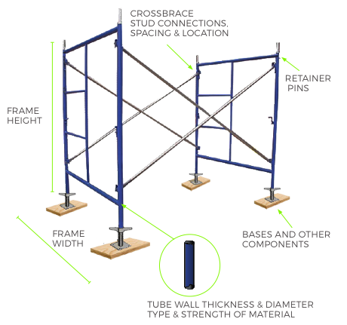
EQUIPMENT INCOMPATIBILITY
The incompatibility of Frame Scaffold equipment usually occur in the following areas:
  frame height and/or width
  type or strength of material
  tube wall diameter or thickness
  retainer pins
  crossbrace stud connections
  stud spacing and location
  bases and other components.
Notes:
Discuss the various potential incompatibilities of Frame Scaffolds and/or components and the possible consequences.

Slide 6
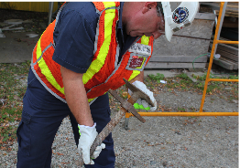
INSPECTING YOUR EQUIPMENT
You must properly inspect your equipment.
Many accidents have occurred due to damaged or faulty scaffold equipment.
Before you begin building your scaffold – you MUST inspect all the components you plan to use to ensure they are safe and work properly.
Do NOT use any damaged or defective equipment.
Notes:
Discuss the importance of inspecting equipment before beginning to build a scaffold.

Slide 7

TYPES OF BASES
Bases are an essential component of Frame Scaffolds.
Several choices are available.
Bases are interchangeable and intended to fit into the inside or around the outside of the scaffold leg.
ALWAYS ENSURE BASES ARE OF A PROPER DIAMETER TO FIT YOUR FRAME
Notes:
Point out the different types of bases and describe when/how they are used.

Slide 8
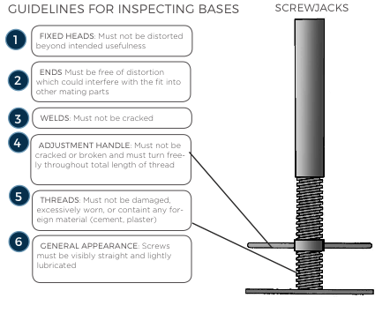
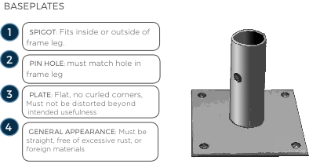
INSPECTING BASES
Fixed Heads
ENDS
WELDS
SPIGOT
ADJUSTMENT
HANDLE
PIN HOLE
THREADS
PLATE
GENERAL APPEARANCE
GENERAL APPEARANCE
Notes:
Describe what to look for when inspecting bases.

Slide 9
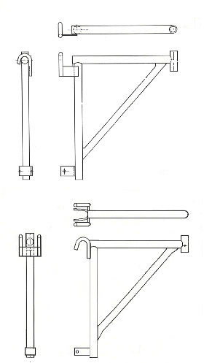
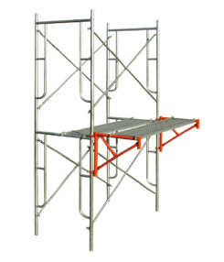
TYPES OF BRACKETS
Brackets extend the length and/or width of the scaffold platform. There are both side brackets or end brackets. They are designed to carry workers only.
Notes:
Describe the different types of brackets and how they are attached to frames. Make sure to emphasize that they are only meant to carry workers.

Slide 10
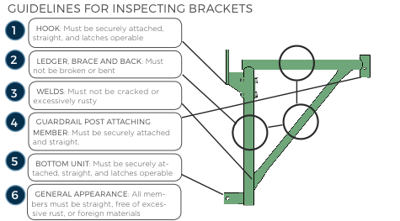
INSPECTING BRACKETS
HOOK
LEDGER, BRACE & BACK
WELDS
GURADRAIL POST ATTACHING MEMBER
BOTTOM UNIT
GENERAL APPEARANCE
Notes:
Point out the parts of brackets and explain what to look for when inspecting them.

Slide 11
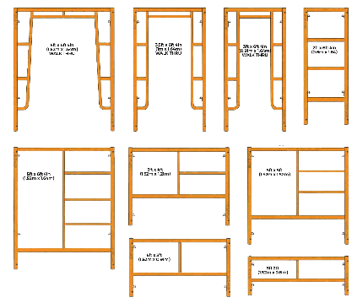
TYPES OF FRAMES
Frames come in a wide variety of sizes and shapes.
If the frames are different widths it will be impossible to put them together.
Use frames with horizontals at the same height to provide a level support for the platform or bracket.
Notes:
Describe the different types of frames and list some typical sizes. Explain the importance of using compatible frames (size-wise) and the problems you can face if you use incompatible frames.

Slide 12
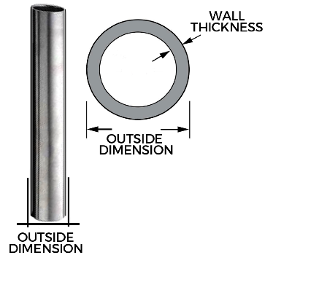
Frame Tubes
Frame Scaffolds are made from steel, aluminum, or fiberglass.
The strength of each of these materials is different.
Scaffolds with different types of material should not be intermixed.
Frame Scaffolds are available in several different size tubes.
Only frame legs of the same diameter and wall thickness should be used together.
Notes:
Discuss frame tubes and the differences in materials and strength. Explain why only frames with compatible tubes should be used together.

Slide 13
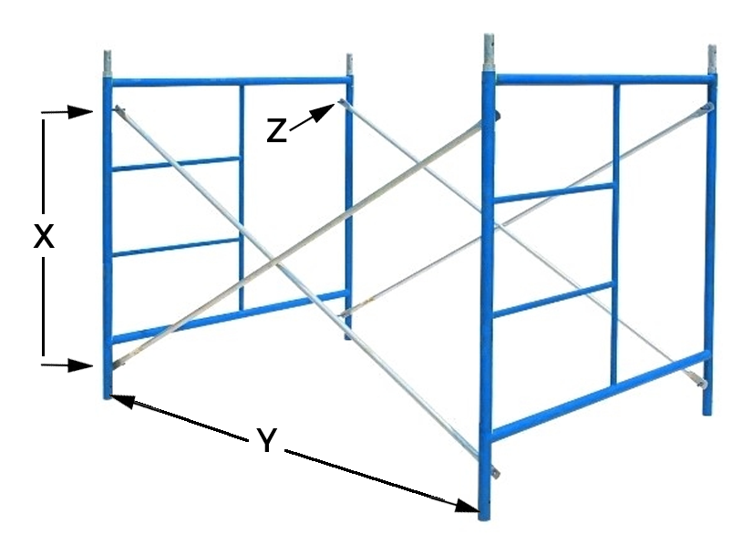
FRAME & BRACE DIMENSIONS
X = STUD SPACING
Y = FRAME SPACING
Z = STUD LOCATION
Notes:
Explain the significance of the frame dimensions shown.

Slide 14
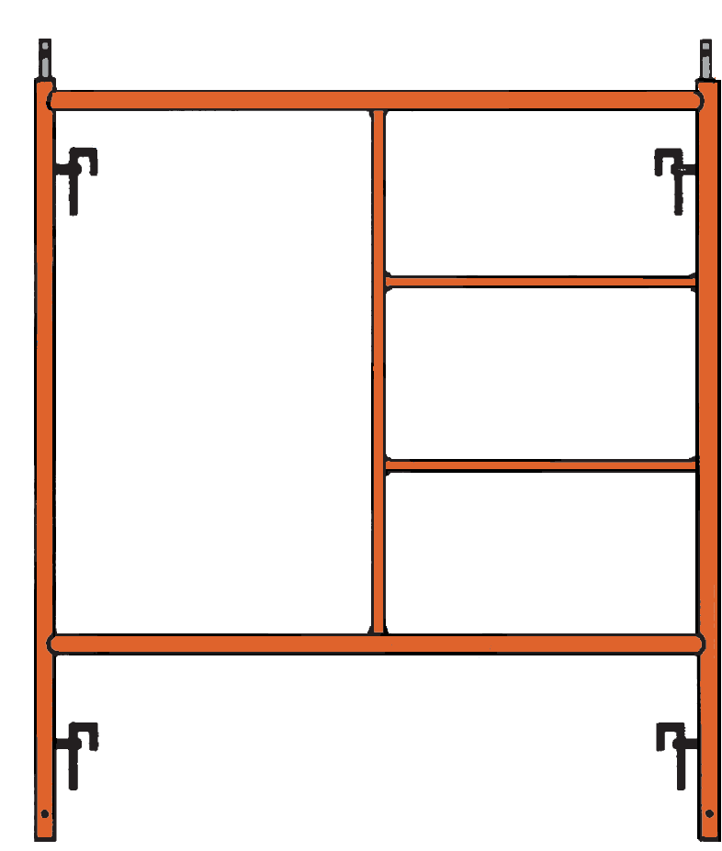
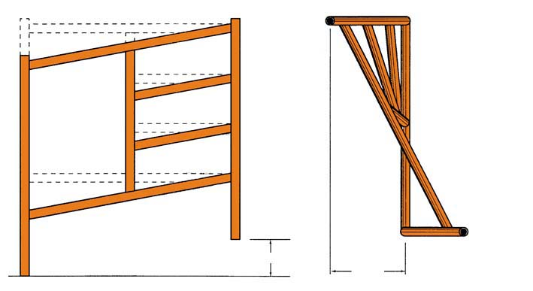
COuPLING PINS
INSPECTING FRAMES
CROSSBRACE
STUDS
Learn to recognize possible defects or unsafe conditions:
structural damage
modification (field welds)
missing parts or pieces,
damage (splits, cracks, holes and/or broken welds)
excessive corrosion (pitting or flaking)
discoloration due to caustic chemicals.
FRAME LEGS
LEDGERS & RUNGS
WELDS
GENERAL APPEARANCE
UNAUTHORIZED MODIFICATIONS
RACK
WARP
RACK
WARP
Notes:
Point out the different parts of scaffold frames and explain what to look for when inspecting them.

Slide 15
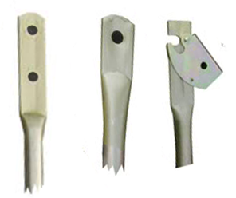
CROSSBRACES
Crossbraces either have single hole or double holes to connect to the studs on frames.
Manufacturers offer different studs based on the user’s personal preference and on the scaffold’s purpose.
All studs should have a locking device so that the brace is not accidentally released.
Notes:
Describe the different crossbrace end types and briefly list advantages/disadvantages of each.

Slide 16
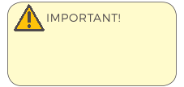
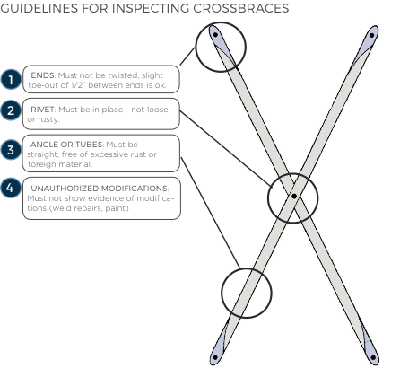
INSPECTING
CROSSBRACES
ENDS
RIVET
ANGLE OR TUBES
UNAUTHORIZED MODIFICATIONS
Equipment manufacturers often provide inspection guidelines for their products. You should use manufacturer’s inspection guidelines for any equipment you plan to use.
Notes:
Describe what to look for when inspecting crossbraces.

Slide 17
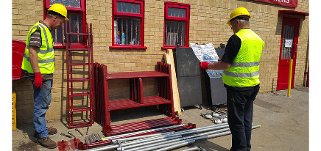

Inspect the scaffold equipment that has been provided for the practical (hands-on) component of this course.
Notes:
Have trainees get up and go inspect the equipment that is to be used for the Practical Assessment.

Slide 18
Key points
Intermixing of equipment from different manufacturers could cause potential hazards.
Frame height and/or width, type or strength of material, tube walls, retainer pins, stud connections, spacing and location, and bases may be incompatible.
There are different types of bases available for Frame Scaffolds. It is important to make sure they fit properly on the frames.
Brackets extend the length and/or width of the scaffold platform. They are designed to carry workers only.
Notes:
Review the key points from this session.

Slide 19
Key points
Selecting the right equipment for the job is important for safety and efficiency.
Jobsite conditions, equipment availability and user requirements determine what equipment to use.
When components are missing or incompatible workers are forced to “make-do” with the equipment they have and Accidents can happen.
Thoroughly inspect scaffold equipment or components before use. Learn to recognize defects or unsafe conditions.
Inspect scaffold for: structural damage, modification, missing parts, damage, corrosion and other defects.
Notes:
Review the key points from this session.

Slide 20
Building Frame Scaffolds
A basic Frame Scaffold unit is the building block for all configurations
2

Slide 21
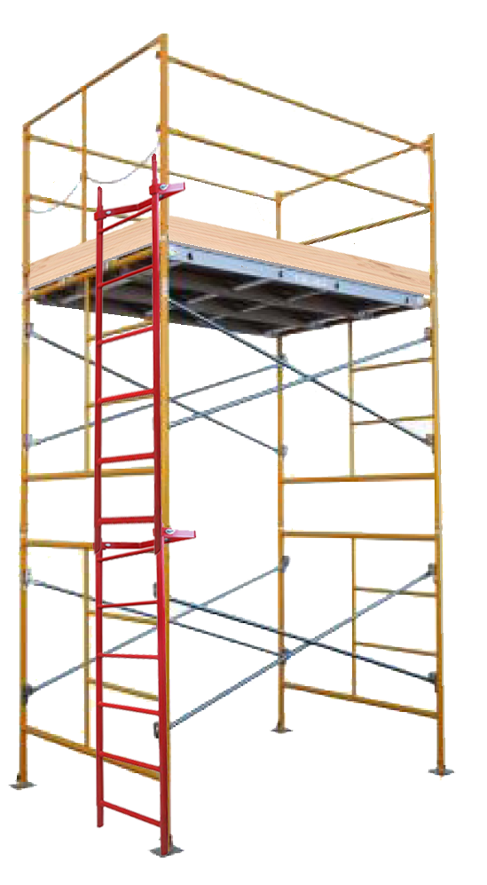
GUARDRAIL SYSTEM
FRAME TOWERS
PLATFORM UNIT
Spacing of the frames are determined by the application, the load and the required configuration.
Guardrails are required on all open sides and ends of work platforms.
The scaffold leg is supported by the foundation, the sill, and the baseplate.
Platforms must be fully planked or decked.
Proper access is required
ACCESS
CROSSBRACES
FRAME
COUPLING PIN
BASES
Notes:
Point out the different components of the basic Frame Scaffold and discuss the importance of including guardrails, fully-planked platforms and providing proper access

Slide 22
1
Select and inspect the equipment
2
Prepare the foundation
3
Determine the highest starting point
4
Set the sills
5
Position
the bases
6
Position
the frames
8
Place the
First frame
on the bases
9
Attach first crossbrace
TO first frame
10
Place the second frame on the bases
11
Attach first crossbrace to second frame
12
Attach second crossbrace to both frames
7
Position the
crossbraces
13
Level, plumb & square the scaffold
14
Secure bases
to sills
15
Attach access
and red tag
16
Install & secure
the platform
17
Install the
guardrail
system
18
Inspect
the Scaffold
Powerful
Suitable for all categories business and personal presentation
Notes:
Briefly describe each step in the process of building a basic Frame Scaffold unit.

Slide 23
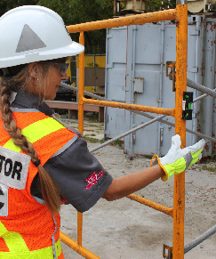
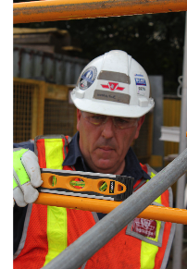
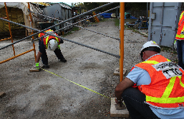
LEVEL, PLUMB & SQUARE THE SCAFFOLD
Make sure vertical members are PLUMB and horizontal members are LEVEL.
SquarE the scaffold by ensuring crossbraces are at right angles to the frames and the frames are parallel to each other.
Notes:
Discuss the importance of ensuring that the scaffold is level, plumb and square. Describe the process of squaring the scaffold (as shown in the image above)

Slide 24
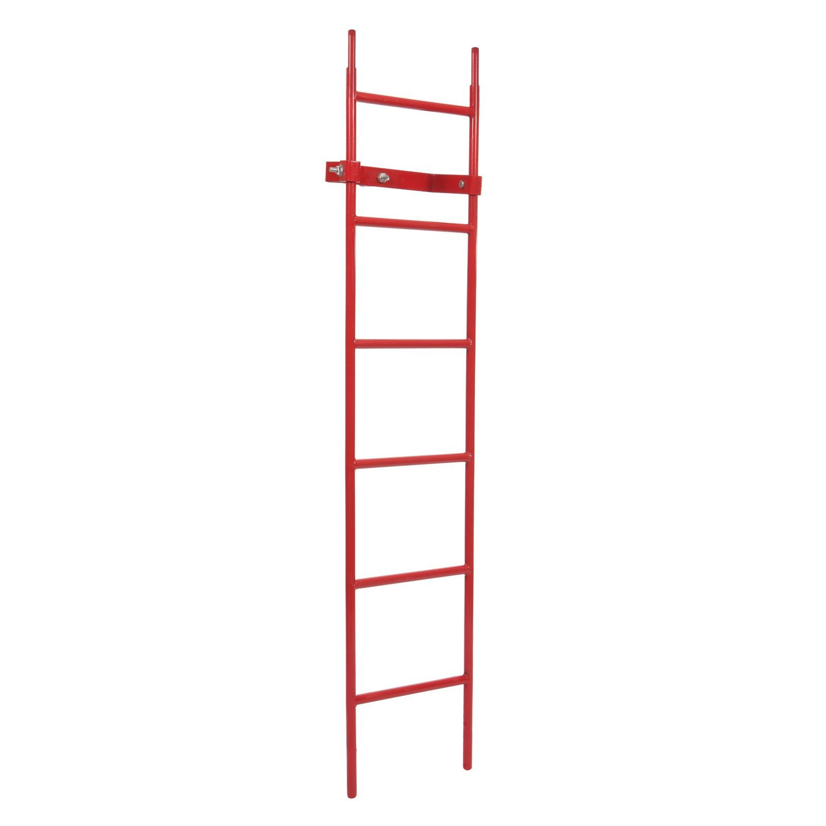
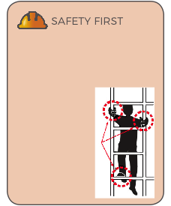
access
Proper access is required for all scaffolds. This access must safely permit a worker to gain access to the platform.
It is good practice to extend your ladder 36in (914 mm) above the platform so that the worker has a hand hold as he/she climbs onto or off the platform.
If the climb is higher than 30ft to 35ft (9.1m to 10.7m), a rest platform may be required.
Approximately 15% of scaffold-related injuries occur when workers are climbing up and down. Climbing scaffold frames and braces has resulted in numerous injuries
and fatalities. To
prevent this,
provide adequate
ladders or scaffold
stairs for workers.
Use safe climbing
techniques
(3-point contact
as shown).
Notes:
Discuss proper access and best practices when installing access. Refer to any relevant regulations related to access (these should already have been discussed in Scaffold Fundamentals Section 2 so just a brief reminder). Discuss the importance of 3 points of contact when climbing ladders.

Slide 25
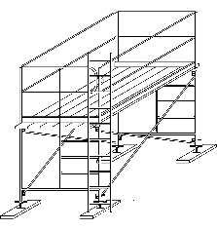
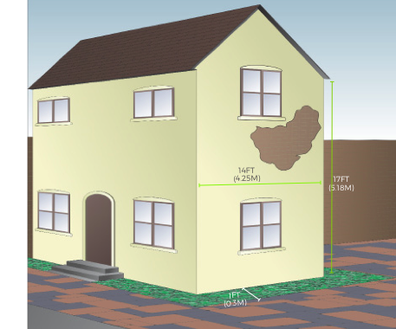
Notes:
Discuss the learning activity as a group or have trainees work in pairs to answer the questions on page 38.

Slide 26
Key points
A basic Frame Scaffold unit is the building block for all scaffold configurations.
Frame Scaffolds must be built according to the steps provided to insure that the scaffold is structurally sound, strong, safe and in compliance with the regulations.
Select crossbrace size to fit the specific frame you are using.
Guardrails must be installed on all open sides and ends of working platforms above 10ft (3m) (or according to local regulations).
All work platforms must be fully planked or decked.
Notes:
Review the key points from this session.

Slide 27
Key points
Provide PROPER ACCESS for workers.
Begin with a firm foundation and clear the area.
Level, square, and plumb the scaffold to avoid problems.
The three-colored tag system is used on many job sites to let workers know when the scaffold is and isn’t safe to use.
The Competent Person must inspect the scaffold after it has been built, before it is used and at minimum it should be inspected once a day, at the change of each shift, or after something happens that could have affected the scaffold’s stability.
Notes:
Review the key points from this session.

Slide 28
ROLLING TOWER SCAFFOLDS
Rolling Tower Scaffolds can be easily moved
3

Slide 29
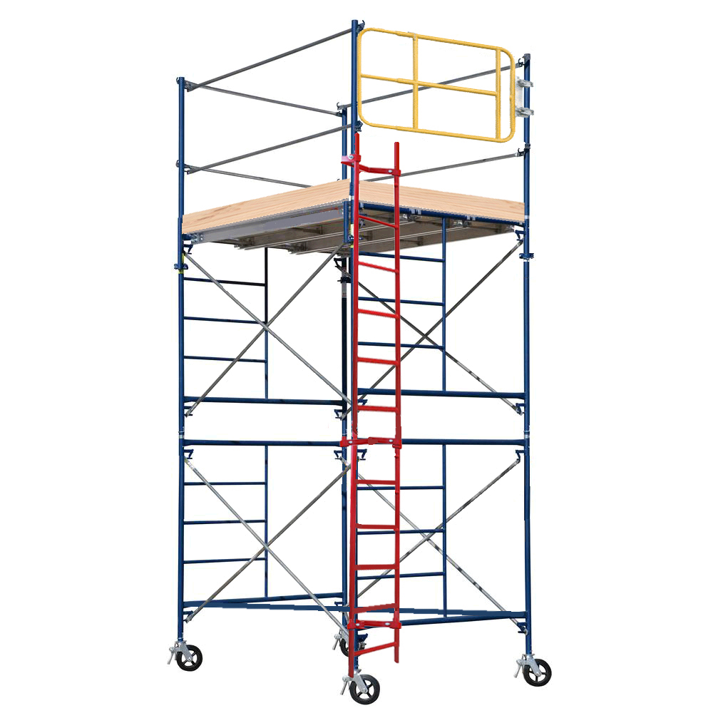
ROLLING SCAFFOLDS
Bases use casters instead of baseplates
Requires a Horizontal Diagonal Brace (or Plan Brace).
The foundation must be a hard flat level surface that can support the anticipated loads.
CASTER
HORIZONTAL DIAGONAL BRACE
(PLAN BRACE)
Notes:
Describe situations when it is advantageous to use a Rolling Scaffold Tower. Point out the elements that differ from a stationary Frame Scaffold tower.

Slide 30
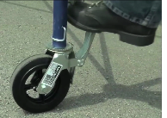
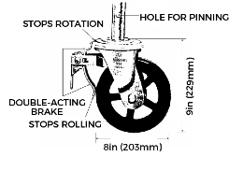
CASTERS
Casters can be inserted and pinned into either a scaffold frame leg or a screwjack. If used with a screwjack, the maximum screw extension can be no more than 12in (305mm) for the scaffold to be safe.
The caster is fitted with a double acting brake that prohibits the wheel from rolling and the wheel from swiveling.
At least two of the casters on a Rolling Tower Scaffold must be steerable.
It is important not to exceed the rated load capacity of the casters.
Notes:
Describe the features of a proper scaffold caster.
Explain the proper way to attach casters to Frame Scaffold legs.

Slide 31
HORIZONTAL DIAGONAL BRACE
A horizontal diagonal brace (plan brace) is attached diagonally across the tower from the leg of one frame across to the opposite leg on the adjacent frame.
Provides stiffness to the tower, keeps the tower square while it is being moved, and prevents the tower from “folding up” and collapsing.
The first horizontal diagonal brace is attached at the very bottom of the tower, as close to the casters as possible.
Notes:
Explain the purpose of a horizontal brace and why it is needed for Rolling Towers.

Slide 32
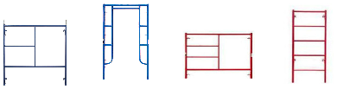
Types of Frames
END FRAMES
(also called Mason Frames or Box Frames)
WALK-THRU (also called Arch Frames)
HALF –FRAME
(also called Bench Frames)
NARROW –FRAME
Notes:
Describe each type of frame and when they are typically used.

Slide 33
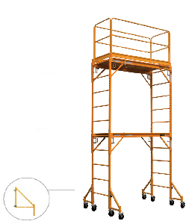
OUTRIGGERS
Outriggers are components that clamp on to the frame enlarging the base and allow the tower to be built higher
Outriggers provide stability by increasing the base dimension of a scaffold whenever you are exceeding a 4:1 or 3:1 height-to-base width ratio (depending on the jurisdiction).
Outriggers are commonly used on Rolling Scaffolds but they are also used on stationary towers.
OUTRIGGER
Notes:
Explain the purpose of outriggers and how they help stabilize scaffolds and when they should be used.
Describe the proper placement and process for installing outriggers.

Slide 34
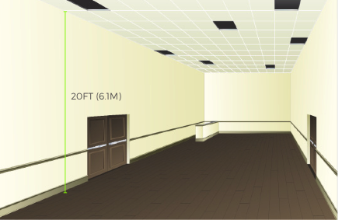
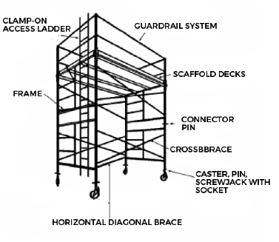
Notes:
Go through the Learning Activity with the group and discuss the equipment required (referring to the equipment list on page 52).

Slide 35
Key points
Rolling Scaffold Towers have casters instead of baseplates and require horizontal diagonal braces (plan braces).
The foundation must be a hard flat level surface capable of supporting anticipated loads.
The caster’s brake prohibits the wheels from rolling and from revolving (or swiveling).
At least two casters on a Rolling Tower Scaffold must be steerable.
Notes:
Review the KEY POINTS from this session.

Slide 36
Key points
A horizontal diagonal brace provides stiffness to the tower, keeps it square while it is being moved, and prevents it from “folding up” and collapsing.
Horizontal Diagonal braces must match the frame width and crossbrace length.
Frames are made in various widths, heights and for various load capacities.
Outriggers are an important safety device designed to provide stability when a scaffold height-to-base width ratio exceeds 4:1 or 3.1 (depending on your local regulations).
Notes:
Review the key points from this session.

Slide 37
MULTI-BAY SCAFFOLDS
Frame scaffolds can be BUILT in MANY different configurations
4

Slide 38
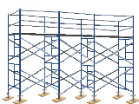
SCAFFOLD RUN
A scaffold run can be built to any length and height.
The process of building a scaffold run involves attaching bays lengthwise to an existing frame unit.
Once the run is built to the desired length, additional lifts can be added to reach the desired height.
Scaffold Runs may have working platforms at several levels.
Scaffold Run
Notes:
Describe a scaffold run and where it is typically used.

Slide 39
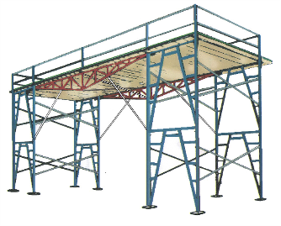
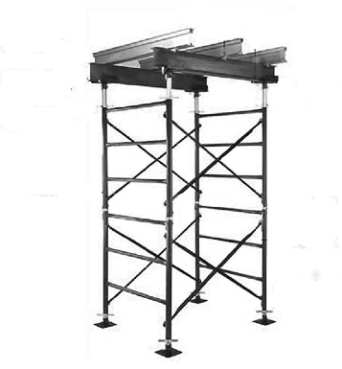
AREA SCAFFOLDS
PUTLOG (TRUSSES)
STRINGER & JOISTS
Notes:
Describe the two ways that area scaffolds can be built. Explain the steps and point out the components involved.

Slide 40
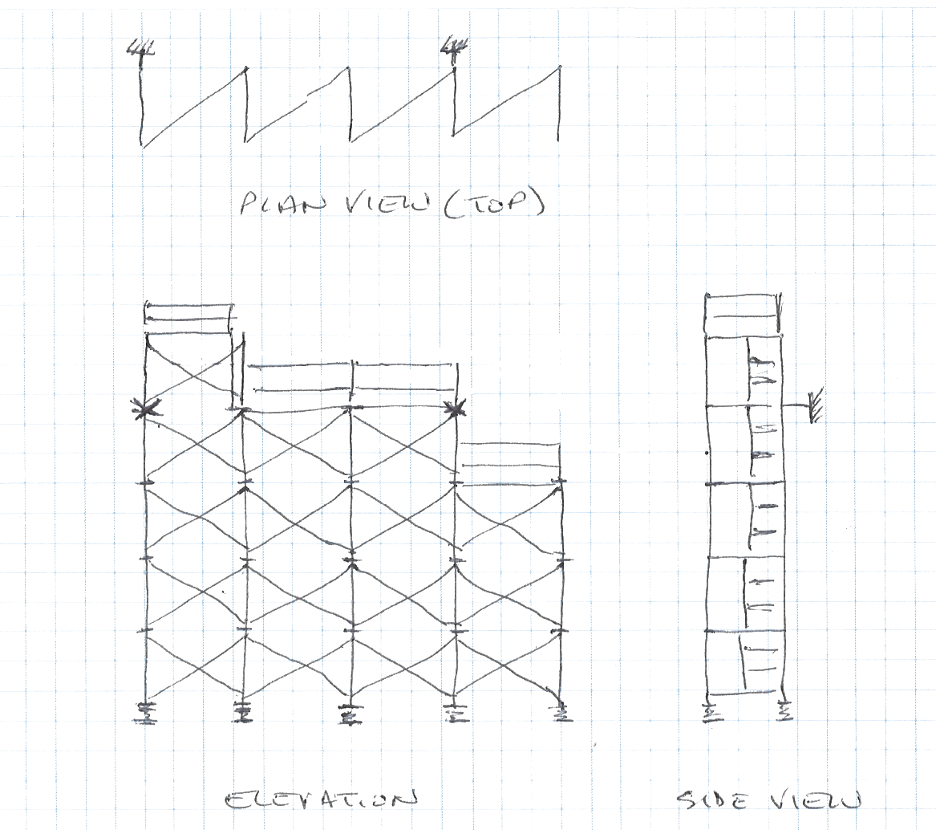
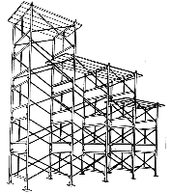
SKETCHING

Slide 41
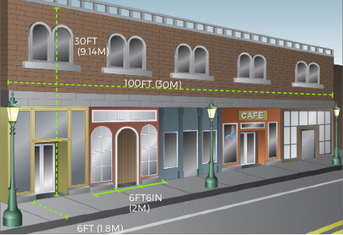
Notes:
Discuss the Learning Activity on page 68 and roughly sketch out (if you have a whiteboard) what the design of the scaffold for this scenario should look like. Discuss what equipment will be needed for this scaffold.

Slide 42
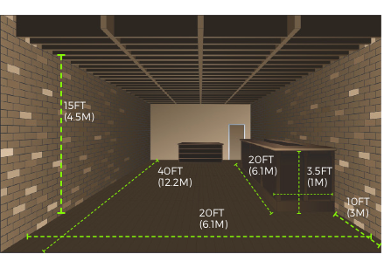
Notes:
Discuss the Learning Activity on page 72 and roughly sketch out (if you have a whiteboard) what the design of the scaffold for this scenario should look like. Discuss what equipment will be needed for this scaffold.

Slide 43
Key points
Frame Scaffolds can be constructed in three fundamental ways: as a Single Bay (Tower), a Scaffold Run or an Area Scaffold.
A sketch or drawing, allows you to figure out the scaffold design on paper.
You can develop your equipment list from a sketch or drawing of the scaffold configuration.
Your sketch should show different views of the scaffold such as: the plan view and elevations (front and side). It should also include important details such as tie design and placement (if required)
Notes:
Review the key points from this session.

Slide 44
Key points
You can add additional lifts and bays to a basic frame scaffold unit.
The first lift of the scaffold is the most critical because it will determine if the scaffold will be plumb, level, and square.
Each frame must be braced to at least one other frame. This means that both the “front” and “back” braces are to be installed.
Area scaffolds can be built in two ways: With putlogs (trusses) or with stringers & joists.
Notes:
Review the key points from this session.

Slide 45
MULTI-LIFT & BAY SCAFFOLDS
Frame scaffolds can be built to any height, length or width.
5

Slide 46
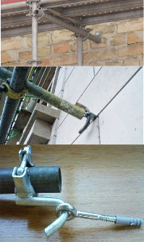
HIGHER MULTI-LIFT SCAFFOLDS
Ties ensure the stability of a scaffold.
Ties must be used when the scaffold exceeds a permissible height- to-base ratio.
A tie must be capable of restraining the scaffold from falling or leaning away from the wall or leaning toward the wall.
Notes:
Discuss the different types of ties and the different ways ties can be constructed. Emphasize the importance of ties for stabilizing higher multi-lift scaffolds.

Slide 47
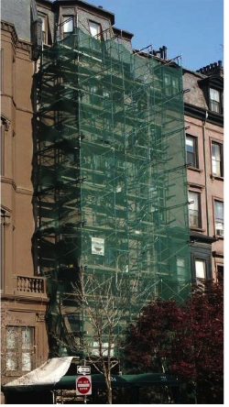
ENCLOSED SCAFFOLDS
Enclosed Scaffolds are usually covered with netting, tarpaulins, plastic sheeting, or plywood.
Enclosed Scaffolds are used for: weather protection, preventing materials from spreading or preventing debris from falling.
Enclosed Scaffolds are subjected to much greater loads than standard scaffolds.
When scaffold equipment is used for hazardous material abatement, the entire scaffold structure must be tightly enclosed to keep the hazardous material in.
Notes:
Discuss the increased loads that enclosed scaffolds are subjected to and the importance of having a qualified person design the scaffold (including the ties required).

Slide 48
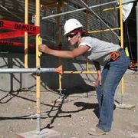

INSPECTING COMPLETED SCAFFOLDS
The Competent Person must inspect the completed scaffold to ensure it is safe.
Scaffold inspections must be made after the scaffold is built, before it is used, at the change of each shift, and at minimum once a dayor after something happens that could have altered the scaffold.
The three-colored tag system notifies workers of the construction or modification status of the scaffold to maximize safety.
Notes:
Clearly outline the Competent Person’s responsibilities regarding scaffold inspections.
Explain how often scaffolds must be inspected and that this is a MINIMUM.
Describe the three colour tag system and how it works.

Slide 49
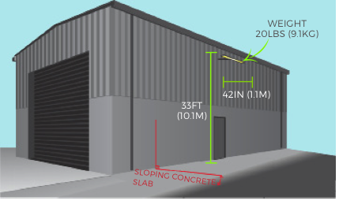
Notes:
Discuss the Learning Activity on page 80. If possible sketch out the scaffold design (on a whiteboard) and the type of tie that should be used in this scenario.

Slide 50
Key points
Enclosed Scaffolds are used for: weather protection, preventing materials from becoming a FALLING OBJECT HAZARD.
Enclosed Scaffolds are subjected to much greater loads.
Before the scaffold can be used, the Competent Person must review regulations and inspect the scaffold to ensure it is safe and can support intended loads.
Codes of Safe Practices are good references for building safe scaffolds.
A Scaffold Inspection Checklist can be a helpful tool.
Notes:
Review the key points from this session.

Slide 51
Key points
Ties to a STABLE existing structure ensure the scaffold’s stability.
Ties are required when the scaffold is enclosed or exceeds allowable HEIGHT-TO-BASE RATIO.
Tension COMPONTENT (prevents the scaffold falling away from the structure), and compression COMPONENT (prevents the scaffold falling into the structure).
Check your local regulations for the required spacing of ties and MAKE SURE all the required ties are in place.
Ties should be placed near the top bearer or horizontal member of the frame.
Notes:
Review the key points from this session.

Slide 52
DISMANTLING & STORAGE
Dismantling scaffolds exposes workers to the same hazards as building them
6

Slide 53
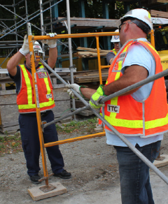
Dismantling
Dismantling scaffolds requires the same knowledge, skills and planning as building them.
You MUST visually inspect the scaffold and address potential hazards before dismantling.
Remove top tie first (all other ties must be removed last at each tie level).
Components should be removed in reverse order of how they were built.
Carefully lower components down to workers below (make sure they are standing in a safe position). DO NOT throw/drop components down.
VISUAL INSPECTION
Cerebelum
Notes:
Discuss the most important points to remember when dismantling Frame Scaffolds.
Remind the trainees that the dismantling of the scaffold is as important a part of the PRACTICAL ASSESSMENT as the building and you expect them to work safely and remove components in the correct order. No matter how short you are on time – DO NOT allow them to rush the dismantling process.

Slide 54
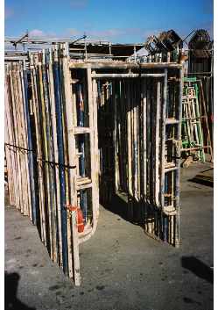
STORAGE
Improperly stored equipment can cause damage and make equipment unsafe
Store equipment to provide easy access
Provide proper support (dunnage)
Provide proper blocking between layers of equipment
Store different size parts in separate stacks
Provide bins for small parts
Separate damaged equipment (discard or repair)
Do not stack equipment too high
Notes:
Explain that while trainees may not be responsible for the storage of the equipment they are using, it is still important to stack equipment neatly and group similar sized components together for easy pick-up and storage. It may be important to compare what is there with the original shipment list to ensure nothing has gone missing. Emphasize the importance of separating and tagging any damaged components so they are not re-used.

Slide 55
Key points
Dismantling should be done carefully.
A Competent Person must inspect the scaffold before dismantling to make sure the scaffold is stable.
Workers at lower levels MUST not get ahead of the dismantlers by removing braces, planking, or guardrails to “speed up the job.”
Wear the proper personal protective equipment when dismantling.
Notes:
Review the key points from this session.

Slide 56
Key points
Check platforms for loose items that could fall off during dismantling.
Remove the guardrails and posts first (workers should be tied off to prevent falls).
Workers below should stand in a safe position during dismantling.
Never leave partially-dismantled scaffold unguarded or without proper barricades.
Examine components for damage and separate them for later disposal or repair.
Once all the scaffold components have been inspected it is important to store them properly.
Notes:
Review the key points from this session.

Slide 57

TIME FOR THE PRACTICAL ASSESSMENT
Review the scaffold drawing/plan before you begin to build.
You MUST wear all appropriate Personal Protective Equipment.
Work safely and communicate/collaborate with your team.
When you have finished building your scaffold, use the Scaffold Inspection Checklist in your Frame Scaffolds Study Guide (page 35) to ensure that your scaffold has been built safely and correctly.
Notes:
Stop the presentation here and review the requirements of the Practical Assessment with the trainees.
Provide them with a drawing or plan for the scaffold you want them to build.
Ensure they are wearing all appropriate Personal Protective Equipment.
After the scaffold(s) have been built – have the trainees inspect their scaffold using their Inspection Checklists.

Slide 58
PRACTICAL ASSESSMENT DEBRIEF
What went well?
What could we have done better?
What did you learn that you will do differently from now on?
What (if anything) did you find during your inspection that needed to be addressed?
Did you discuss and make a plan before dismantling? (why or why not?)
Notes:
After the equipment has been stacked or put away. Share your observations of the build with the trainees (what you saw that they did well and what you feel they could have improved). Allow them the opportunity to share their answers to these debrief questions. REMEMBER – THIS IS YOUR OPPORTUNITY TO CORRECT ANY UNSAFE OR INCORRECT PRACTICES.

Slide 59
REVIEW
In preparation for the Written Assessment, let’s go over some of the KEY POINTS of the course.
Notes:
REMEMBER – THIS IS YOUR OPPORTUNITY TO CLARIFY ANY INFORMATION OR EXPLAIN ANY CONCEPTS TRAINEES SEEM UNCLEAR ON.

Slide 60

Contact Us:
Scaffold & Access Industry Association
400 Admiral Blvd. Kansas City, MO 64106
816.595.4860 info@saiaonline.org

